Slide 1
Welcome
Year-end 2012
Accounts Payable
Fiscal Year End Procedures Presentation
September 13, 2012

Slide 2
Year-end 2012
Agenda
Important Dates
Voucher Payables
Special Services Conversion Update
Payments to CSBE Vendors
Construction Payable
Resolution Reminders
Unclaimed Checks Process
ACH Payment – Email Notification Project
Vendor Payment Inquiry Web Program Application – Update
P-Card Reminders
Delinquent Contractor List
Petty Cash / Change Funds
Accounts Payable Workflow Project
Travel

Slide 3
Year-end 2012
Important Dates
_ Monday, September 21, 2012 - Encumbrance Liquidation
  Monday, September 17, 2012 - Authorized Forms Due
  Friday, September 28, 2012-First Accounts Payable Cutoff
  Monday, October 1, 2012 - 1st Preliminary Reports
  Friday, October 5, 2012 (noon) – FINAL-Accounts Payable Cutoff
  Saturday, October 6, 2012 – On-Demand Preliminary Reports will be available
  Tuesday, October 09, 2012 - 2nd Preliminary Paper Reports
  Friday, October 12, 2012 - G/L Final Closing

Slide 4
Year-end 2012
Monday, September 21, 2012
Liquidation of Encumbrances
  Last day to submit to Patrick Price - Accounting and Reporting.
  Excel Spreadsheet of liquidations of encumbrances.
      NOTE: Liquidated purchase orders CANNOT be re-encumbered and will be closed in ADPICS.

Slide 5
Year-end 2012
Monday, September 17, 2012
Last day to submit to Dania Diaz or Nieves Del Rio
  Accounts Payable Authorized Signature Forms
  Purchase and/or Travel Card Reconciliation Authorization Form
  Travel Authorization Signature Forms
  Wire Transfers Authorization Forms
  Accounts Payable Liaison Forms
  Purchasing/Travel County Credit Card Liaisons Form
Last Day to Submit to Maria Hernandez
    Petty Cash and/or Change Fund Form
    Department Employee Recognition Award Form (DERA)
Last Day to submit to Raul de la Campa
    FEMA Liaison Form

Slide 6
Year-end 2012
Monday, September 17, 2012
Continued:
  Last Day to Submit to Arlin Montero
    FAMIS Liaison and Authorized Signatures for Systems Security Access Form
  Last Day to Submit to Lori Madrigal
    Trust Fund Authorization Forms
  Last Day to Submit to Hilda Garcia
    Debt Arrearage Ordinance Liaisons
  Last Day to Submit to Anita Gibboney
      Travel Liaison Form

Slide 7
Year-end 2012
Saturday, September 29, 2012
Last day to create a Purchase Order for 2012 fiscal period appropriated funds. FAMIS will be closed on Sunday September 30th.
Accounts Payable
  Please be certain that all releases (POs) for prior year invoices are created prior to 9/29/12 (calendar), for you will not be able to process the corresponding FYE 2011-12 invoices for the prior fiscal year, during the dates of October 1, 2012 through October 5, 2012 if PO is not created by 9/29/2012.

Slide 8
Year-end 2012
Saturday, September 29, 2012
Accounts Payable Staff will be on hand to receive invoices processed by your department.

Slide 9
Year-end 2012
Monday, October 1, 2012
  1st day of fiscal year 12/13. (Note: Both fiscal years are open)
    Separate “Old Year Invoices” (2011/2012) from “New Year Invoices”(2012/2013).
    Deliver New Year Invoices to a supervisor.
    Marla, Meryyein, Nieves, Adriana or Dania

Slide 10
Year-end 2012
Accounts Payable
  For all Purchase Order Vouchers, the “invoice received” date on PCHL 1500 is the key factor in differentiating between fiscal periods. Please be certain that this input field properly shows a date of 9/30/12 (ADPICS accepts vouchers dated Sunday even if FAMIS is closed) or prior for all invoices pertaining to FY 2011-12. Voucher Document Sequence assigned will be VAXX12.
  Vouchers with the invoice received date AFTER 09/30/12 will post in Fiscal 12/13 and the document sequence assigned will be VAXX13.
  Service Periods should be “noted” in the description field of the Invoice Header screen (1500) in order to assist with accruals from October 1st to December 31.

Slide 11
Year-end 2012
PCHL1500 V5.1 MIAMI-DADE COUNTY ADPICS 5.1 08/29/2012
LINK TO: INVOICE HEADER ENTRY 7:40 AM
INVOICE SEQ : DOC TYPE : IV INVOICE ALL : N (Y/N)
INVOICE NO/DESC : / SERVICE PERIOD
ACTION INDICATOR : N INTF TYPE : IV VOUCHER NO :
INVOICE DATE : DTE IVC REC: 9/30/12 ALT ACCT:
PURCHASE ORDER NO : NOTE PAD : DEPT :
PO DOC BALANCE : CR BAL :
PROPERTY ID : IVC AMT: NET:
VENDOR ID/SUFFIX :
DBA NAME : HDR CR AMT :
ADDRESS : MATCH TYPE:
STATUS :
CITY: ST: ZIP: CTRY:
DISTRIBUTION METHOD: D SINGLE CHECK: N LETTERS SENT:
FREIGHT : LIQ DAMAGES :
OTHER CHARGES : F.O.B. POINT:
DISC TERMS :
REJECT CODE :
SFX INDEX SUBOBJ USERCODE PROJCT PRJDTL GRANT GRNTDTL
F1-HELP F2-SELECT F3-DELETE F4-PRIOR F5-NEXT F6-VIEW DOC
F8-VIEW SUM F9-LINK F10-SAVE F11-VW ACCTG
G461 - RECORD DOES NOT EXIST, PLEASE TRY AGAIN

Slide 12
Year-end 2012
Accounts Payable (continued)
  For all Direct Vouchers and Credit Memos, please be certain that the effective date on screen PCHL 1800--vouchers OR PCHL 1700—credit memos is properly input (saved) as 9/30/12 or prior for goods and services pertaining to FYE 2011-12.
NOTE: The effective date needs to be changed to 09/30/12 PRIOR to saving the document (F10).

Slide 13
Year-end 2012
PCHL1800 V5.1 MIAMI-DADE COUNTY ADPICS 5.1 08/29/2012
LINK TO: DIRECT VOUCHER HEADER ENTRY 7:48 AM
DIR VOUCHER ID: DOC TYPE: DV EFF DATE : 9/30/12
ACTION IND : N DUE DATE: INTF TYPE : V1
SINGLE CHECK : N CHECK NO: DOC REF NO :
VEN INVOICE NO: /
DEPARTMENT : FN02 FINANCE CONTROLLER'S DIV INVOICE DATE:
CONTACT : INV RECPT DT:
TELEPHONE : EXT: NOTE : N
VOUCHER AMOUNT: STATUS:
VENDOR ID/SFX : CREATE:
DBA NAME :
ADDRESS : ADDRESS NOT ON FILE UPDATE:
POST :
CITY : ST: ZIP: CTRY:
DISCOUNT TERMS: NET TERM :
DISTRIB METHOD: S REJECT CODE: CONTRACT ID :
SFX INDEX SUBOBJ USERCODE PROJCT PRJDTL GRANT GRNTDT G/L SUB PCT%
F1-HELP F2-SELECT F3-DELETE F4-PRIOR F5-NEXT F6-VIEW DOC
F7-COPY F8-SEL TERMS F9-LINK F10-SAVE F11-VW ACCT
G461 - RECORD DOES NOT EXIST, PLEASE TRY AGAIN

Slide 14
Year-end 2012
PCHL1700 V5.1 MIAMI-DADE COUNTY ADPICS 5.1 08/29/2012
LINK TO: CREDIT MEMO HEADER ENTRY 7:49 AM
CREDIT MEMO ID : DOC TYPE : CM EFF DATE : 9/30/12
ACTION IND : N CM DATE : INTF TYPE: PC
VOUCHER ID : CRDT ALL : N (Y/N)
VEN CM NO : OPEN PO : (Y/N) PO ID :
DEPARTMENT : FN02 SINGLE CK: CHECK NO :
CONTACT : STATUS:
TELEPHONE : EXT CREATE:
CM AMOUNT : UPDATE:
VENDOR ID : POST :
ADDRESS : ADDRESS NOT ON FILE NOTE : N
CITY : ST: ZIP: CTRY:
CM DESCRIPTION :
FREIGHT : REF VEN INV NO :
OTHER CHARGES : REJECT CODE :
PRINT : N
DIST METHOD:
SFX INDEX SUBOBJ USERCODE PROJCT PRJDTL GRANT GRNTDTL
F1-HELP F2-SELECT F3-DELETE F4-PRIOR F5-NEXT F6-VIEW DOC
F8-SEL TERMS F9-LINK F10-SAVE F11-VW ACCT F12-PRINT
G461 - RECORD DOES NOT EXIST, PLEASE TRY AGAIN

Slide 15
Year-end 2012
Accounts Payable (continued)
  Approval Path documents need to be monitored on a daily basis. You need to start cleaning up screens PCHL9210 and PCHL9212 so that there are no documents left unapproved or in error at year-end.

Slide 16
Year-end 2012
Accounts Payable (continued)
  PLEASE FORWARD INVOICES WITH VOUCHER SERIES (VAXX12/VNXX12), BY THE NEXT BUSINESS DAY. You have access to view all documents in Approval Path in On-Demand - A/P/APPR04 Report, make note that documents designated "N/A" under the Approval Level are in No Post Status (NOPT) at the department level and need to be addressed ASAP if department wants it processed prior to year-end.

Slide 17
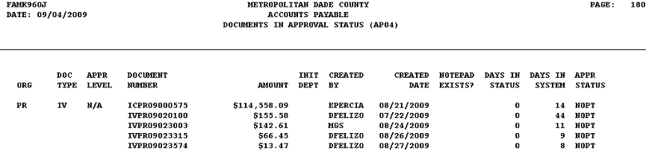
Year-end 2012
FAMF/DA/AP/APPR/04 - DOCUMENTS IN APPROVAL STATUS

Slide 18
Year-end 2012
Accounts Payable (continued)
  Purchase order vouchers will be posted in FY 2012 for all invoices received by 12:00 noon on Friday, October 5, 2012. Vouchers in the system for which the invoices are not received will be posted into the new FY 2012-13.
  Invoices for Direct Vouchers and Credit Memos need to be received by 12:00 noon on Friday, October 5; otherwise, they will be rejected to the initiator and will need to be re-approved FY 2012 – 2013.

Slide 19
Year-end 2012
Special Services Refund Update
Inquiry Phase is available for all to view on the intranet at:
  http://intra.miamidade.gov/Finance/special-services.asp
  Sign in is the same as your current mainframe ID and Password to FAMIS.
If an error message is received please contact Marilyn Crucet for assistance.
Select “Check Search/Inquiry”.

Slide 20
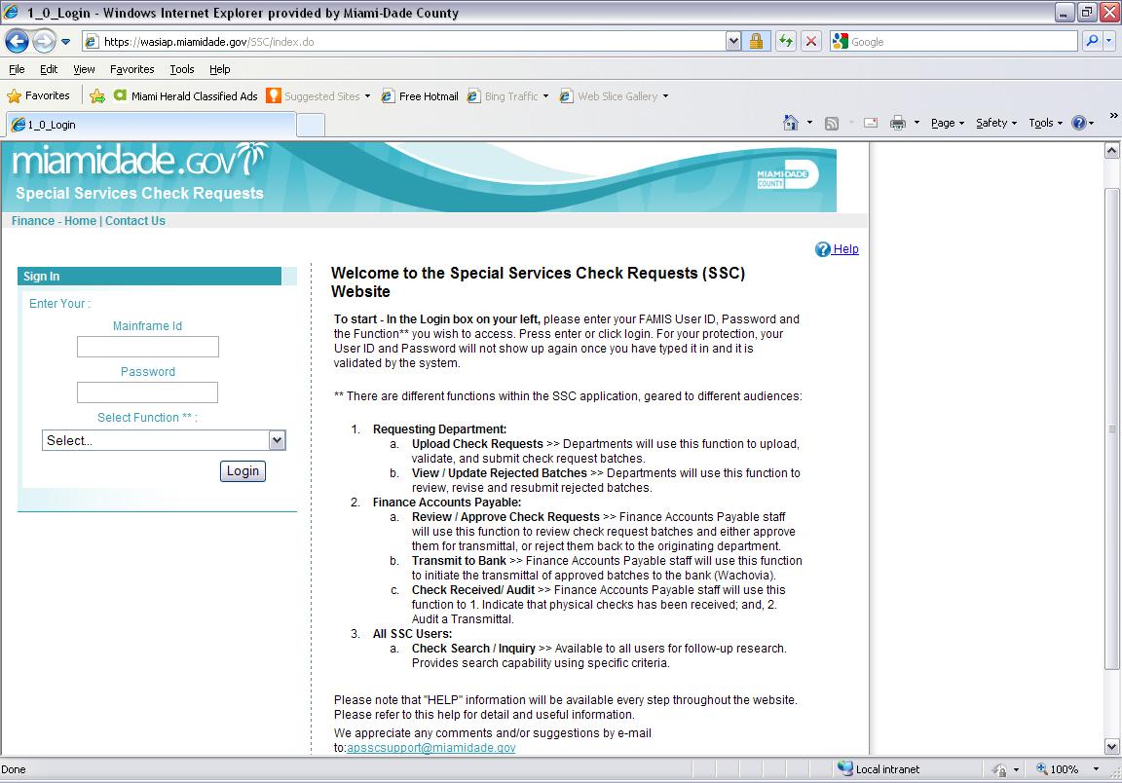
Year-end 2012

Slide 21
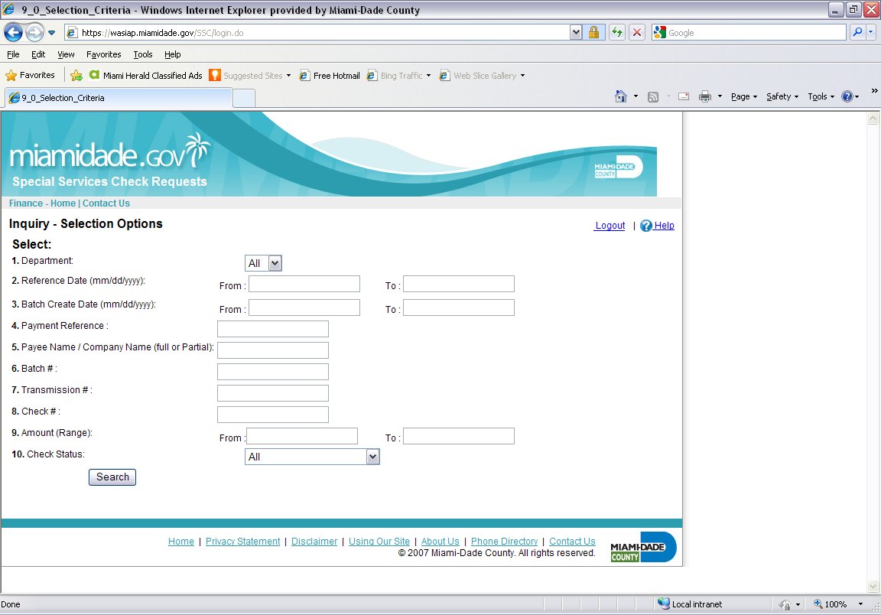
Year-end 2012

Slide 22
Year-end 2012
Payments to CSBE Vendors
Payments to vendors participating in the “Community Small Business Enterprise Program”: (CSBE) have to be paid within 14 calendar days from receipt of billing to the County.
Invoices should be stamped “EXPEDITE”, (CSBE, pay within 14 days).
Please separate these stamped invoices from the daily work submitted to our office so staff can handle expeditiously.

Slide 23
Year-end 2012
Monday, October 1, 2012
1st Preliminary Reports are available

Slide 24

Year-end 2012
Construction Contracts Payable
  Friday, September 28, 2012
  Last day to Submit:
  Construction or PSA contracts.
  Purchase Order/Work Order for appropriated funds for FY 2012. (PC’s) for invoices to be entered in Fiscal Year 11/12. All releases (POs) for prior year invoices are created prior to 9/30/12 (calendar), you will not be able to process corresponding FY 2011-12 invoices for the prior fiscal year, during the dates of October 1, 2012 through October 5, 2012 if PO is not created prior to 9/30/2011.
Miami-Dade Finance Department

Slide 25

Year-end 2012
Construction Contracts Payable
  Friday Noon, October 5, 2012
  Last day to process invoices for construction or consultants for services rendered on or before September 30, 2012.
  Construction Invoices - the invoice received date on PCHL 1500 should properly show date of 9/30/12 or prior for all invoices pertaining to FY 2011-12. This is the key field in differentiating between fiscal periods. Invoice Document Sequence assigned will be ICXX12.
  If invoice received date field is enter with any date AFTER 09/30/12, it will post in Fiscal 12/13 and document sequence assigned will be CVXX13

Slide 26
Year-end 2012
PCHL1500 V5.1 MIAMI-DADE COUNTY ADPICS 5.1 09/12/2012
LINK TO: INVOICE HEADER ENTRY 2:07 PM
INVOICE SEQ : DOC TYPE : IV INVOICE ALL : N (Y/N)
INVOICE NO/DESC : 20040031-WO1-Req1 / SERVICE PERIOD (e.g. Augt 1 – Augt 31, 2012)
ACTION INDICATOR : N INTF TYPE : IV VOUCHER NO :
INVOICE DATE : DTE IVC REC : 9/30/12 ALT ACCT:
PURCHASE ORDER NO : NOTE PAD : DEPT :
PO DOC BALANCE : CR BAL :
PROPERTY ID : IVC AMT: NET:
VENDOR ID/SUFFIX :
DBA NAME : HDR CR AMT :
ADDRESS : MATCH TYPE:
STATUS :
CITY: ST: ZIP: CTRY:
DISTRIBUTION METHOD: D SINGLE CHECK: N LETTERS SENT:
FREIGHT : LIQ DAMAGES :
OTHER CHARGES : F.O.B. POINT : DISC TERMS :
REJECT CODE :
SFX INDEX SUBOBJ USERCODE PROJCT PRJDTL GRANT GRNTDTL
F1-HELP F2-SELECT F3-DELETE F4-PRIOR F5-NEXT F6-VIEW DOC
F8-VIEW SUM F9-LINK F10-SAVE F11-VW ACCTG
G641 – RECORD DOES NOT EXIST, PLEASE TRY AGAIN
Miami-Dade Finance Department
Notes:
26

Slide 27
Year-end 2012
Construction Contracts Payable
To expedite work orders (Purchase Orders) and payments, please provide all necessary documents or information:
  A signed Work Order and an authorization assignment if necessary (EDP projects, Surveys, testing, Environmental Test).
  Provide an Index code and Sub-object for new or revised Work Orders.
  Be reminded that MCC Projects/P.O. have an extra approval path (ISD). Please plan accordingly, especially if you have invoices for expenditures incurred during FY 11/12.
  When entering invoices, please remember to check screen 2363 for retainage percentage set up in the P.O.
  When entering an invoice, please follow the format for invoice number: Project #-Work order #-Req/Inv/Est # for construction, or actual invoice number for consultants if available. Example: (20040031-WO1-Req1).
Miami-Dade Finance Department

Slide 28
Resolution Updates
Resolution Conversion Intro/Definition
  Switching from Direct Voucher payment to Purchase Orders.
  Conversion Process (Creating Contract, BPO’s, PC’s, Posting of Invoices, & Generating/Posting of Vouchers).
  All Direct Voucher Payments associated with resolutions are to be forwarded to Finance Compliance Specialist for approval PRIOR to final disbursement.
Documentation Needed for Conversion
  Completed ‘Conversion Documentation Input Form’.
  Copy of Approved & Executed Resolution.
  Copy of Signed Contract Agreement.
  Verification of DPM registered Vendor # on Contract Agreement.
ALL NEW RESO/CONTRACTS TO BE ENTERED NEED TO BE DELIVERED BY COB WEDNESDAY SEPTEMBER 19, 2012!!!

Slide 29
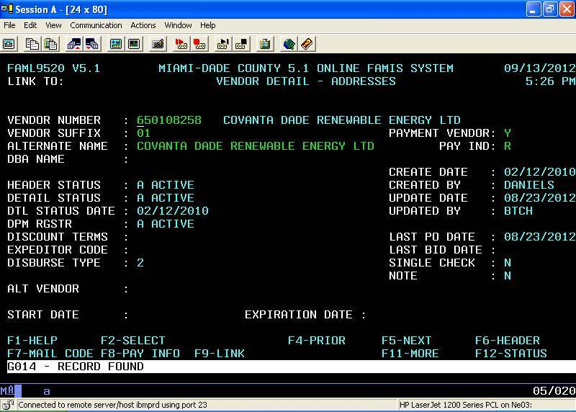
Sample of Active DPM Registration
Miami-Dade Finance Department
29

Slide 30
Resolution Conversion
Vendor Registration
  Verify that vendor is DPM registered in FAMIS screen 9520 or 9600 PRIOR to submitting paperwork to our office.
  If vendor is not registered have the vendor download the registration package at the DPM website & submit registration to DPM. www.miamidade.gov/dpm/doing_business_with_us.asp

Slide 31
Resolution Conversion-Update
Ordinance Number 10-47 Adopted 07/08/2010
Amended the Code of Miami-Dade to exempt certain transactions and purchases from the standard County vendor affidavit and registration requirements.
Waiving of regular registration requirements for the following services:
  Purchase of land
  Lease of vehicles for county officials
  Engagement of performers, honorariums or trainers
  Historical preservation services
  Rehabilitative services (such as courses/trainings for ex-offenders)
  Cable and satellite services; video conferencing services
  Dental services for inmates
  Tutoring services
  Animal medication purchases; animal care services and shipment of animals
  Anti-venom purchases

Slide 32
Resolution Conversion-Update
Business/Entity Information Form needs to be filled out by the vendor and provided to the user department with W-9 Form.
This will be the form that vendors providing the above services will need to complete in order to be registered with Miami-Dade County and be paid timely.
For more information on the form and process please contact ISD, Procurement Division, Vendor Services at 305-375-5773.

Slide 33
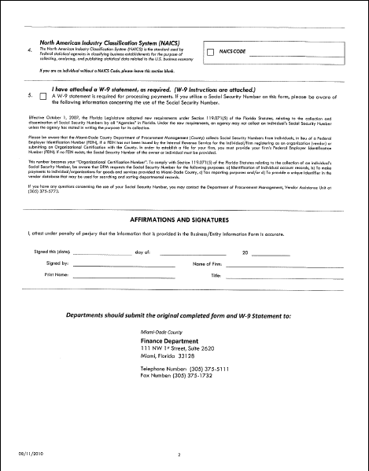
Business/Entity Information Form
Front
Back

Slide 34
Unclaimed Checks Website
USE WEBSITE, IT’S BEEN AVAILABLE SINCE 11/2006
http://wsintra.miamidade.gov/UnClaimedChecks/enterUNCC.do
Please refer to Florida Statue 717 for the Timeliness of Payments.
April 30, 2013 is the deadline to file with the State of Florida for unclaimed property; therefore, please clean out the stale dated checks for the 2011 and prior calendar years for your departments on or before March 30, 2013.
Due Diligence letters are sent on a semi-annual basis in order to attempt to make contact with the payee (owners) of these unclaimed checks, but we still need your help!!

Slide 35
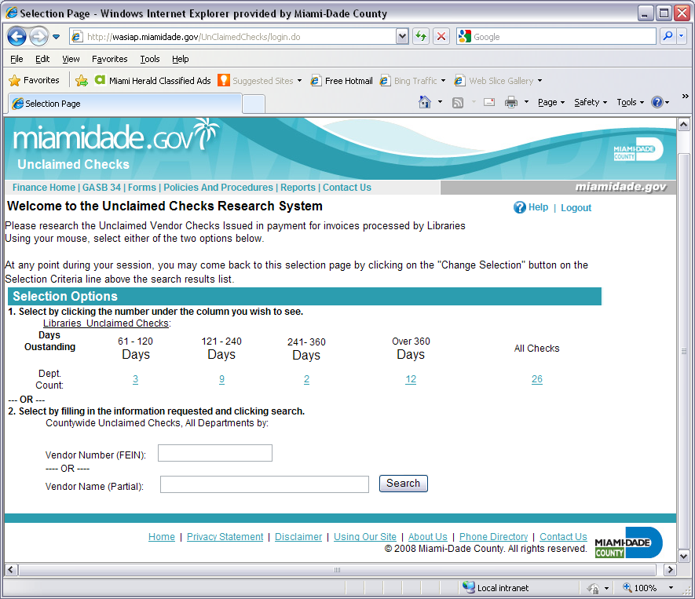

Slide 36
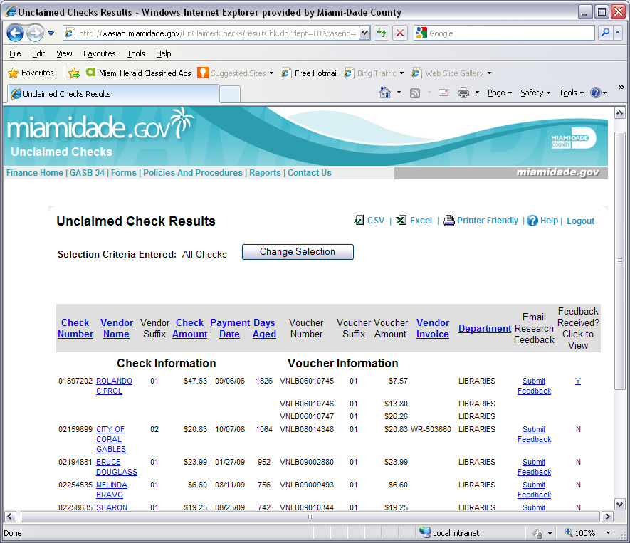

Slide 37
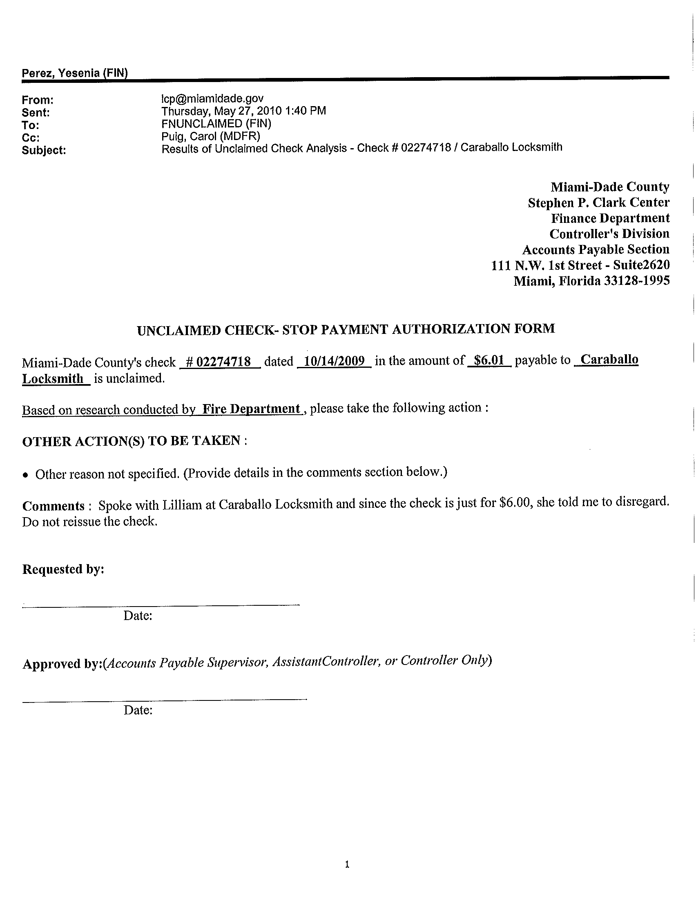

Slide 38
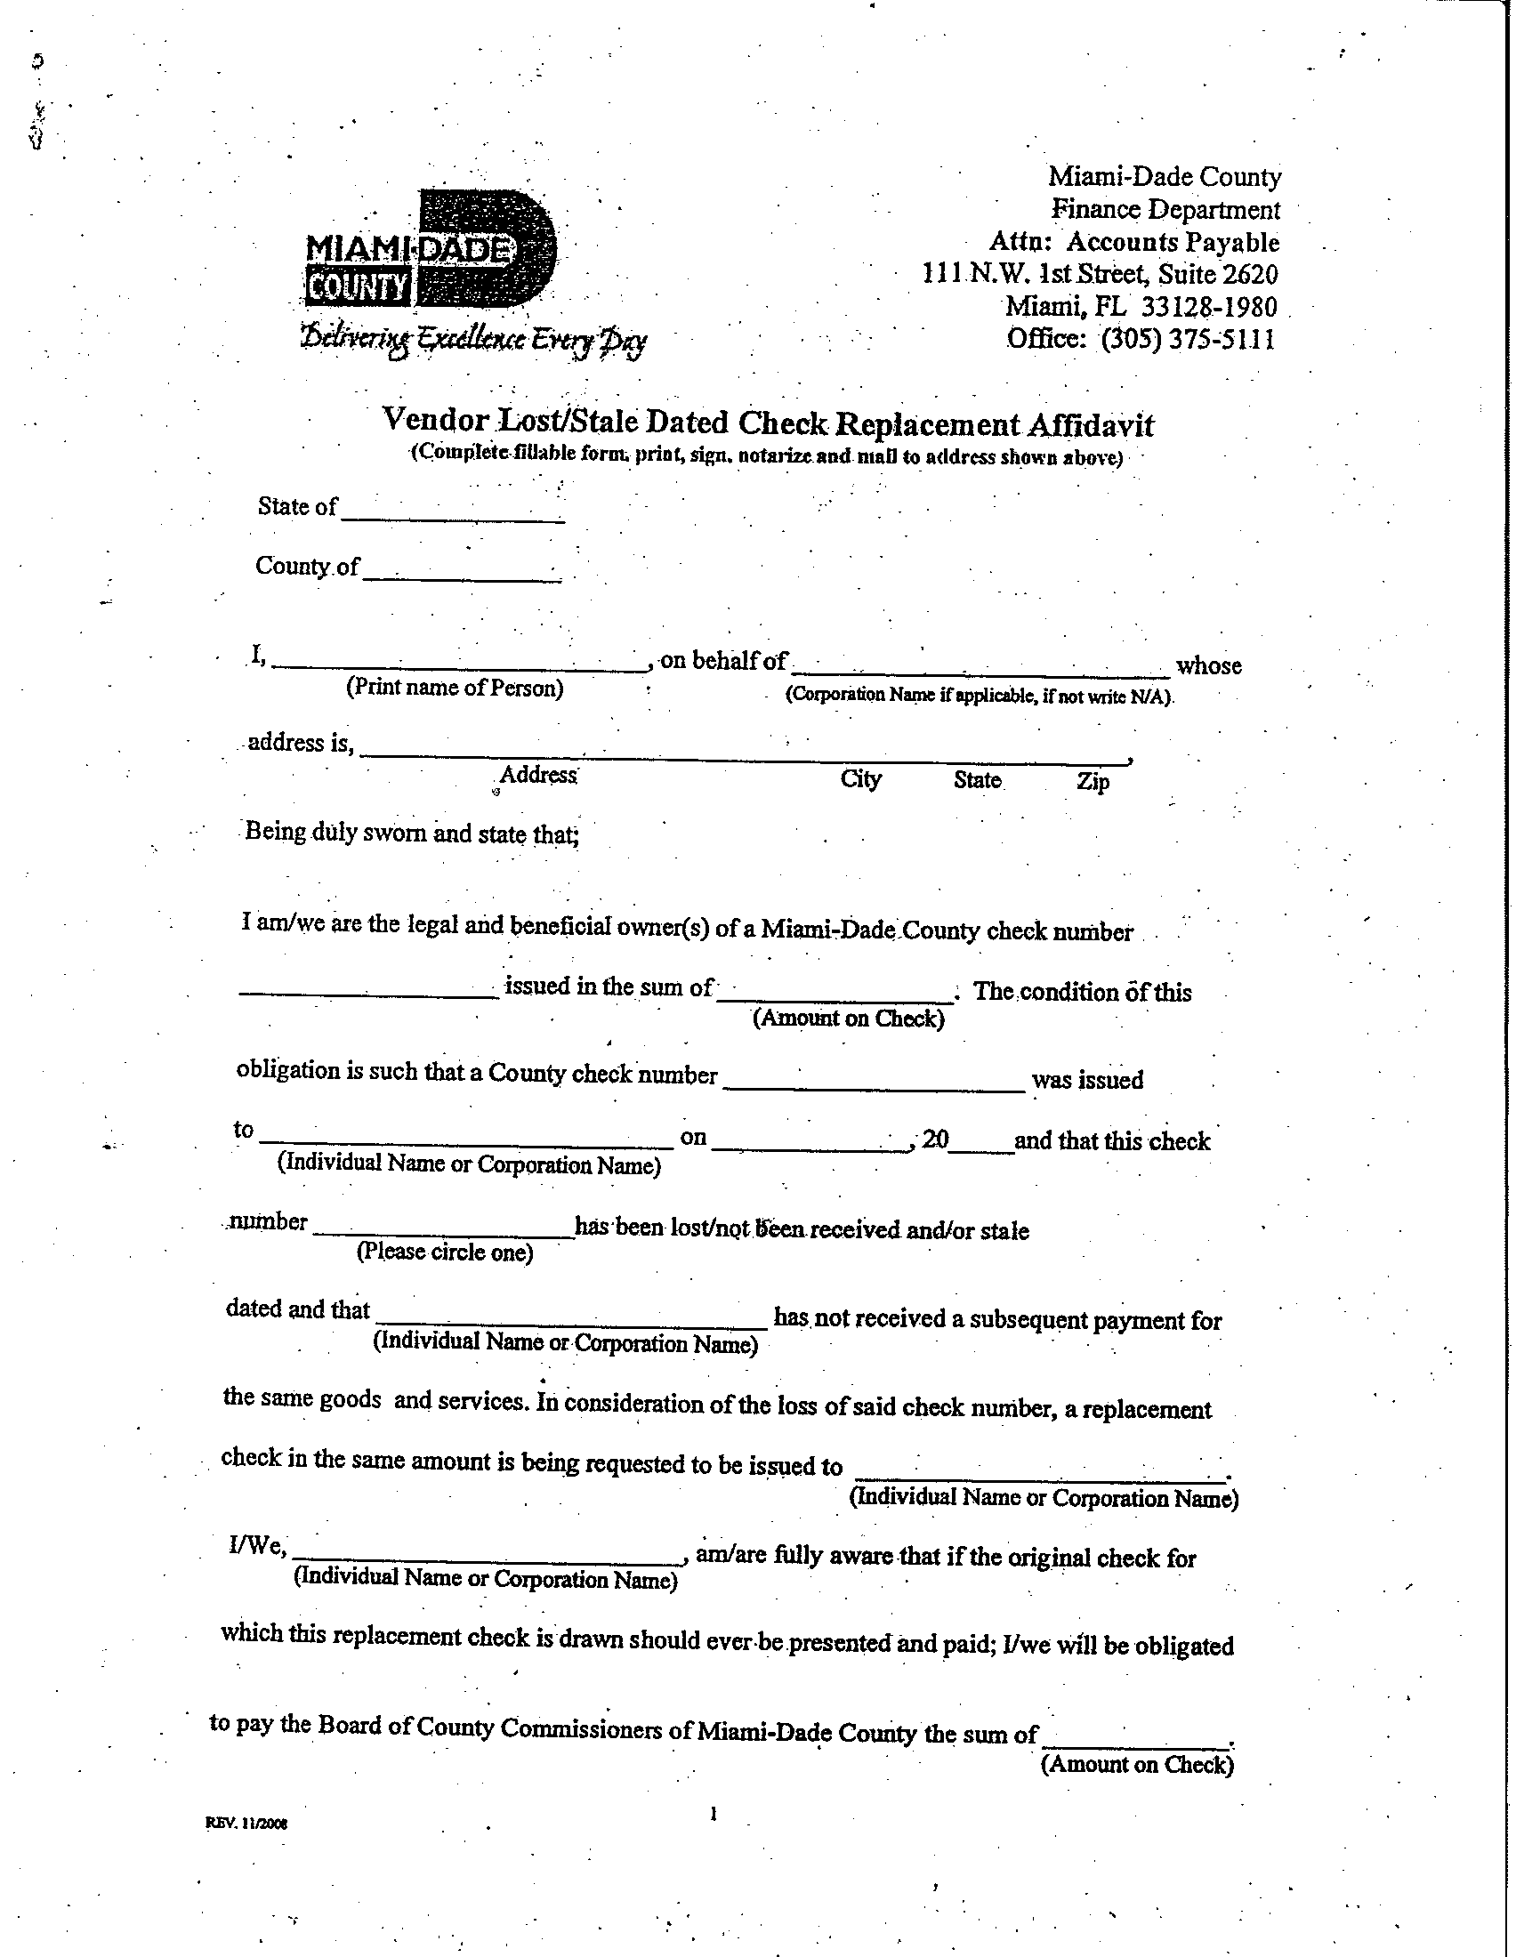
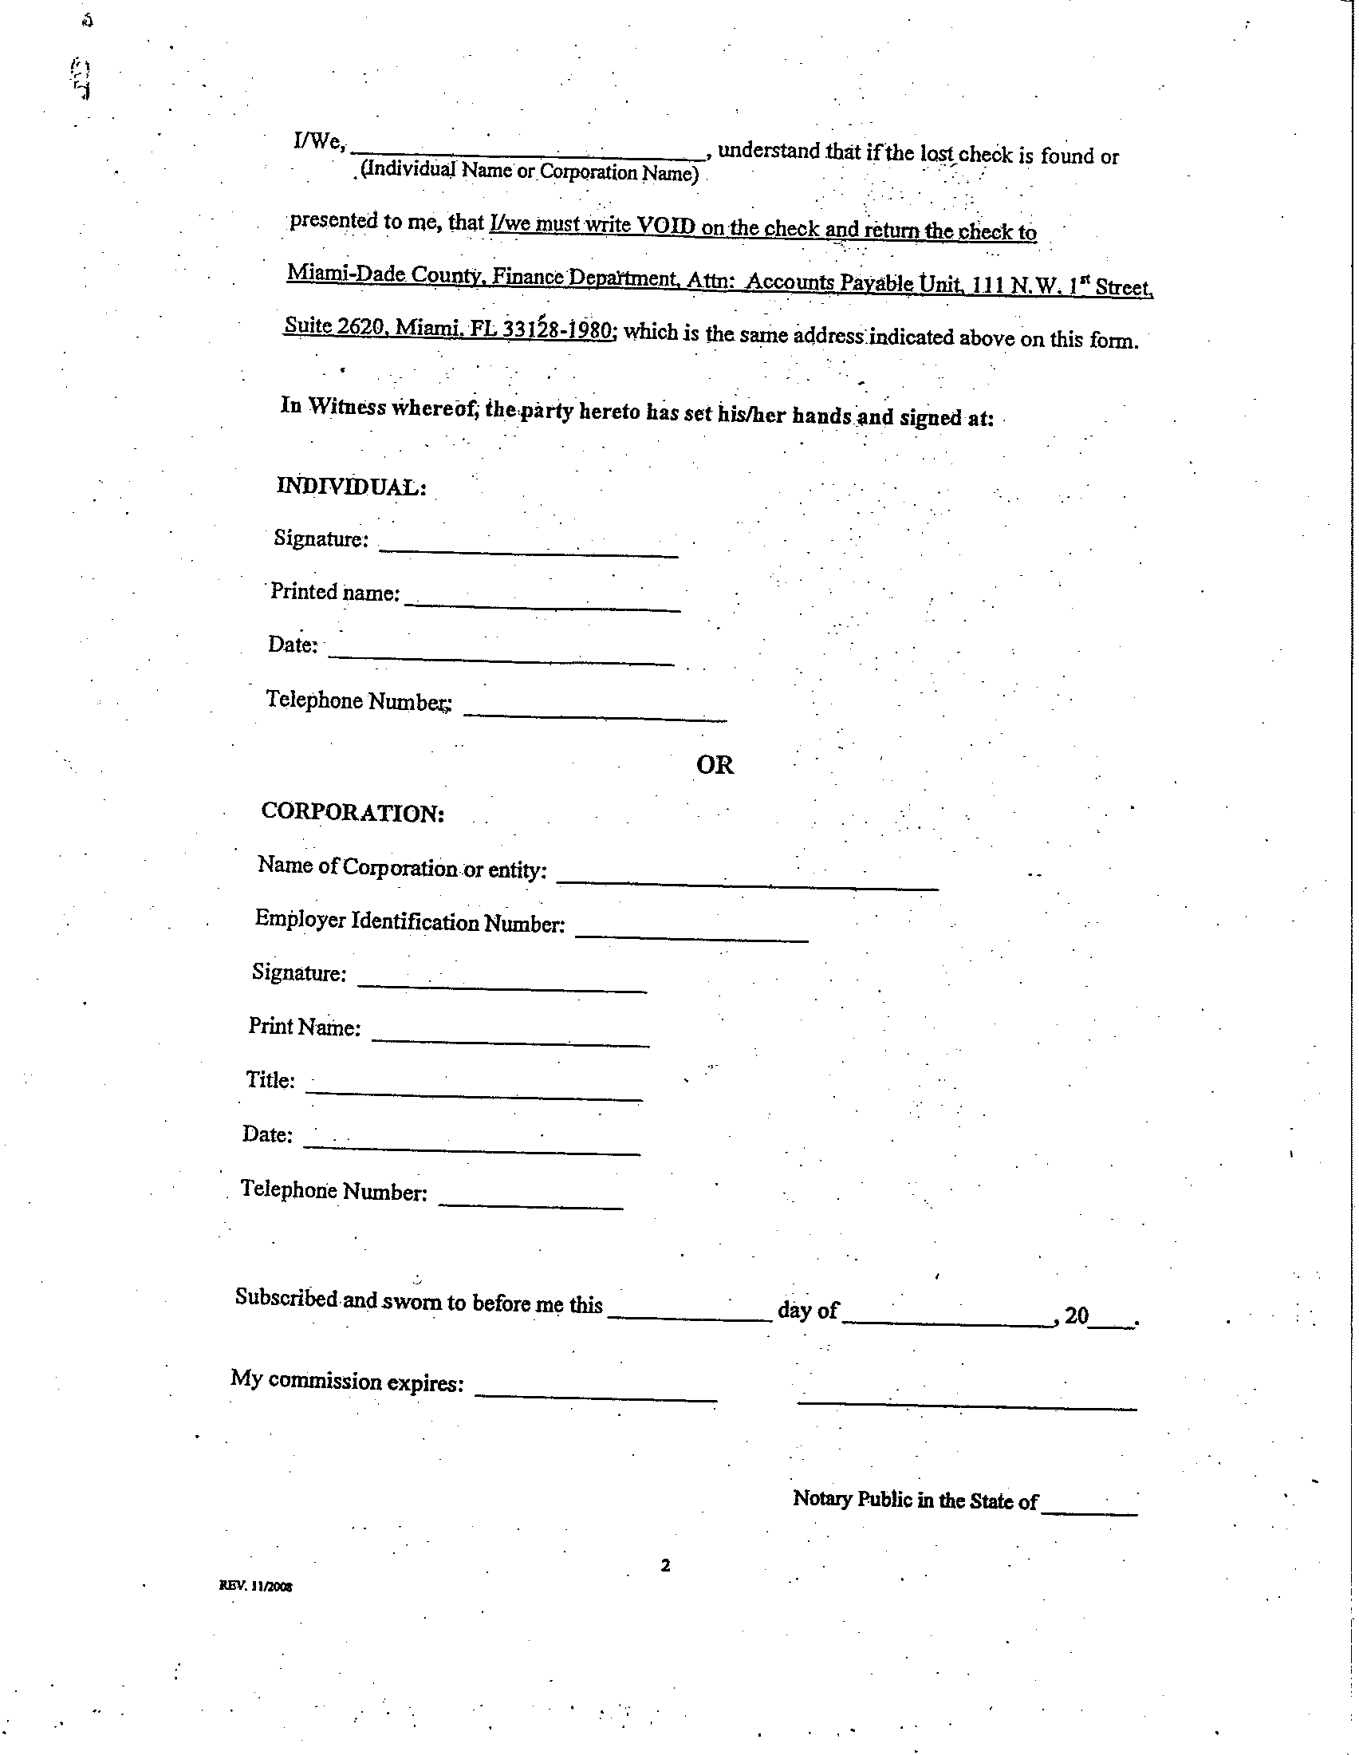

Slide 39
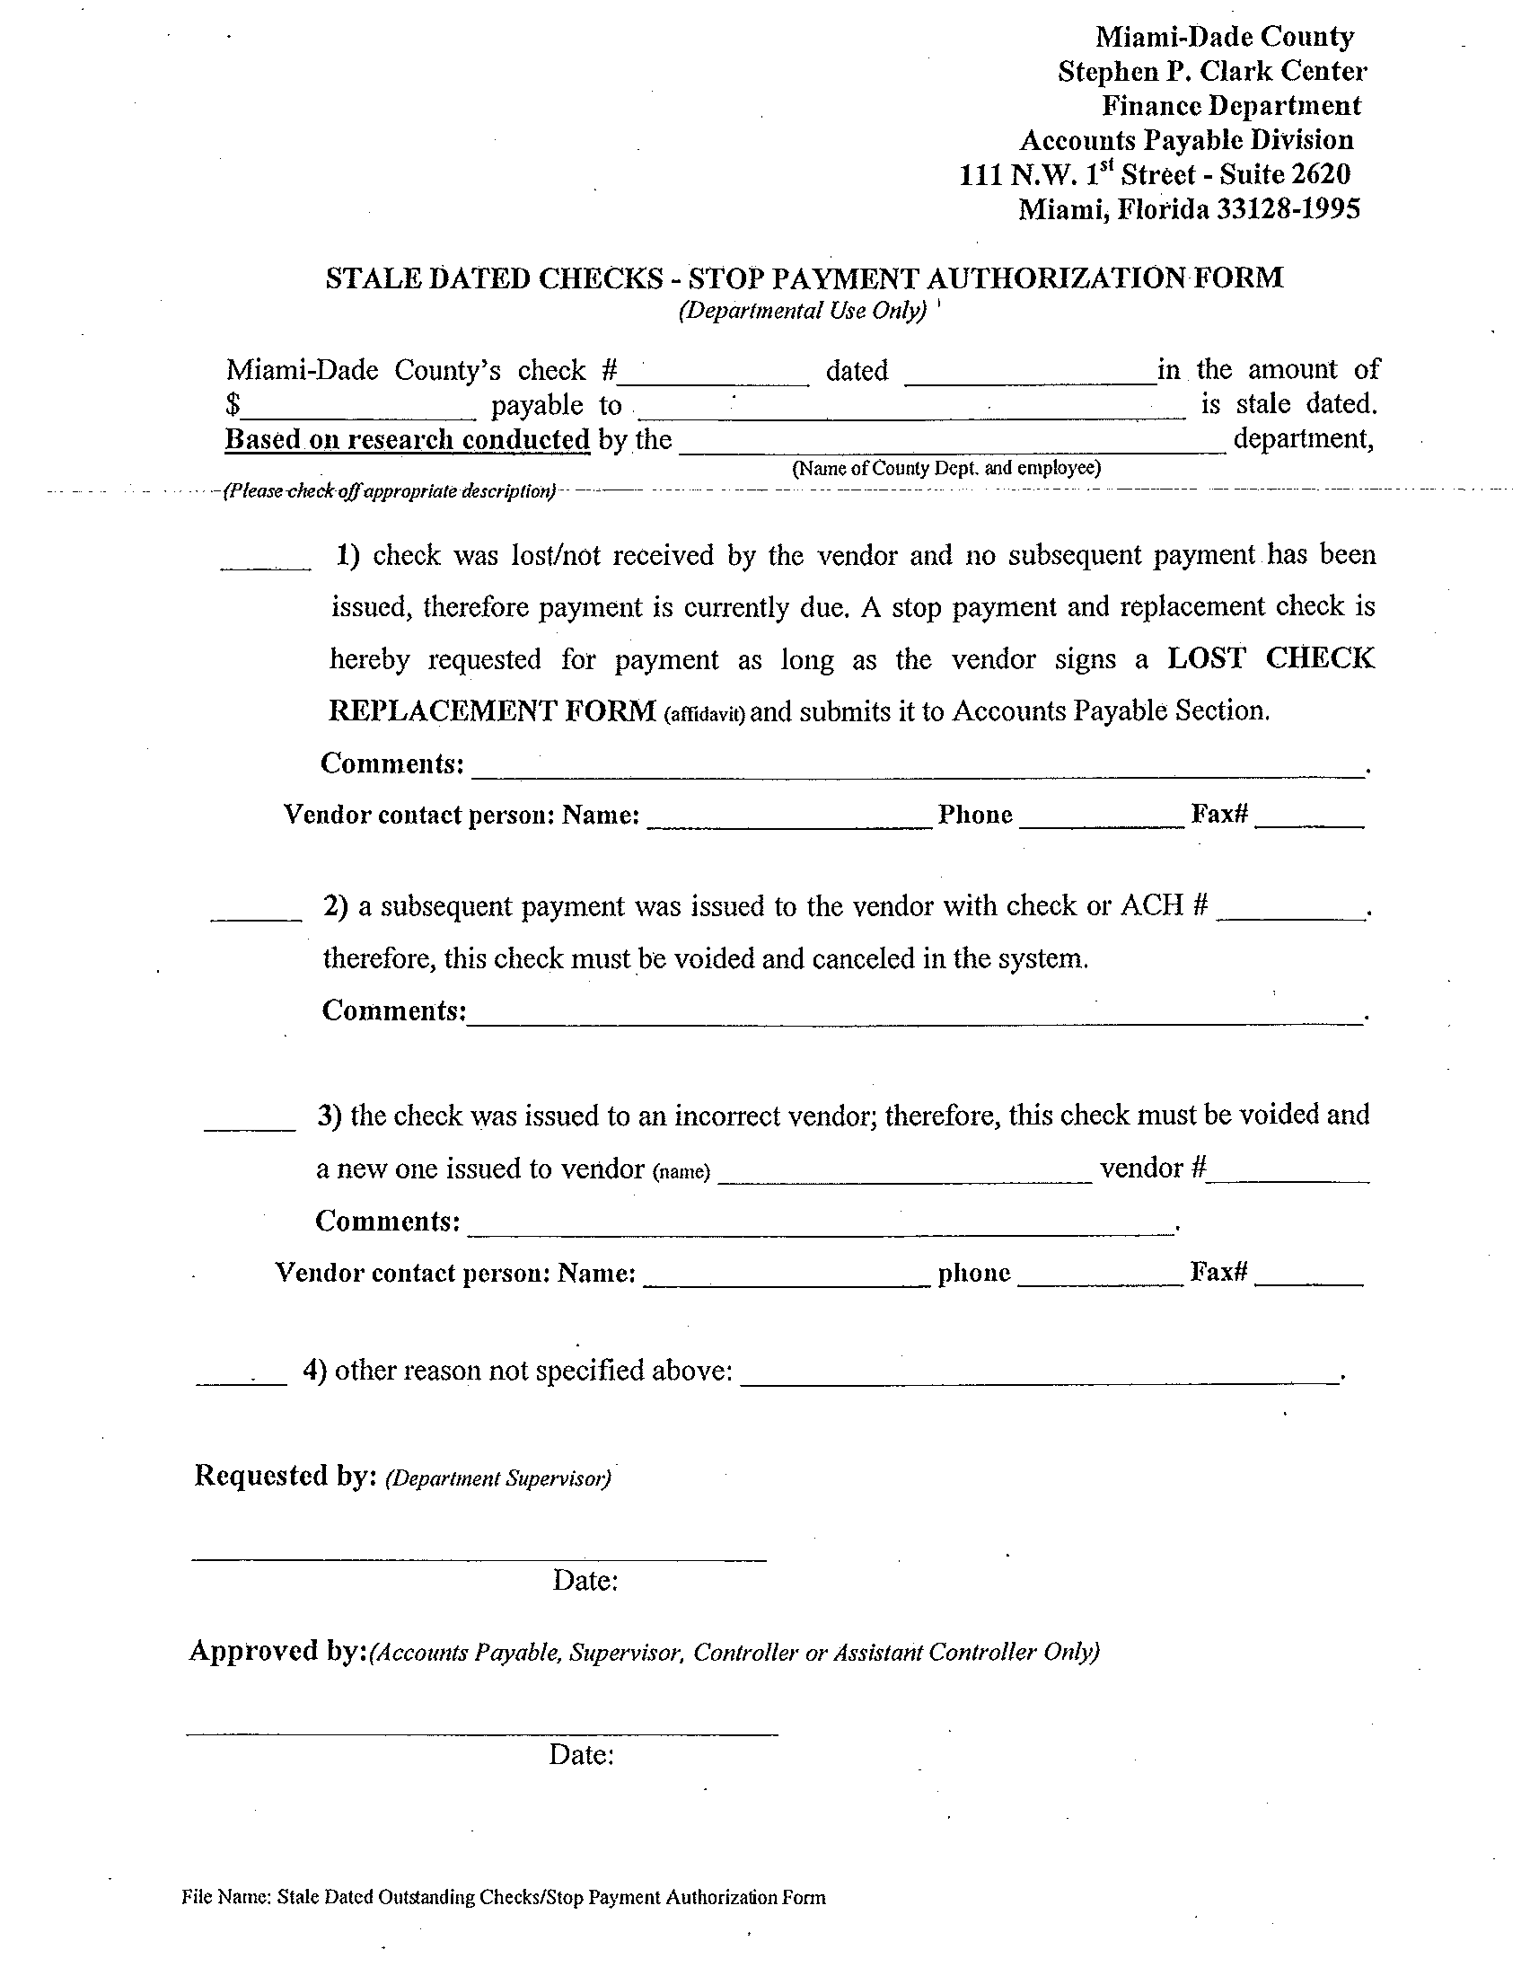

Slide 40
Year-end 2012
ACH PAYMENTS
Forms available at website: http://intra.miamidade.gov/Finance/# or at www.miamidade.gov/finance
Please encourage all vendors to sign up for this program.
Reduces unclaimed checks.
Expedites availability of funds to vendors.
Reduces emergency checks.
Finance is now e-mailing deposit notifications to our vendor community that have signed up for the program.
Enclosures for these payments will need to be sent to the vendor by the user department.

Slide 41
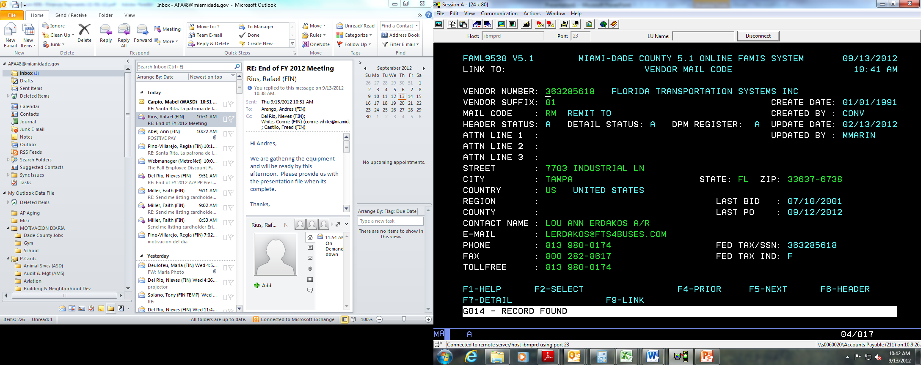
ACH Continued
Vendor Receiving ACH E-Mail Notification

Slide 42
Year-end 2012
VENDOR PAYMENT INQUIRY WEB APPLICATION
Continue to introduce vendors to this site and what it provides.
Reduces telephone payment inquiries.
History in website for checks and invoices issued for 4 fiscal years to date.
Ability to track the entire cycle of an invoice.
Contact information for cycle of invoice is the Departments A/P Liaison.

Slide 43
P-Card Reminders
Review monthly reconciliation carefully & question those items that do not appear to be for the proper use of public funds and/or not eligible.
    Parking Citations
    Plants
    Food
    Parties
Avoid fees imposed by the airlines for calling customer service and ordering a paper ticket – use (e-tickets).
Travel Requests should be properly authorized by the Office of the Mayor or designee when applicable.

Slide 44
P-Card Reminders (Continued)
No premium air fares allowed.
Avoid splitting purchases unless it’s part of the normal. course of business.
    Building Permits
    Registrations
If sales tax is charged please try to get reimbursed.

Slide 45
P/T- Credit Card Reminders (Continued)
Hurricane/POD card Reminder-When a “Hurricane Watch” is declared by local authorities all P-cards which are approved annually by the Department Directors via the ‘Hurricane Form’ will be raised to their appropriate levels. POD cards will also be increased to their ‘normal’ set limits.
Reminder to cardholders – NO cardholder is allowed to share their assigned credit card number with any other County employee. This is clearly stated in the P-card agreement signed by the cardholder and Department Director. This is done for the protection of the credit card program/County. All transactions have be completed by the cardholder themselves. (i.e. job advertisings for job openings)
Sunpass – As per the Mayor’s directive, ALL departments must have Sunpass transponders assigned to all their fleet vehicles. These payments must be made with a county issued P-card. Departments are responsible for tracking the assignment of these transponders to assigned staff and corresponding vehicle tag numbers with the Sunpass vendor.
Miami-Dade Finance Department
45

Slide 46
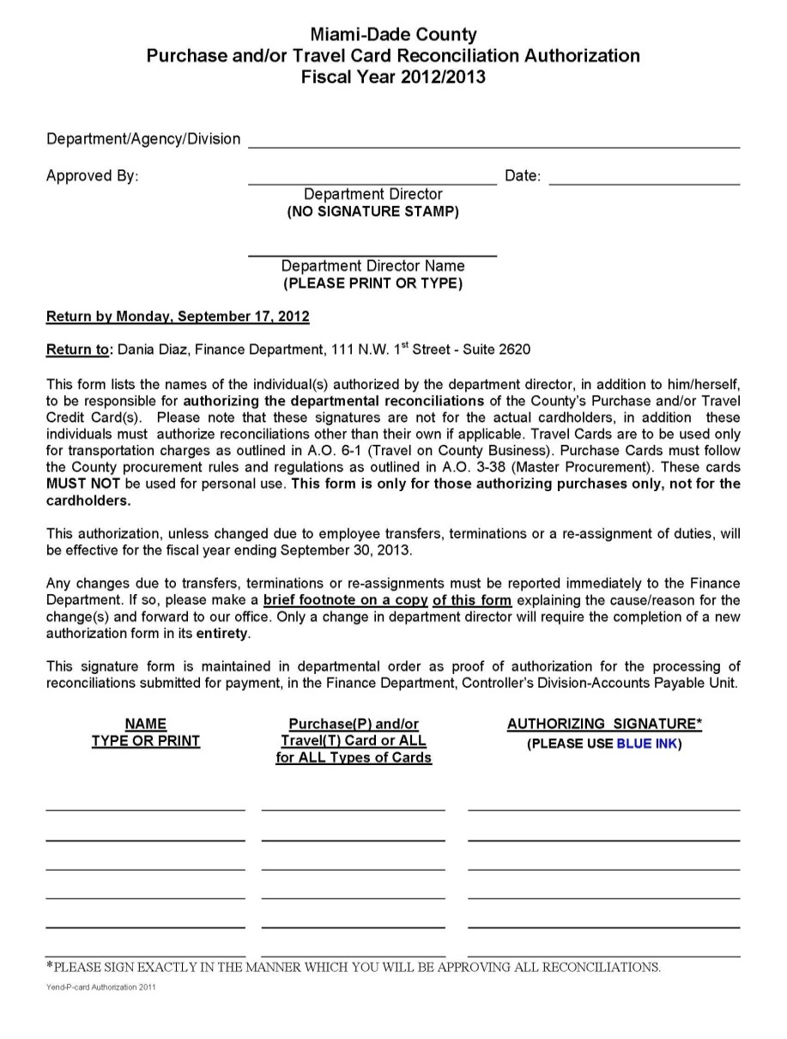
P-Card Authorization Form
This form is for signatures that authorize the P-Card reconciliations. (Sign in Blue ink – to verify original and not a copy of the form)
Only people who are authorized to sign off on card charges for their department need to sign this form.
Cardholders do not sign this, with the exception of authorizing charges other than their own card. (Cardholders can’t sign for their own charges, but can authorize others, if the Dept. Director allows.)
Make sure to mark the center section as P (purchase card charges only), T (travel card charges only), All (for all types of charges)
46
Miami-Dade Finance Department

Slide 47
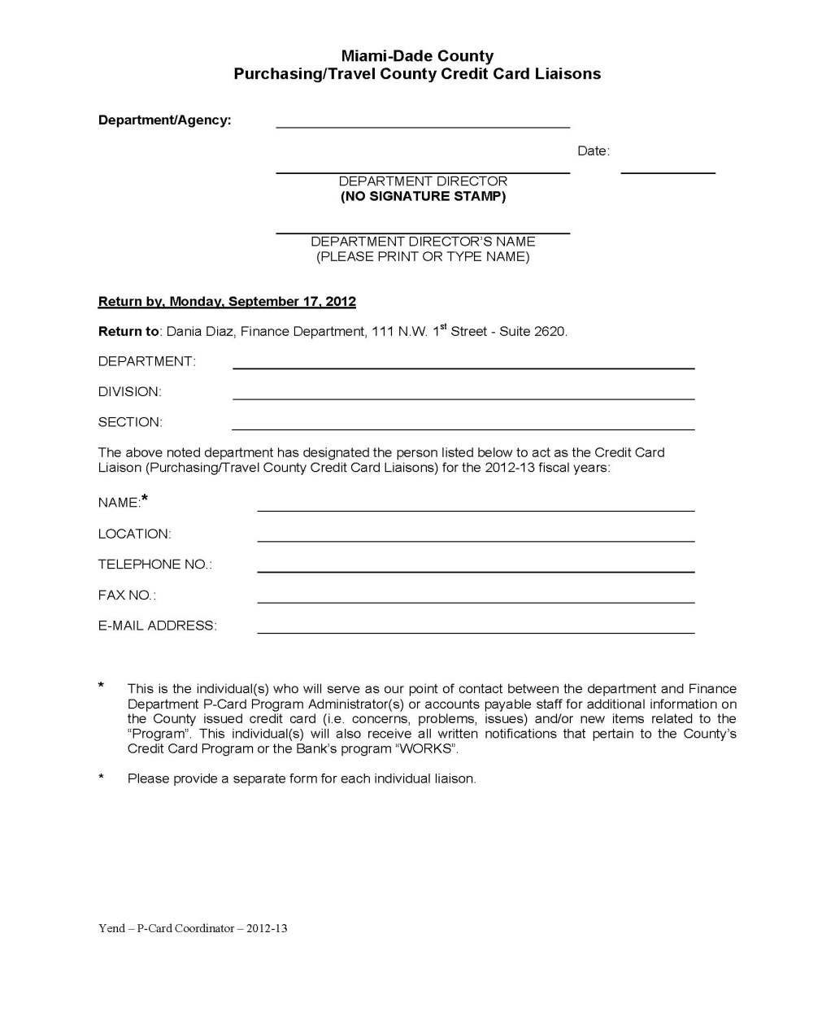
P/T-Credit Card Liaison (Coordinator) Form
This form is for Liaison/Coordinators for the Agency/Section/Division within each Department. (Sign in Blue ink – to verify original and not a copy of the form)
Only individuals who are authorized to receive emails from the Finance Department or the Works program, related to any P/T-Cards should be listed on this form.
It is highly recommended that there be be more than one coordinator for the department in case someone is out of the office.
A separate form must be filled out for each Coordinator.
47
Miami-Dade Finance Department

Slide 48
Year-end 2012
REGISTRY OF DELINQUENT CONTRACTORS ADMINISTRATIVE ORDER 3-29
A web application on the Finance Intranet with search capabilities and additional information. http://wasiap.miamidade.gov/ARI/menu_1_0.do
A reminder is sent by Hilda Garcia on the 10th of each month to the liaison.
Please have your department liaison provide the required information to Hilda Garcia no later than the 15th of each month.

Slide 49
Year-end 2012
REGISTRY OF DELINQUENT CONTRACTORS ADMINISTRATIVE ORDER 3-29
Please include in your delinquent vendor list the FEID number of the contractor/vendor.
“As of Date” needs to be entered on spreadsheet sent to Hilda.
If your list is not sent monthly vendors that were blocked the previous month will be deleted from the system when monthly information is uploaded.
    The County can be held liable if a payment is made to a delinquent vendor.

Slide 50
Petty Cash/Change Funds
Administrative Order No. 3-6 requires that departments:
  establish written departmental Petty Cash Fund procedures,
  ensure a secured on-site storage facility to safeguard the funds,
  immediately notify the Finance Director of changes in custodian via “Petty Cash/Change Fund Change Form”, and
  perform independent, unannounced verifications of petty cash fund balances at least annually to assure accountability and compliance with County ordinance.

Slide 51
Petty Cash/Change Funds
Administrative Order 3-6 can be found on the intranet at http://www.miamidade.gov/aopdfdoc/aopdf/pdffiles/AO3-6.pdf
Petty cash forms are due by September 17, 2012.
If you need a list of the Petty Cash accounts for your department please see me after the presentation and we will send you the list electronically.
If you have any questions, please contact Annette Perez (ext. 1482) or Maria Hernandez (ext. 7848).

Slide 52
Year-end 2012
Monday, October 08, 2012
2nd Preliminary reports available

Slide 53
Year-end 2012
Accounts Payable Reminders
Procedure 606 can be found in the County Procedures manual at http://intra.miamidade.gov/procedures/library/606.pdf

Slide 54
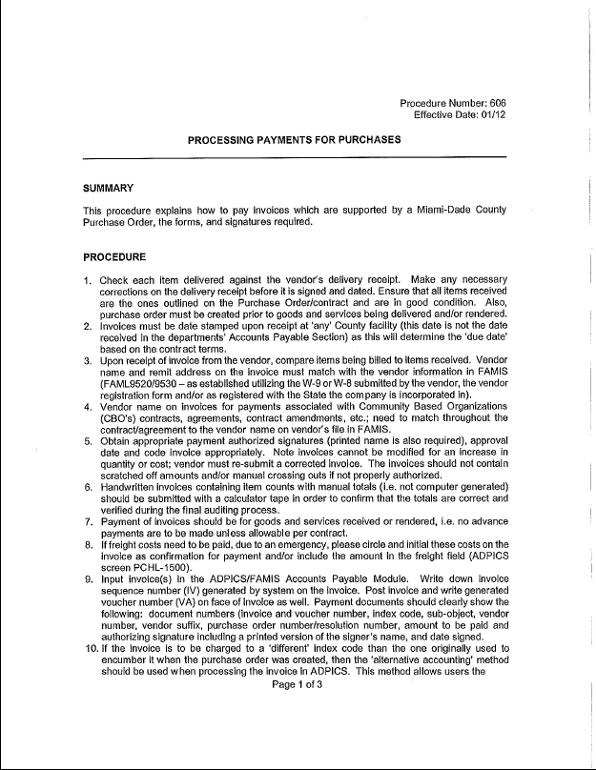
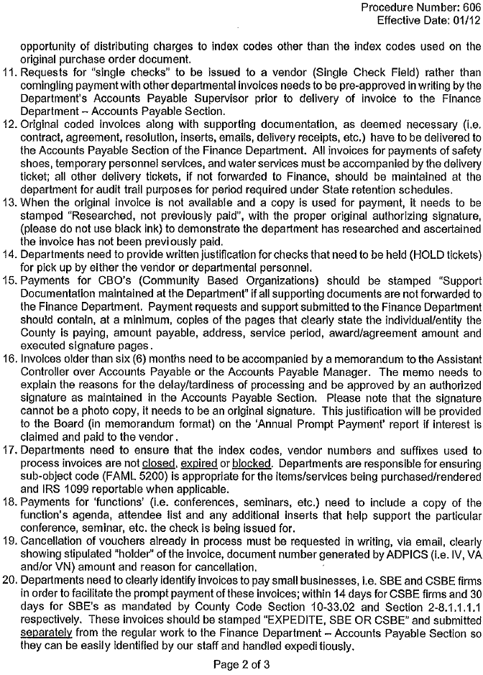

Slide 55
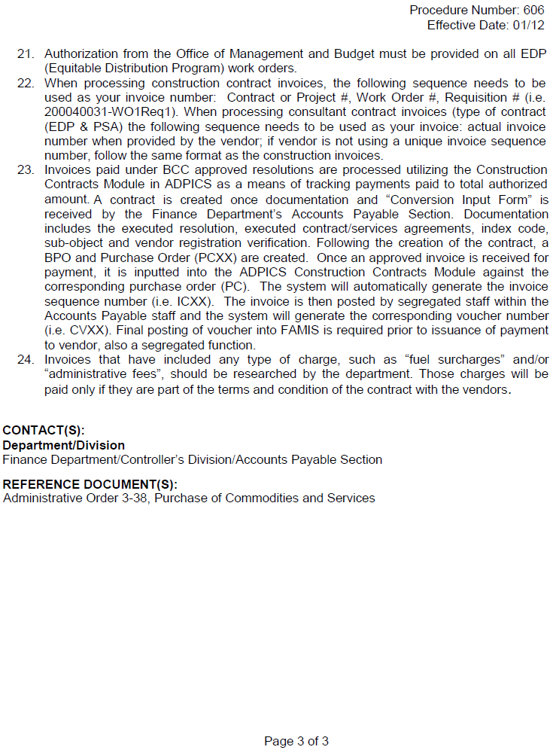

Slide 56
Shared Services Enabled by Accounts Payable Imaging and Workflow Automation
Background
Partnered with ITD to identify a software architecture to obtain an Accounts Payable Invoice Workflow Application and to modernize the County’s electronic content management (ECM)
A contract was awarded December 2011 to EMC² (EMC Corporation)

Slide 57
Accounts Payable Imaging and Workflow Automation (IWA)

Slide 58
Proposed Solution using a Shared Services Concept
AP Invoice Process providing functional consolidation
  Phased-in approach including 4 phases over a 2-year period
    5 Departments are included in the pilot phase:
      Currently live - Audit & Management Services, Finance, and Management & Budget
      Going live on October - Information Technology
      Going live on November - Public Works & Waste Management
    Finance and ITD will rollout to the rest of the county
  Vendor invoices will be received at Finance Department – approximately 483,000 invoices annually affecting 11,300 active vendors, excluding special services checks and purchasing/travel card transactions
    Phase 1 represents approximately 90,000 invoices and 6,000 vendors
    Types of invoices for Phase 1 include goods & services, direct payments, construction, CBO’s, Mom & Pop, resolutions and interfaces
  Initial implementation excludes WASD, MDAD and MDHA payables.

Slide 59
AP / IWA Implementation Goals and Benefits
The goals after full implementation is completed are to:
Streamline the County’s Accounts Payable process by
  Capturing invoice information at the beginning, either via imaging or electronic input
  Eliminating the need for paper to be routed for approvals
  Migrating from paper files into electronic files
Benefits of IWA implementation:
Lower invoice processing costs result from
  Lowering administrative costs
  Eliminating paper handling during invoice processing and retrieval
  Eliminating of multiple departmental storage
Reduced invoice receipt-to-payment cycle time by
  Centralizing invoice processing
  Automating routing of tasks to individuals
Improved invoice visibility and control resulting from
  Improved reporting and analytical capabilities
  Improved financial audit ability and potential fraud prevention
  Disaster recovery protection

Slide 60
Year-end 2012
Final Closing
Friday, October 12, 2012
  FAMIS will close at noon for fiscal period 2011/12 and will not be available until Monday, October 15, 2012.
  Final reports available on Monday, October 15, 2012.
  Any emergency check/s needed on Friday, October 12, 2012 have to be received no later than 11:00 am in order to meet the noon deadline.

Slide 61
Year-end 2012
TRAVEL UPDATES
County’s Travel Coordinator-Anita Gibboney
The Departmental Travel Liaison listing
Updated Travel Policy and Procedures-soon to come
Travel website can be found at http://intra.miamidade.gov/travel/

