Slide 1
GIS Metadata Training & Outreach Assistance
Miami-Dade county & NSDI
2015
Notes:
Welcome , thank you for attending the GIS Metadata Training and Outreach Assistance workshop
This training was made possible through a 2012 National Spatial Data Infrastructure grant

Slide 2
Introduction
Name
Agency
Use of GIS
Familiarity with Metadata?
Workshop expectation?
Notes:
My name is Bibi Oung, I have worked for Miami-Dade County Information Technology Department as the GIS Data and Metadata administrator for over 17 years.
And my name is Jeffrey Ruiz and I am a systems analyst programmer with Miami-Dade county Information Technology Department and have been working with GIS for over 10 years.
We hope that at the end of the workshop your knowledge and understanding of GIS metadata have increased and will facilitate your organization’s metadata creation and maintenance process.

Slide 3
Outline
What is Metadata?
Value of Metadata
Metadata quality
National Geospatial Data Assets (NGDA)
National Spatial Data Infrastructure (NSDI)
Geospatial Metadata Standards
CSDGM & ISO Standards Overview
Metadata Tools (CSDGM & ISO)
Use ISO or CSDGM?
Break
Hands-on training using ArcGIS
Notes:
This workshop will cover the following outline:

Slide 4
What is Metadata?
Information about the data
Who, what, when, where, why and how about data
Metadata
Notes:
What is metadata?
Metadata is information about the data
It addresses the who, the what the when, where , why and how about the data, for example
Who provided the data, maintains the data, is the data contact, determines data criteria
What the data contains, what it reflects, what criteria or exclusions were used, what environment was used to collect the data, what reference layers were used, what application uses the data and what scale was used to create the layer
When was the layer created, data collected, when does it need to be updated
Why was the layer created and for what purpose
How is the layer going to be used,? (mapping, legal, application or analysis)
Example
Sexual predator
Who – Miami-Dade Police Department
What – Sexual Predators and offenders
When – To find a sexual predator residence relocating
Where – Miami-Dade County Limits
Why – To comply with the sexual predator ordinance to be within a certain distance from a park, school, etc.
How – The data is geocoded against streets and address
At the end of most slides there will be a hyperlink that points to the FGDC website that contains additional detail information that will expand on each subject matter

Slide 5
Value of Metadata
Avoid financial and analysis errors
Reduce support efforts and cost
Role, restrictions, limitation, etc.
Aid data distribution efforts & data users
Improve service & decision-making process
Value
Notes:
Some of the values of having metadata are
Helps to avoid financial and analysis errors such as using a file that is a subset instead of a comprehensive file.
It reduces support efforts and cost such as calls, and email responses which ultimately increase resource costs.
It addresses role, restrictions, limitation, such as is the file public, internal, or sensitive, and what accuracy or scale was used to create the data
It aids in data distribution & data users efforts by having the information readily attached to the data.
It Improves service & decision-making process. If a layer has proper documentation the analyst can easily make the determination as to whether the file can be used for a given request.
Overall , having metadata avoids an individual from repeating the same, or a variation of information , which ultimately saves time and money.

Slide 6
Quality Metadata
Agency standard & level of documentation
Difference between essential and operational level of metadata
Metadata Review
Quality Metadata
Notes:
Quality metadata is maintained through each agency’s established standards and level of documentation
It also addresses the difference between essential and operational level of metadata, for example having very limited documentation vs well detailed documentation that addresses the maintenance and the process of the layer creation.
It is recommended to have a metadata review process to capture errors and ensure that essential information is included to eliminate gaps in the information.

Slide 7
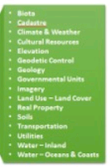
NGDA
National Geospatial Data Assets (NGDA)
Coordinate Federal Geospatial assets
Support government mission
Benefits
Reduce cost and duplication
Promotes Accessibility
Data sharing
Greater return on investment: reuse data, application & tools.
Etc…
NGDA
Notes:
- Portfolio Management, according to OMB Circular A-16 Supplemental Guidance, is the coordination of Federal geospatial data assets and investments to most efficiently support national priorities and government missions.

Slide 8
NSDI
National Spatial Data Infrastructure (NSDI)
Federal Geographic Data Committee (FGDC) leadership role in geospatial community.
Presidential Executive Order 12906 (A-16)
State of Florida Rule 1B-26.003, Florida Administrative Code
Collaboration of governmental, private, non-profit and academia agencies.
Vision: reduce geographic data duplication effort, improve quality and reduce cost among agencies.
Notes:
- What is NSDI? Collaboration of governmental, private and academia agencies that generate or use geographic data and facilitate the sharing of geographic data
- Executive Order 12906: COORDINATING GEOGRAPHIC DATA ACQUISITION AND ACCESS: THE NATIONAL SPATIAL DATA INFRASTRUCTURE, signed by President Bill Clinton on April 11, 1994, launched the initiative to create the National Spatial Data Infrastructure.
The NSDI is a physical, organizational, and virtual network designed to enable the development and sharing of this nation's digital geographic information resources.
FGDC activities are administered through the FGDC Secretariat, hosted by the U.S. Geological Survey.
FGDC is tasked by an Executive Order to develop procedures and assist in the implementation of a distributed discovery mechanism for national digital geospatial data
The FGDC is a 32 member interagency committee composed of representatives from the Executive Office of the President, and Cabinet level and independent Federal agencies
A-16 was issued in 2010
Collection of data nationally to served many users
The National Spatial Data Infrastructure (NSDI) is a means to assemble geographic data nationwide to serve a variety of users. GIS applications of many different disciplines have a recurring need for a few themes of data. The framework is a collaborative community based effort in which these commonly needed data themes are developed, maintained, and integrated by public and private organizations within a geographic area. The framework is one of the key building blocks and forms the data backbone of the NSDI. The framework concept was developed by representatives of county, regional, State, Federal, and other organizations under the auspices of the Federal Geographic Data Committee (FGDC). Local, regional, state and federal government organizations and private companies see the framework as a way to share resources, improve communications, and increase efficiency.
Framework has three apects: Data, Procedures and technology for building and using the data, and Institutional relationships and business practices that support the environment.
The framework is designed to faciliate production and use of geographic data, to reduce costs and improve service and decision making.

Slide 9
NSDI cont.
Source: technology, policies, criteria, standards and promote geospatial data sharing.
Role: Provides structure of practice and relationship among data producers and users.
Set of actions and new ways of accessing, sharing and using data geographic data.
Clearinghouse: points to current and accurate data.

Slide 10
NSDI cont.
GISInventory.net (National inventory of data)
Search for data
Create metadata
Publish metadata
Identify community-specific resources via theme
Post data
FGDC
Data.gov (harvest from GISInventory)

Slide 11
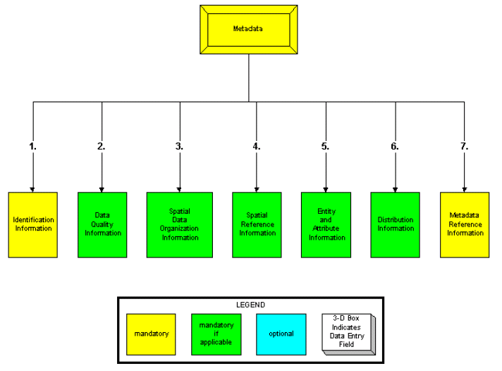
Geospatial Metadata Standards
Benefits of standards
Content Standard for Digital Geospatial Metadata (CSDGM)
Notes:
current US Federal Metadata standard.
The FGDC originally adopted the CSDGM in 1994 and revised it in 1998

Slide 12
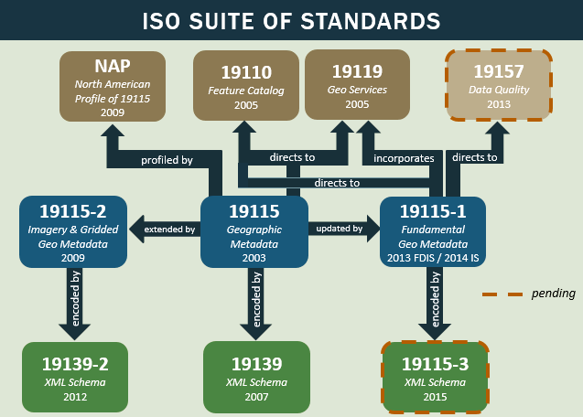
Geospatial Metadata Standards
International Standard of Organization (ISO)
Geospatial Metadata Standards

Slide 13
Metadata tools
Metadata Tools (ISO or CSDGM)
Freeware
Commercial (ArcGIS, etc.)

Slide 14
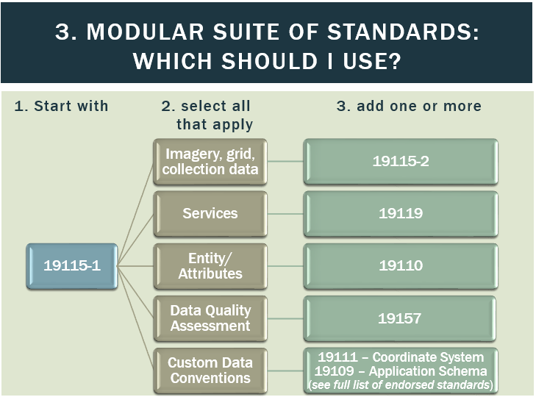
ISO or CSDGM
Should you agency use ISO or CSGDM?

Slide 15
Questions

Slide 16
Break

Slide 17
Hands-on training
Using ArcGIS
User: CitrixTraining#
Password: Password

Slide 18
Credits
Many thanks to the Metadata staff at:
FGDC (Jen, Gita, Lynda and others)
NOAA
FGDC site
Materials Miami-Dade County GIS site
Notes:
https://search.yahoo.com/search;_ylt=ApjOTZlNLXq7bkOHjaZGS3WbvZx4?fr=yfp-t-605-s&toggle=1&fp=1&cop=mss&ei=UTF-8&p=vivaldi%20four%20seasons

