Slide 1

Welcome
Finance Department
Year-End Presentation
Accounts Payable – Construction Payables
Fiscal 2021
September 17, 2021
2:00PM - 4:00PM
Disclaimer: Please note that the audio and other information sent during this presentation will be recorded. By participating in this presentation, you automatically consent to such recording and to subsequent use of the recording.

Slide 2
2021 Year-End Presentation
AGENDA
Welcome/Introduction –
  Use of Chatbox for Questions
Construction Payable –
Accounts Payable
  Key Dates –
  Special Services/Travel/Resolutions
  AP Control/P-Cards –
  Adjournment –

Slide 3
2021 Year-End Presentation
Introduction
Welcome
Working From Home
Limited Staff at the Office MON-FRI
Official Days for Pickups – TUES & THUR
Official Days for Cashiering Services – TUES & THUR
Payment Runs:
ACH – MON thru FRI
CHECKS GOA – TUES & THUR
CHECKS SSC - WED

Slide 4

Capital & Construction Payable Section
Fiscal Year-End 2021

Slide 5
FY 2021 Capital & Construction Payments Deadline
  Construction Payments Cut-Off:
  Email Francisco Garcia at FKG@miamidade.gov all construction related invoices by Friday, October 1st, 2021, at noon.
  Tips to minimize unnecessary voucher rejections:
  We encourage department approvers to open the invoice attachment and compare it with the voucher
  We receive numerous Construction Cover Sheets and Invoices with:
  The Incorrect Invoice Date or Incorrect Invoice Received Date
  Payments being applied to the incorrect Fund and/or Account Number
  - Invoice Remit to Address on the voucher does not match the Remit to
Address on the invoice

Slide 6
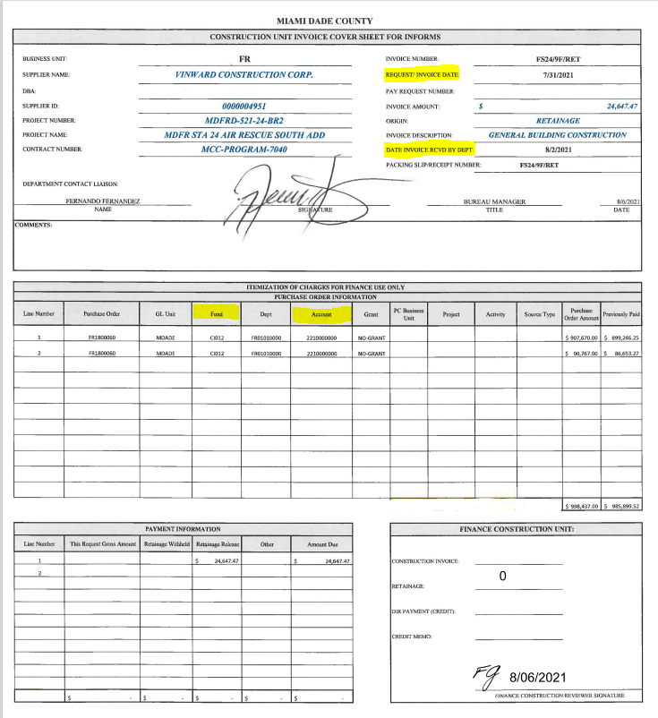

Slide 7
  Important Construction Reminders:
  To increase the allocation on the Equitable Distribution Program Contracts (EDP) or the Miscellaneous Construction Contracts (MCC), or for general questions about these contracts, reach out to Marcia Martin at ISD Department. Her email address is: Marcia.Martin@miamidade.gov.
  If submitting invoices for services rendered in fiscal year 2021, remember to process purchase order increases and reclassifications prior to September 30th, 2021.
  Retainage payable from FAMIS POs was converted to Informs. To view a Business Unit, Supplier or PO retainage balance in Informs, access the Finance/Supply Chain Tile, Payables Operations, Accounts Payable Work Center, Links, Vouchers, Retainage Tracking by Supplier Inquiry.
  In addition, retainage must be released using the Chartfield Values found on the Retainage Tracking by Supplier Inquiry table and from the Informs Retainage Payable Account 221000000 (In FAMIS – General Ledger 210).
  When preparing capital journal entries, do not comingle various projects’ charges or credits into one single journal entry line.

Slide 8
Departments that manage capital & construction projects (Excluding Enterprises):
Cultural Affairs, Corrections & Rehabilitation, DTPW, Fire, ISD, ITD, Library & Parks, need to provide a report listing the projects completed in fiscal year 2021 with the following information:
Capital project number
Brief description of the project
Funding information
Total project cost since inception (design, bidding, surveys, project management, construction, etc.)
Completion Date
Send report to: Megan.Litcher@miamidade.gov and Patricia.Hernandez-Blanco@miamidade.gov
In addition, it is very important that departments flag or mark capital purchases in Informs. This can be accomplished at various levels: The requisition, the PO, the voucher and at the project level.

Slide 9


Questions
Please enter all your questions in the chatbox. If time allows, we’ll try to answer those that we can at the end of the presentation. Responses to all questions posted in the chat will be sent via email to all attendees.

Slide 10

Accounts Payable
Year End 2021

Slide 11
Accounts Payable Agenda
2021 Year-End
Important Dates & Other Interesting AP Updates
Voucher Payables
Special Services/Refunds Reminders
Travel Reminders
Resolution Reminders
AP Control (aka E-Payables)
P-Card Reminders

Slide 12

What is New in Accounts Payable?
PROCEDURES:
Processes have changed Procedures remain the same.
Procedures available at:
http://intra.miamidade.gov/managementandbudget/procedures.asp

Slide 13
2021 Year-End
Important Dates
Monday, September 27, 2021
Due date for Fiscal 2022 AP Signature Forms
2022 Forms available at: http://intra.miamidade.gov/finance/forms.asp
Accounts Payable Disbursement and Wire Transfer Authorized Signatures Form
Purchase (P-Card) and/or Travel Card Reconciliation Authorization Signatures Form
Travel Authorized Signatures Form
Accounts Payable/Travel/Purchasing & Travel Credit Card Liaisons Form
*All Individuals listed on Authorized Signature Forms must read through AP Procedure 606 prior to signing.

Slide 14

2021 Year-End
Important Dates
  Final Closing Deadlines
  Thursday, Sept 30 – Last Day to dispatch a FYE 2021 PO or process a change order on a FYE 2021 PO
  Tuesday, Oct 5 (Noon) – Cutoff for scanning all FYE 2021 invoices
  Thursday, Oct 7 (Noon) – Cutoff for final approval of Payment Requests and PO invoices over $300K by Department
  Friday, Oct 8 (Noon) – Cutoff for final approval of PO invoices under $300K by Department
  Wednesday, Oct 13 – Cutoff for Accrual Journal Entries (Detail to be covered by Accounting and Reporting)
  Saturday, Oct 23 – Reports available Self Service

Slide 15
Indicating Old vs New Year
All invoices processed after September 30th and until October 8th must be identified as FYE 2021 or FYE 2022. Departments are responsible for identifying the applicable FYE.
    Indicate in Comments or
    Indicate in Invoice Description
AP will be changing the Accounting Date for invoices between Oct 1 – Oct 8
Invoices that do not make the cutoffs will not have their dates changed and will be processed in the new year.

Slide 16
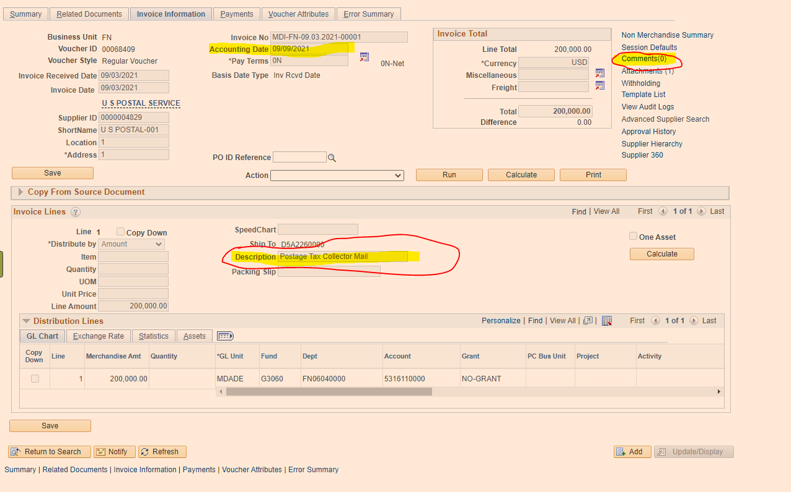
Indicating Old vs New Year

Slide 17
ACCOUNTS PAYABLE ACCRUALS
INFORMS SYSTEM ACCRUALS
Quick Invoice in Voucher Build
Open Payables Report
Unmatched Receipt Transactions
Payment Requests Pending
During the time of October 1 – 8, Departments should suspend processing invoices for 2022 and focus on getting as much of FYE 2021 items processed as possible to avoid large accruals.
Finance Shared Services will be processing all invoices as they come in until October 5th at which point invoices received after the cutoff will be held until AP finishes processing FYE 2021 on October 8th.

Slide 18
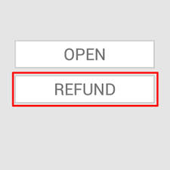

SPECIAL SERVICES SECTION
YEAR END 2021

Slide 19
Special Services Section
Overview
Prior to INFORMS, the Special Services Section used to process miscellaneous refunds less than $2,000 and Tax Collector (TC) refunds less than $10,000. This section now processes all type of refunds regardless of the amount.
Refunds may occur for numerous reasons such as: tax overpayments, refundable deposits for reservations at Parks & Recreation facilities, witness fees, or any other miscellaneous refunds and payments such as the Save Our Senior checks.
Refund payments can only be issued via check, and they are processed in INFORMS as Single Payment Vouchers.
Single Payment Vouchers online Informs training: FIN201 – Guide, Lesson 2.
https://www.miamidade.gov/global/humanresources/training/informs.page

Slide 20
Special Services – Key Dates
Single Payment Vouchers – need to be fully approved at department level by Monday September 20
Stop Payments/Cancellations, Affidavits & documentation needs to be submitted to Special Services by Friday September 17. Reissues may not be processed until the new Fiscal Year 2022.
Please email all supporting documentation to: (FIN) SSC Group

Slide 21
Special Services – Transition to Informs
I - Original Refund Payment Requests:
SSCRA - Old Platform | INFORMS
Departments or Finance uploaded refund payments request files into the SSC platform | Departments initiate Single Payment Vouchers for refunds in Informs. Finance does not initiate payments in the system. *In order to Initiate this request, Departments need to have at least two staff with the Dept. AP Processor and Dept. AP Approver roles. For segregation of duties, these roles should not be assigned to the same staff.*
After uploads, Departments sent Finance the supporting documentation of files uploaded into SSC | Supporting documentation is uploaded and attached to the Single Payment Voucher when initiated at the Department level. Originals are kept by Depts. *Single Payment Vouchers with NO supporting documentation, or supporting documentation with low quality of legibility or NOT legible, will be rejected back to the departments.*
FIN SSC staff reviewed outside the system the supporting documentation received before approving or rejecting in SSC the uploaded refund request files. | Central FIN Compliance Officer (SSC Staff) reviews and approves/denies in INFORMS the Single Payment Vouchers and their corresponding support.
Finance transmitted to the bank approved files for check issuance. | Finance runs pay cycles in INFORMS which will pick up approved vouchers awaiting payment.
Finance and Depts. prepared Journal Entries to book expenses into FAMIS for checks issued through SSCRA. | No journal entries are required. Chart Fields are entered when the Single Payment Voucher is initiated. Depts. can add multiple lines as needed. Further reclassifications, if any, are processed as journal vouchers in INFORMS.
Payment Description printed on the remittance advice of the checks | Information on the "Message Field" located under Payment Options, in the Payments Tab of the Single Payment Voucher is printed as the remittance advise of the check. - Departments do not have access to this field right now. Defect was logged – No resolution yet. - Alternatively, Departments can add the remittance advice to the Payments Note link (same location as message field). Finance will paste it to the Message Field.

Slide 22
Special Services – Transition to Informs
II - Checks Re-issue for Refund Payments Initiated in Informs:
SSCRA - Old Platform | INFORMS
Finance scanned and emailed Departments affidavits received and checks returned by mail | No change *Affidavit link: lostckreplace.pdf (miamidade.gov)
Departments reviewed received affidavits and returned checks, completed and provided FIN with the approved "Outstanding Checks-Cancelation/ Stop Payment Authorization Form". When applicable, additional supporting documentation was provided together with the Cancelation/Stop Payment forms. | No Change *To ensure you are always using the most updated form, please always download it from below link: https://www.miamidade.gov/finance/library/stoppaymentreq.pdf
SSC Staff received/reviewed documentation from Depts. and submitted to FIN Approvers. | No Change
For approved cancellations/stop payments forms: Finance first voided/stopped outstanding checks with the bank. Then prepared and uploaded a file to SSCRA of checks to be re-issued. | FIN Approvers (AP Manager/Supervisor/ Compliance Spec.) will: Void & leave vouchers open for the re-issue of the checks, or Void checks and cancel their vouchers (total cancellation) when checks do not need to be re-issued. *Finance will not void-reissue or total cancel any checks without properly approved supporting documentation.* * Supporting documentation with low quality of legibility or NOT legible will not be accepted as backup.*
Departments sent original documents to Finance for records keeping purposes. | Documents uploaded into INFORMS are stored in Documentum which is considered the official records repository of the County. Originals are kept by the Depts.
Finance prepared the Journal Entries to reverse entries posted when the original checks were requested. | No entries needed for re-issues, same voucher generated for the original payment request is used. For total cancellations, entries are reversed when vouchers are canceled.

Slide 23
Special Services – Transition to Informs
III - Checks Re-issue for Refund Payments Initiated in SSCRA (Legacy):
These instructions apply only to SSC checks outstanding as of 03/31/2021
The review process, required paperwork, and steps to cancel/void checks remains the same as before conversion to INFORMS.
Once the cancelation/stop payment form is approved by FIN Approvers and the check is voided with the bank, SSC staff will email back to the Departments the approved documents and bank confirmation of the checks being voided/cancelled. Finance will prepare and post to INFORMS the required reversing journal entries.
Departments will initiate re-issues in INFORMS the same way as original requests originated in INFORMS (section I). Departments must upload as attachments the supporting documentation for the re-issue: i.e. fully approved cancellation/ stop payment form, affidavit from payee(s) if applicable, bank confirmation of voided/cancelled check (required) and any other supporting documentation. *DO NOT initiate a re-issue until Finance provides confirmation that the check to be reissued was voided at the bank. Failure to do this may result in duplicated payments and/or double accounting or rejection by FIN of the reissue.*
To be consistent, and to be able to track re-issues of checks outstanding as of 03/31/21, please use this format in INFORMS for the invoice number: original CHECK#-REISSUE, e.g. 123456-REISSUE.
For reissues, the remittance advice entered in the Message field of the Payments tab, should be the same description as the original issue. Refer to section I for more information of the Message Field.
The SSC Group will send independent emails to the departments with the supporting documentation of checks already voided and ready to be re-issue in informs. Departments should initiate the Single Vouchers in Informs.

Slide 24

TRAVEL
YEAR END 2021

Slide 25
2021 Year-End Travel Deadlines
  All Fiscal Year 2021 County travels need to be closed prior to Wednesday, 9/22/2021.
  Please forward to AP Finance all Travel Expense Reports (TER) and related supporting documentation.
  We will be sending email reminders by department of pending close-outs by traveler.
  Travels occurring on/or before September 30, place a 2021 notation on Travel Request Form (TRF) and/or on Travel Expense Reports (TER) if “old year” expense (FYE 2021) or “new year” expense (FYE 2022), for proper posting of expenditure.

Slide 26
Travel Policy & Procedures
Key Reminders
Conference hotel exceeding the daily maximum - Allowable lodging rate may be exceeded; however, proof of such destination must be attached to travel request. If it is not a conference hotel and rate exceeds the maximum allowable lodging, a written justification provided by the Department Director or designee needs to be attached to the traveler’s Travel Request Form (TRF) stating why it is in the best interest of the County to pay for the excess rate and have the traveler stay at selected hotel.
Definition of MDC Immediate Vicinity - Lodging expense reimbursement are not provided for travel within the immediate vicinity of Miami Dade County, defined as the area between West Palm Beach and Marathon Key.
Approvals - Travel for employees must be authorized by the Department Directors or designee. Proof of available travel budget funds must be provided. If budget is not available, the travel request form must also be authorized by the department’s Budget Analyst in OMB before TRF can be routed for final approval to the Mayor’s Office.
Approval & Submittal -Travel Request Forms must be approved and submitted before travel occurs and/or charges are incurred on the County’s Travel Card.
Electronic approvals/signatures are currently accepted.

Slide 27
Travel Policy & Procedures
Key Reminders
Travel agent fees - are NOT reimbursable expenses (except in extreme and unusual cases, which must be accompanied by a memo signed by the Department Director stating the saving and benefits to the County)
All TRF submitted to Finance must include proof of three airfare quotes demonstrating that the most economical fare was purchased.
Purchase of the Collision Damage Waiver insurance is required on rental vehicles.
Travel expenditures not allowed include but are not limited to - seat upgrades and/or seat reservations, airline upgrades, tips, porter charges, valet parking, etc. (Refer to pg. 46 of the Travel Policy and Procedures for further guidance)
INFORMS Chart Fields: To avoid delays on processing Travel requests, the forms must come accompanied with the appropriate chart fields.
For travel related inquiry/request, email (FIN) Travel Group.
Travel Policy and Procedures can be found at:
http://intra.miamidade.gov/managementandbudget/procedures.asp

Slide 28
Travel Policy & Procedures
Issues Delaying Processing Travels
Experienced staff is retiring and the duties to prepare travels are distributed among several staff.
Recommendation: designate one (or two for backup) individuals at the department level to prepare travels. Please refrain from designating too many travel liaisons.
To reduce the number of errors: training, training, training…
Risk of duplicating payments if registrations are submitted through the travel package and then paid again as a Payment Request on INFORMS or through the P-Card.

Slide 29

Purchasing/Travel
Cards
Year End 2021

Slide 30
P-Card Program Policy Reminders – Prohibited Items
Certain types of purchases are strictly prohibited by the P-Card policy. Such purchases include, but are not limited to:
Personal purchases of any kind (personal purchases are defined as purchases of goods or services intended for non-work related use or use other than for official County business)
Donations or gifts to a charity, gift to an entity, floral arrangements or political contribution.
Fuel for personal cars, since use of personal vehicle expenses are compensated via mileage reimbursement, in accordance with A.O. 6-3.
Gift cards (unless allowed by specific programs and/or funding sources), stored value cards, calling cards, pre-paid cards or similar products
Entertainment type venues/establishments
Food and/or beverages for internal meetings or employee gatherings are prohibited. Food and/or beverages for community events or meetings are permitted only if specifically allowed by funding source.
Alcoholic beverages
Tobacco products

Slide 31
P-Card Policy Reminders – Prohibited Items
Goods and services available on an existing County contract
Purchase of computers, iPhones, iPads and other wireless communication devices which are done via ITD, in accordance with A.O. 5-5.
Non- Emergency maintenance on County vehicles, handled by ISD Fleet Management Division.
Please immediately notify a Finance Department P-Card Administrator if a cardholder terminates employment with the County or transfer to another department.
Refer to the P-Card Policies and Procedures under the Finance Department website:
http://intra.miamidade.gov/finance/purchasing-card.asp

Slide 32
P-Card Reconciliations -
Key Reminders
Review monthly reconciliations carefully and question items that do not appear to be for the proper use of public funds and/or not eligible.
Please make sure all reconciliations are prepared timely and submitted to Finance by the 30th of every month.
When card is used for travel related expenses, the Travel Request Form (TRF) needs to be properly authorized by the Office of the Mayor. The approved TRF is needed for override requests and must be submitted with the reconciliation.
If sales tax was charged, please try to get reimbursed or provide proper documentation with reconciliation as to efforts employed.
Authorized signers cannot approve their own P-card reconciliations and supporting documentation.
The cardholder or employee receiving the products or services should sign (or an equivalent, e.g. email) and date the receipt/invoices as acknowledgement that the products and services were received in accordance with purchasing terms.
Due to COVID-19, we are accepting PDF copies of the P-card reconciliations and supporting documentation via email (group: (FIN) P-Card Reconciliations). We are also accepting P-card reconciliation approvals from the authorized signors via email and PDF electronic signatures.

Slide 33
P-Card Journal Vouchers – Expense Reclassifications
Reclassify P-card expenditures to the appropriate chart fields prior to the closing of each quarter*.
Finance records journal vouchers to the chart fields associated to each cardholder for the total expenses incurred during the month. Purchase/Dual card expenses are posted to account 5330520000, Travel cards to 5312150000 (Accounts reserved for Finance use)
Departments should further reclassify Finance postings based on purchases type to the appropriate chart fields and accounts.
To reverse transactions posted by Finance, Departments must credit 5330530000 when reclassifying Purchasing/Dual cards, and 5312160000 for Travel Cards. (Accounts reserved for Departments use).
P-card reclassification Journal vouchers are initiated and approved at the department level first. They are latter routed to the AP Compliance Officer and approved by staff of the P-Card unit.
Reclassification Journal Vouchers for P-Card Transactions – need to be fully approved at department level by Thursday September 30 to allow time for Finance approvals before closing of the books.

Slide 34
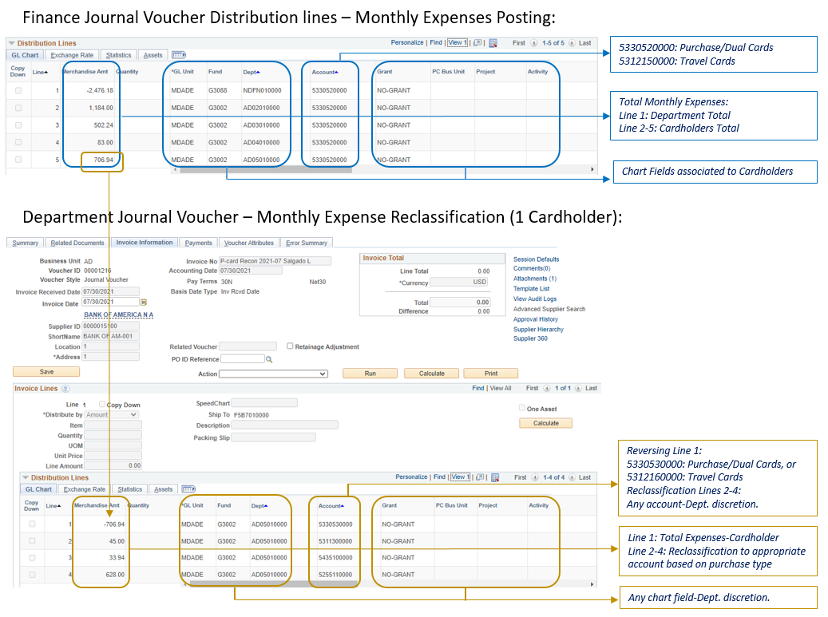
P-Card Journal Vouchers – Expense Reclassifications

Slide 35
P-Card Program Statistics
Fiscal Year 2019/20
Active Cards: 469
Total Spending: $13,551,825.13
Monthly Average Spending: $1,129,319
Number of Transactions: 23,557
  Fiscal Year 2020/21
Active Cards: 494
Total Spending: $20,277,531
Monthly Average Spending: $1,689,794
Number of Transactions: 23,720
Data includes Enterprise Transactions by Aviation, WASD, Housing

Slide 36


Questions
Please enter all your questions in the chatbox. Responses to all questions posted in the chat will be sent via email to all attendees.

Slide 37

Thank You & Stay Safe

