Slide 1
Finance Department Fiscal Year-End 2022 Presentation
Accounts Payable & Construction Payables
September 16, 2022
Disclaimer: Please note that the audio and other information sent during the webinar will be recorded. By participating in this webinar, you automatically consent to such recording and to subsequent use of the recording.

Slide 2
Agenda
Welcome/Introduction
Construction Payable
Accounts Payable
Key Dates
Special Services/Travel
P-Cards
Adjournment

Slide 3
Introduction
Welcome
Please submit all questions through the Teams chat so they can be compiled and distributed to all attendees.
Temporarily located on 25th floor
Official Days for Cashiering Services – TUES & THUR
Payment Runs:
ACH – MON - FRI
CHECKS GOA – TUES & THUR
CHECKS SSC – WED
TRAVEL ADVANCES & REIMBURSEMENTS - WED

Slide 4
Capital & Construction Payable Section

Slide 5
Capital & Construction Payments Deadlines
Construction Payments Cut-Off:
Email Francisco Garcia at FKG@miamidade.gov all construction invoices by Friday, September 30, 2022 at noon.
If submitting invoices for services rendered in fiscal year 2022, please remember to process purchase order increases and reclassifications prior to September 30th, 2022. POs must be in “Dispatched Status” to be able to process the invoices
Errors and Tips to minimize unnecessary voucher rejections:
Although significant progress has been made with the construction payments in comparison to last year, the Capital Construction Group continues to receive invoices with the following recurring errors:
Payments being applied to the incorrect accounting chartfields. For example, incorrect Fund, Capital Project and Account Number. This can be prevented by verifying that the information entered on the voucher matches the Construction cover sheet
Invoice Remit to Address on the voucher does not match the Remit to Address on the invoice. This error can be prevented by checking the invoice address in INFORMS under Finance/Supply Chain, Payables Operations, Accounts Payable WorkCenter, Supplier Inquiry screen
As a suggestion, we encourage department approvers to always open the invoice attachment and compare it with the voucher to minimize most of the existing errors

Slide 6
Other Important Construction Reminders
Expenditures incurred in INFORMS should be reclassified via journal voucher in the AP Module and expenditures incurred in FAMIS should be reclassified via journal entry in the GL Module. If needed, retainage payable can also be reclassed or reduced from the Retainage Tracker by Supplier table in the Accounts Payable WorkCenter. The Retainage Maintainer role is needed to perform that function
Some capital related journal entries require OMB approval. Please submit your end of year journal entries as soon as possible to allow sufficient time for such review and approval. The deadline for journal entries is 10/14/22.
For assistance with the creation of construction parent and child contracts in INFORMS, please contact Connie White and Janice Bandhu
For assistance with purchase orders or to correct PO discrepancies, please contact Thomas Burns and Yuly Chaux-Ramirez
To report payment issues with construction invoices, please contact Main Finance Accounts Payable and/or the Capital Construction Section. In addition, the INFORMS Accounts Payable Module Liaison is Karen Manjarres

Slide 7
Fixed Assets Reminders
Physical Inventories were due to ISD on 7/31/22. If your department requested an extension, your inventory is due on 9/30/22. There are no additional extensions.
The acquisition of a capital assets through the procure-to-pay process, needs to be indicated in the P.O., receipts and / or AP Voucher so an asset is created in the Asset Management Module.
The preferred way is when the PO is created. If the asset is not flagged in the PO or at the time of payment, it must be manually added.
Many departments are not creating their Assets in the Asset Management Module, because the assets are not being flagged properly in the procure-to-pay process.
Construction in Progress (CIP) assets relating to capital projects, should be created in the Project Costing Module and the transactions be assigned to the CIP asset.

Slide 8
Fixed Assets Reminders
For FY 2022, Central Finance is creating capital assets and CIP assets in the Project Costing & Asset Management modules for the General Segment Departments, so we can close FY 2022. However, we need the departments to flag capital assets correctly going forward to ensure proper recording of capital assets
Enterprise funds are responsible for identifying and creating their assets in INFORMS
If you need assistance, please reach out to the INFORMS team. The points of contact in case of questions or if additional training is needed are:
Marlene Amaro – Project Costing Module
Marilyn Crucet – Asset Management Module
Additionally, the following job aids are available:
FIN 202 - Asset Management Accounting
FIN 209B – Capital Projects

Slide 9
Fixed Assets Reminders
The following reports are available in INFORMS and may be used to reconcile your capital assets:
Report Name | Description | Report Type
MD_AM0255_ASSET_DETAIL_REPORT | Asset Detail Report | Schedule Query
MD_AM0259_ENT_ASSET_DETAIL_RPT | Enterprise Asset Detail Report | Schedule Query
If you foresee any additional fixed assets issues for this year’s closing, please inform our department and we will assist you the best way possible

Slide 11
Accounts Payable Agenda 2022 Year-End
Important Dates & Other AP Updates
Vouchers Payable
Special Services/Refunds Reminders
Travel Reminders
P-Card Reminders

Slide 12
What’s New in Accounts Payable?
P-card and Travel (T&E) Module went live July 2022
Procedures available at:
http://intra.miamidade.gov/managementandbudget/procedures.asp

Slide 13
Important Dates
2023 Forms are due Monday, September 26, 2022
Forms are located at: http://intra.miamidade.gov/finance/forms.asp
Accounts Payable Wire Transfer Authorized Signatures Form
Travel Authorized Signatures Form
Accounts Payable Liaisons Form
Accounts Payable Purchasing and Travel Card Liaisons Form
Accounts Payable Travel Liaisons Form
*All Individuals listed on Authorized Signature Forms must read through AP Procedure 606 prior to signing.

Slide 14
Important Dates
Thursday, Sept 23rd – Last day to dispatch a FYE 2022 PO or process a change order on a FYE 2022 PO
Wednesday, Sept 28th – Last day to drop FY22 interface files. FY23 files can be submitted beginning Tuesday, Oct 11th
Monday, Oct 3rd (Noon) – Cutoff for scanning all FYE 2022 invoices
Wednesday, Oct 5th (Noon) – Receipt creations
Delays in receipt creation will delay invoice processing
Wednesday, Oct 5th (Noon) – Cutoff for final approval of Payment Requests, PO invoices, adjustment vouchers (credit memos) and wires/ACH Debits by Departments
Saturday, Oct 8th – PO Rollover Process (INFORMS Team)
Tuesday, Oct 11th (Noon) – Cutoff to approve Journal Vouchers by Departments
Friday, Oct 14th – Cutoff for Accrual GL Journal Entries
Monday, Oct 24th – Reports available for Self Service

Slide 15
Indicating Old vs New Year
During the time of October 1 – 5, Departments should suspend processing invoices for 2023 and focus on getting as much of FYE 2022 items processed to avoid large accruals.
Finance Shared Services will be processing all invoices as they come in until October 3rd at which point invoices received after the cutoff will be held until AP finishes processing FYE 2022 on October 7th.
Departments must identify the applicable FY for all invoices processed between October 1st and October 5th, must be identified as FYE 2022 or FYE 2023.
Indicate in Comments
Indicate in Invoice Description
AP will be changing the Accounting Date for FY22 invoices between Oct 1 – Oct 5.
FY 22 invoices that are not scanned by October 3rd or approved by the department by October 5th at noon, should be accrued.
To facilitate the PO Rollover Process: PO Vouchers (GAS, CON, & REL) and adjustment vouchers not approved by the department by October 5th will be DELETED. This includes vouchers in error. Once the PO Rollover takes place, previously deleted vouchers will be re-triggered.

Slide 16
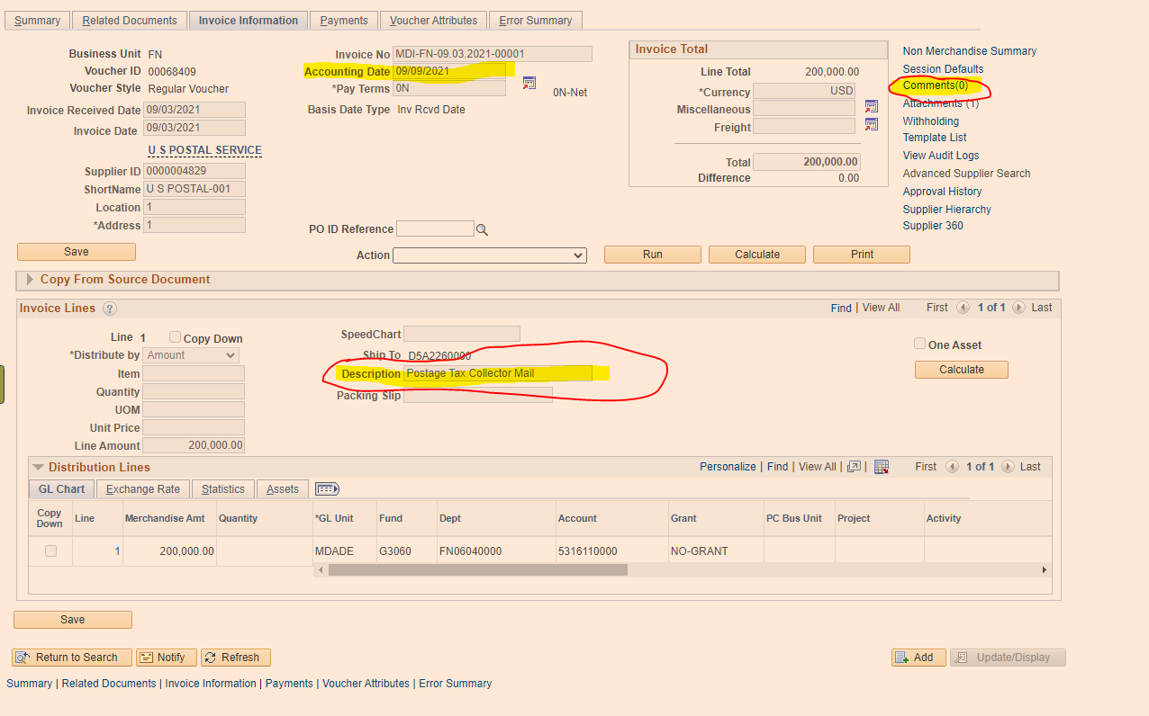
Indicating Old vs New Year

Slide 17
Accounts Payable Accruals
The deadline to submit AP Accruals via GL Journal entry is Friday, October 14th. As support for the GL Journal Entries, please attach the query used to determine the accruals and indicate which invoices are being accrued for.
We are in the process of designing a query which will include all AP items not fully approved. This query will list all potential AP Liabilities to be analyzed for accrual, which are currently found in the below existing queries.
Voucher Status | Query
Pre-Edit Error & Voucher Build | Quick Inv Pending VCH Build
Unposted | Vouchers Pending Approval
Error | Vouchers in Error
Voucher Exceptions | Budget Check Errors
*PO Vouchers (GAS, CON, & REL) and adjustment vouchers not approved by the department by the deadline will be DELETED. Therefore, they will not appear in the queries beginning, 10/6/2022 until they are re-triggered after the PO Rollover.

Slide 18
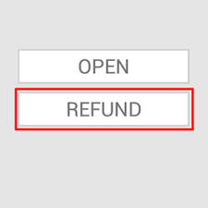
SPECIAL SERVICES

Slide 19
Special Services Overview
Prior to INFORMS, the Special Services Section used to process miscellaneous refunds less than $2,000 and Tax Collector (TC) refunds less than $10,000. This section now processes all type of refunds regardless of the amount.
Refunds may occur for numerous reasons such as: tax overpayments, refundable deposits for reservations at Parks & Recreation facilities, witness fees, or any other miscellaneous refunds and payments such as the Save Our Senior checks.
Refund payments can only be issued via check, and they are processed in INFORMS as Single Payment Vouchers.
Single Payment Vouchers online INFORMS training: FIN201 – Accounts Payables: Create and Process non-PO Vouchers Guide, Lesson 2. https://www.miamidade.gov/global/humanresources/training/informs.page

Slide 20
Special Services – Important Dates
Stop Payments/Cancellations, Affidavits & documentation needs to be submitted to Special Services by Wednesday, September 21st.
Single Payment Vouchers including reissues need to be fully approved at department level by Monday, September 26th.
Please email all supporting documentation to: (FIN) SSC Group.

Slide 21
Special Services – Reminders
I - Original Refund Payment Requests:
Departments initiate Single Payment Vouchers for refunds in Informs.
In order to Initiate this request, departments need to have at least two staff with the Dept. AP Processor and Dept. AP Approver roles. For segregation of duties, these roles should not be assigned to the same staff.
Supporting documentation is uploaded and attached to the Single Payment Voucher when initiated at the Department level. Originals are kept by Depts. Single Payment Vouchers with NO supporting documentation or low-quality (must be legible) supporting documentation will be rejected.
Central FIN Compliance Officer (SSC Staff) reviews and approves/denies Single Payment Vouchers and their corresponding support within INFORMS.
Finance runs pay cycles in INFORMS on Wednesdays. The pay cycle will pick up approved vouchers awaiting payment.
No journal entries are required to post transactions to the system. Chart Fields are entered when the Single Payment Voucher is initiated. Departments can add multiple lines as needed. Further reclassifications, if any, are processed as journal vouchers in INFORMS.
The "Message Field" located under Payment Options, in the Payments Tab of the Single Payment Voucher is required as it is printed as the remittance advise of the check.

Slide 22
Special Services – Reminders
II - Checks Re-issued for Refund Payments Initiated in Informs:
Finance scans and emails Department affidavits received, and checks returned by mail.
Affidavit link: lostckreplace.pdf (miamidade.gov)
Departments review received affidavits and return checks, complete and provide FIN with the approved "Outstanding Checks-Cancelation/ Stop Payment Authorization Form".
Provide additional supporting documentation, when applicable.
To ensure you are always using the most updated form, please always download it from below link: https://www.miamidade.gov/finance/library/stoppaymentreq.pdf
Central Finance reviews documentation from departments, voids the checks, and returns the fully approved package to departments to be used as supporting documentation for the re-issued vouchers.
Finance will not void-reissue or total cancel any checks without properly approved supporting documentation.
Documents uploaded into INFORMS are stored in Documentum which is considered the official records repository. Originals are kept by the Departments.
No GL journal entries are needed for re-issues. The voucher generated for the original payment request is used. For total cancellations, entries are reversed when vouchers are canceled.

Slide 23
Special Services – Reminders
III - Checks Re-issue for Refund Payments Initiated in SSCRA (Legacy):
These instructions apply only to SSC checks outstanding as of 03/31/2022
The review process, required paperwork, and steps to cancel/void checks remains the same as before conversion to INFORMS.
Once the cancelation/stop payment form is approved by FIN Approvers and the check is voided with the bank, SSC staff will email back to the Departments the approved documents and bank confirmation of the checks being voided/cancelled. Finance will prepare and post to INFORMS the required reversing journal entries.
Departments will initiate re-issues in INFORMS the same way as original requests originated in INFORMS (section I). Departments must upload as attachments the supporting documentation for the re-issue: i.e. fully approved cancellation/ stop payment form, affidavit from payee(s) if applicable, bank confirmation of voided/cancelled check (required) and any other supporting documentation.
DO NOT initiate a re-issue until Finance provides confirmation that the check to be reissued was voided at the bank. Failure to do this may result in duplicated payments and/or double accounting or rejection by FIN of the reissue.
To be consistent, and to be able to track re-issues of checks outstanding as of 3/31/22, please use this format in INFORMS for the invoice number: original CHECK#-REISSUE, e.g. 123456-REISSUE.
For reissues, the remittance advice entered in the Message field of the Payments tab, should be the same description as the original issue. Refer to section I for more information of the Message Field.
The SSC Group will send independent emails to the departments with the supporting documentation of checks already voided and ready to be re-issue in informs. Departments should initiate the Single Vouchers in Informs.

Slide 24
TRAVEL

Slide 25
What is New in Travel?
The Travel & Expense module went live on July 1st, 2022.
The transition to INFORMS does NOT represent a change to the Travel Policies and Procedures. This transition is only changing the way travel requests are prepared and approved, from a paper submission to an electronic approval flow within INFORMS.
Finance has sent notification emails to the Departments’ AP and Travel Liaisons about some updates to the Travel business process. To receive a copy of the emails, please contract the Travel Group (fin-tg@miamidade.gov).
Online Resources
BPW Recording and PowerPoint Presentation
https://secure.miamidade.gov/employee/informs/business-process-workshop-rollout-2.page
Training Materials
FIN 214 – Travel and Expenses: Travel Authorization
FIN 215 – Travel and Expense Report
https://www.miamidade.gov/global/humanresources/training/materials-rollout-2.page

Slide 26
Travel – Important Dates
All Fiscal Year 2022 County travel need to be fully approved by Wednesday, September 21,2022.
Travels processed outside of Informs: Please forward to AP Finance all Travel Expense Reports (TER) and related supporting documentation. Travels occurring on/or before September 30 - place a 2022 notation on Travel Request Form (TRF) and/or on Travel Expense Reports (TER) if “old year” expense (FYE 2022) or “new year” expense (FYE 2023), for proper posting of expenditure.
Travels processed in INFORMS: Please ensure all Expense Reports (ER) are fully approved at the Department Level, and their related supporting documentation is attached to the request.
We will be sending email reminders by department of pending close-outs by traveler.

Slide 27
Travel Policy & Procedures Key Reminders
Cash Advances: A comment MUST be added to the Travel Authorization.
Conference hotel exceeding the daily maximum – The allowable lodging rate may be exceeded if proof of conference hotel location is attached to the travel request. If lodging is not at a conference hotel and exceeds the maximum allowable rate, a justification memo from the Department Director/designee needs to be attached to the travel documents stating why it is in the best interest of the County to pay for the traveler to stay at the selected hotel.
Definition of MDC Immediate Vicinity - Lodging expense reimbursements are not provided for travel within the immediate vicinity of Miami Dade County, defined as the area between West Palm Beach and Marathon Key.
Approvals – Travel requests are now approved electronically through INFORMS. Departments must complete and submit a security form every time their security access needs to be updated. Travel documents are no longer routed to OMB Budget Analysts. They are systematically budget checked.
Approval & Submittal -Travel Authorizations must be approved before the travel occurs and/or charges are incurred on the County’s Travel Card.

Slide 28
Travel Policy & Procedures Key Reminders
Travel agent fees - are NOT reimbursable expenses (except in extreme and unusual cases, which must be accompanied by a memo signed by the Department Director stating the savings and benefits to the County)
All Authorization forms initiated in INFORMS must include proof of three airfare quotes demonstrating that the most economical fare was purchased.
Purchase of the Collision Damage Waiver insurance is required on rental vehicles.
Travel expenditures not allowed, include but are not limited to - seat upgrades and/or seat reservations, airline upgrades, tips, porter charges, valet parking, etc. (Refer to pg. 46 of the Travel Policy and Procedures for further guidance)
For travel related inquiry/request, email (FIN) Travel Group.
It is the traveler’s and the department travel liaison’s responsibility to keep track of the approval flow of Travel Authorizations in INFORMS to ensure that the Travel Authorization is fully approved prior to the travel date. Travelers who travel without a proper approval are in violation of the County Travel Policy.

Slide 29
Travel Policy & Procedures Issues Delaying the Travel Process
System errors. Report ALL errors you encounter through a remedy ticket.
INFORMS Pre-paid expense definition: Expenses paid with County funds. Expenses paid by the traveler are NOT pre-paid expenses. They should be coded as ‘check’ and are considered for calculating travel advances.
Recommendation: designate a limited group individuals at the department level to specialize in preparing travels in accordance with the MDC Travel Policy.
To reduce the number of errors: train your staff by reviewing the resources available online, and guidance provided by central finance.
Travel Policy and Procedures can be found at: http://intra.miamidade.gov/managementandbudget/procedures.asp

Slide 30
Travel & Expenses Module Queries
Helpful queries available in Query Viewer

Slide 31
Purchasing/Travel Cards

Slide 32
What is New in P-Card?
The Purchasing Card module went live on July 5th, 2022
The transition to INFORMS does NOT represent a change to the P-Card Policies and Procedures. This transition is only changing the way p-card transactions are prepared, reconciled and approved, from a paper submission to electronically in INFORMS.
Starting on July 5th, 2022 (Statement Date August 04th, 2022), p-card transactions and their supporting documentation are reconciled and approved in INFORMS. Paper Reconciliations are not required starting with bank statement date August 04th, 2022.
Finance is working on updating some business processes and the p-card application forms. A notification will be sent to the Department AP and P-Card liaisons.
P-Cards are now shipped from the bank to the address chosen by the cardholders/liaisons: cardholders’ home or Department address.
Online Resources
BPW Recording and PowerPoint Presentation
https://secure.miamidade.gov/employee/informs/business-process-workshop-rollout-2.page
Training Materials - FIN 213 – Reconcile and Approve P-Card Transactions
https://www.miamidade.gov/global/humanresources/training/materials-rollout-2.page

Slide 33
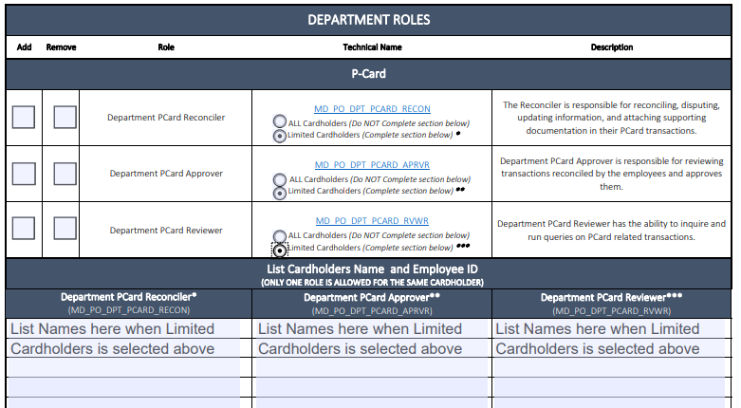
What is New in P-Card?
P-Card roles are assigned to users upon requests from the Department by completing the INFORMS security form, found in the link below:
https://www.miamidade.gov/technology/library/informs/security-form-solely-p-card-roles.pdf
The Department p-card Reconciler role must be assigned to ALL new cardholders.
Ensure page 2 of the form is properly completed (proxy assignation). List all cardholders this user (the p-card reconciler) will be reconciling, approving or reviewing for.

Slide 34
P-Card Important Dates
September 4, 2022 is the last statement posted to INFORMS for FY22.
September 21, 2022 is the deadline for departments to update transactions to ‘verified’ status which will be closed and post to FY 22.
Transactions in ‘initial’ and ‘staged’ status after September 21, 2022 will be closed and posted to FY 2023.
October 11, 2022, noon, is the deadline for departments to approve Journal Vouchers (JVs) debiting the correct accounting chart fields and crediting below chart fields. Those JVs must be reversed in new FY.
Transactions from September 5th through September 30th should be accrued via GL Journal entry by October 14, 2022. All accruals must be reversed in FY23.
October 4th, 2022 is the first statement of the new FY and includes transactions dated September 5th through October 4th. These transactions will be closed and posted via the p-card module after FY22 is closed.

Slide 35
P-Card Policy Reminders – Prohibited Items
Certain types of purchases are strictly prohibited by the P-Card policy. Such purchases include, but are not limited to:
Personal purchases of any kind (personal purchases are defined as purchases of goods or services intended for non-work-related use or use other than for official County business)
Donations or gifts to a charity, gift to an entity, floral arrangements or political contribution.
Fuel for personal cars, since use of personal vehicle expenses are compensated via mileage reimbursement, in accordance with A.O. 6-3.
Gift cards (unless allowed by specific programs and/or funding sources), stored value cards, calling cards, pre-paid cards or similar products
Entertainment type venues/establishments
Food and/or beverages for internal meetings or employee gatherings are prohibited. Food and/or beverages for community events or meetings are permitted only if specifically allowed by funding source.
Alcoholic beverages
Tobacco products

Slide 36
P-Card Policy Reminders – Prohibited Items
Goods and services available on an existing County contract
Purchase of computers, iPhones, iPads and other wireless communication devices which are done via ITD, in accordance with A.O. 5-5.
Non- Emergency maintenance on County vehicles, handled by ISD Fleet Management Division.
Please immediately notify a Finance Department P-Card Administrator if a cardholder terminates employment with the County or transfers to another department.
Refer to the P-Card Policies and Procedures on the Finance Department website:
http://intra.miamidade.gov/finance/purchasing-card.asp

Slide 37
P-Card – Key Reminders
Review daily transactions carefully and question items that do not appear to be for the proper use of public funds and/or not eligible.
Please make sure all transactions are reconciled/approved timely, right after they are loaded to INFORMS.
When cards are used for travel related expenses, the Informs Travel Authorization needs to be properly authorized by the Department Director or designee and the Office of the Mayor prior to using the p-card to pay. The approved Travel Authorization is needed for override requests and must be uploaded to INFORMS as supporting documentation of expenses paid with the p-card. The Travel Approval document must include the breakdown of the total expenses for the travel and the INFORMS approval path to show the date it was fully approved.
If sales taxes were charged, please try to get reimbursed or provide proper documentation as support as to efforts employed.
Authorized signers cannot approve their own P-card reconciliations and supporting documentation. INFORMS will not allow the same user to reconcile and approve for the same cardholder
The cardholder or employee receiving the products or services should sign (or an equivalent, e.g. email) and date the receipt/invoices as acknowledgement that the products and services were received in accordance with purchasing terms.
Due to COVID-19, we are accepting PDF copies of the P-card reconciliations and supporting documentation (up to Statement date July 04th, 2022 – before INFORMS) via email (group: (FIN) P-Card Reconciliations). We are also accepting P-card reconciliation approvals from the authorized signors via email and PDF electronic signatures.

Slide 38
P-Card Journal Vouchers – Expense Reclassifications Only Applies to P-Card transactions up to July 4, 2022
Reclassify P-card expenditures to the appropriate chart fields prior to the closing of each quarter.
Finance records journal vouchers to the chart fields associated to each cardholder for the total expenses incurred during the month. Purchase/Dual card expenses are posted to account 5330520000, Travel cards to 5312150000 (Accounts reserved for Finance use)
Departments should further reclassify Finance postings based on purchases type to the appropriate chart fields and accounts.
To reverse transactions posted by Finance, Departments must credit 5330530000 when reclassifying Purchasing/Dual cards, and 5312160000 for Travel Cards. (Accounts reserved for Departments use).
P-card reclassification Journal vouchers are initiated and approved at the department level first. They are latter routed to the AP Compliance Officer and approved by staff of the P-Card unit.
Reclassification Journal Vouchers for P-Card Transactions – need to be fully approved at department level by Tuesday, October 11th, noon to allow time for Finance approvals before closing of the books.

Slide 39
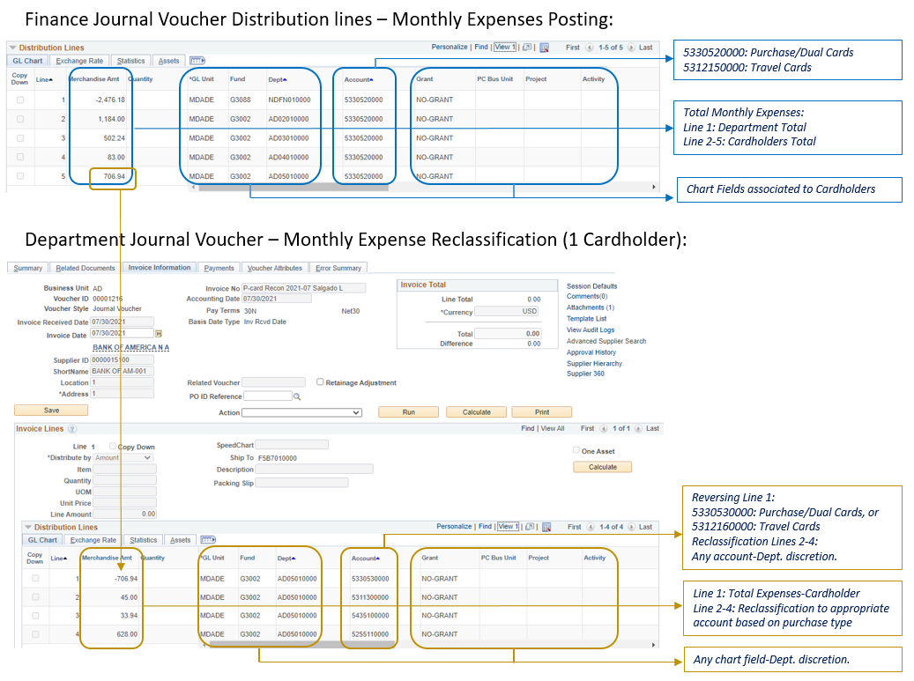
P-Card Journal Vouchers – Expense Reclassifications Only Applies to P-Card transactions up to July 4, 2022

Slide 40
Questions Please enter all your questions in the chatbox. Responses to all questions posted in the chat will be sent via email to all attendees.

Slide 41
Thank You & Stay Safe

