Slide 1
Finance Department
Year-End Presentation
FY 2022
September 16, 2022
Disclaimer: Please note that the audio and other information sent during the webinar will be recorded. By participating in this webinar, you automatically consent to such recording and to subsequent use of the recording.

Slide 2

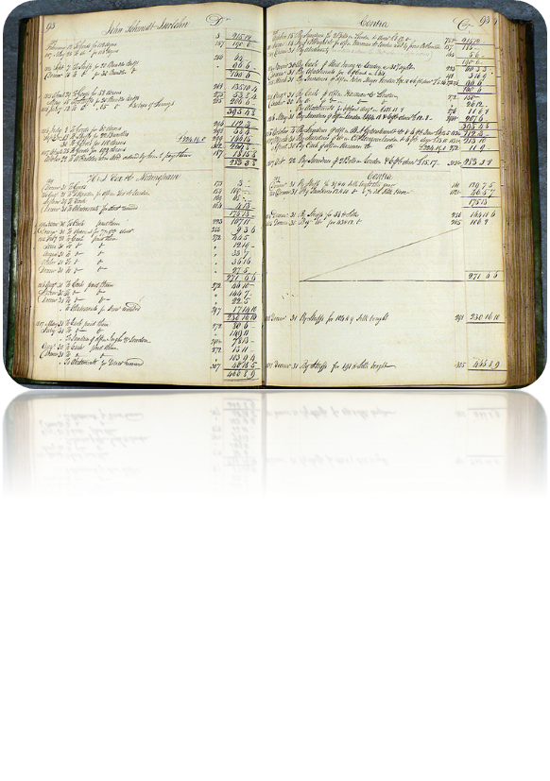
AGENDA
Financial Reporting
Speakers: Leany Perez, Assistant Controller
Eric Herrera, Financial Reporting Manager
Gabriel Ruffino, Financial Reporting Administrator
General Accounting
Speaker: Melvin Cartagena, Assistant Controller
Girsi Andreu, Finance Manager
Single Audit and FEMA
Speaker: Maria Hernandez, Assistant Controller
Business Solutions Update
Speaker: Joaquin Bello, Division Director Finance Business Solution
Questions
Enter questions in chatbox
FAQ document to be distributed

Slide 3
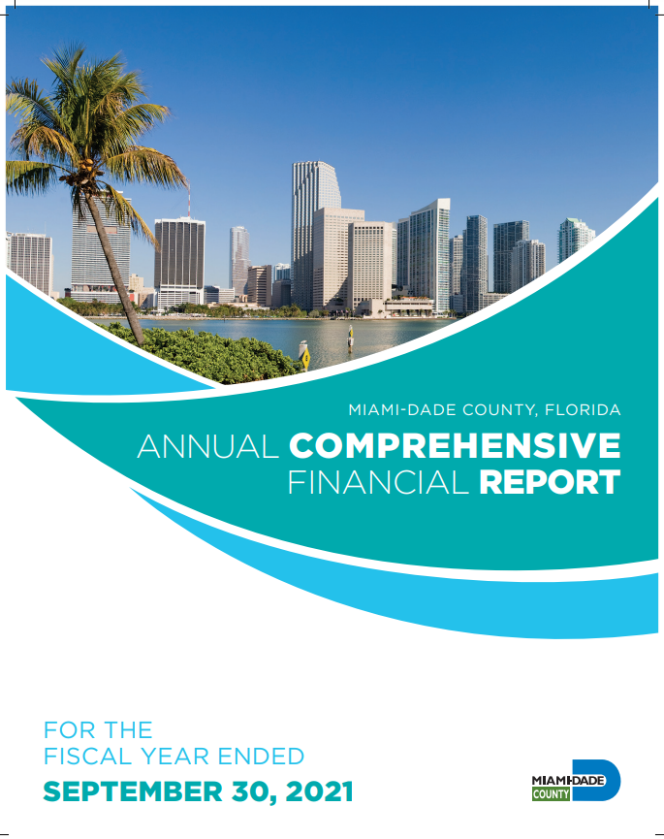
Financial Reporting
Eric Herrera and Leany Perez
Controller Division

Slide 4

Discussion Items
Introduction
Internal Control Review Project
Prior Year Audit Results
Prior Year Audit Lessons Learned
Management Representation Letter
FY 2021 GASB Statement Implementation
FY 2022 GASB Statement Implementation
Fund Folders
Storage Tanks
Conclusion

Slide 5



Introduction/Opening Remarks
Financial Reporting Team Changes
  New Team Members and Roles
    Financial Reporting:
      Arben Hankollari, Finance Control and Policy Administrator
      Kevin Willis, Accountant 2
RSM US, LLP (External Audit) Team
  Lead Auditors
    Chantelle Knowles, Sr. Manager
    Michelle Diaz, Audit Supervisor
Key External Audit Dates
  RSM Interim Audit Fieldwork (Approximately: September 6, 2022 – September 30, 2022)
  RSM Year-End Audit Fieldwork (Approximately: November 28, 2022 – April 30, 2023)
INFORMS Impact – FY 22 data will be solely from INFORMS
    Inquiry access has been provided to external auditors in INFORMS

Slide 6


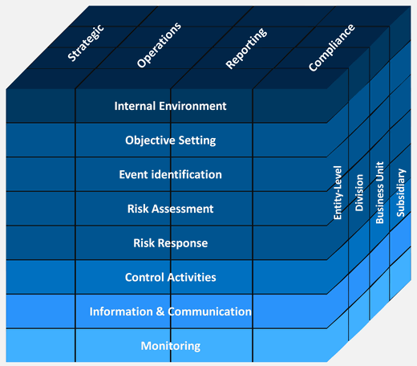

Internal Control Review Project
INFORMS Rollout 1 FSCM
  Phase 1 and Phase 2 – Complete
    Documentation and Walkthroughs
    Exit meeting will be held with each
    Department to discuss observations,
    a response with corrective action
    plan will be required.
  Phase 3 – Partially Complete
    Segregation of Duties Review
INFORMS Rollout 2 HCM
  Phase 1 and Phase 2 – Set to begin soon
    Documentation and Walkthroughs

Slide 7
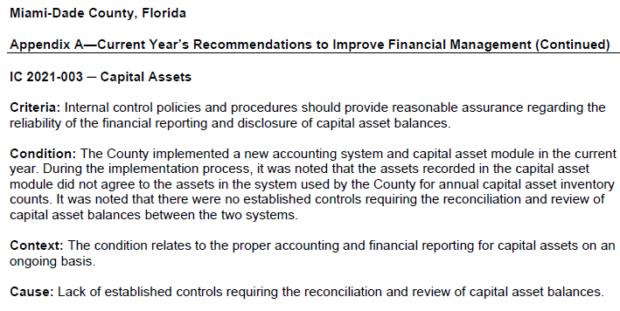
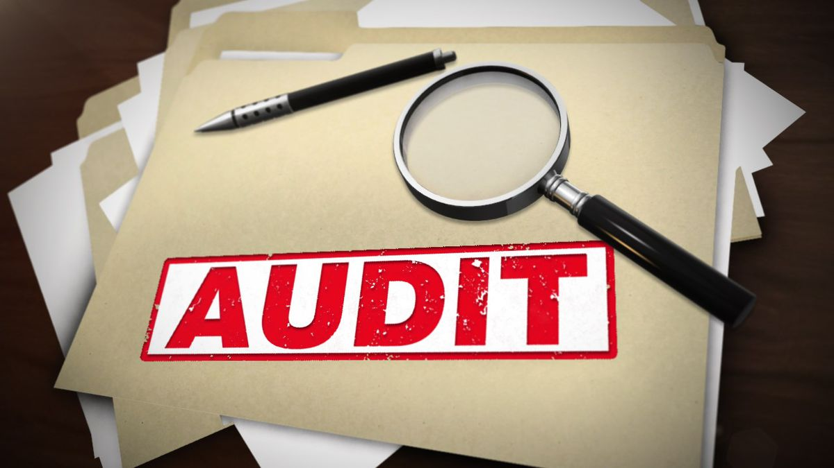
Prior Year Audit Results

Slide 8

Prior Year Audit Lessons Learned
Departmental Audit Liaisons
  Provide name of 1 or 2 department lead who will act as departmental audit liaisons for purposes of providing supporting documents and answering auditors’ follow up questions, if supports in INFORMS are not substantial
Timing of Audit Deliverables
  If Department Audit Liaisons are reached out by the external auditors, please provide supporting documentation in a timely manner in order to avoid auditors’ follow up emails
  RSM Collaborate will end in December 2022
  Suralink will replace RSM Collaborate and start in January 2023
Review of Audit Supporting Documentation
  Review of departmental supporting documents (e.g. journal entries; purchase orders; invoices; proof of payments (ACH/direct deposit, copy of check, lockbox transaction detail); bank statements; grant award documents; adopted budget ordinance; resolution/ordinance) should be performed prior to being uploaded
  **IMPORTANT** - Redact all personal and/or sensitive information (e.g. SSN, Credit Card Numbers, Health Information, Bank Account Numbers, Other Types of Protected Personal Information)
Submittal of Supporting Documentation
  Ideally, supporting documentation should be attached in INFORMS for each journal entry posted
  However, if supports are not sufficient, please upload supporting documents directly to the auditors’ website upon receiving request from auditors and avoid emailing supports
  Auditors’ website will change for final fieldwork, more information will be provided when available

Slide 9

Prior Year Audit Lessons Learned (continued)
Accounts Receivable (AR)
  GASB 65 requirement - Revenues related to AR’s not expected to be collected within our ‘period of availability’ must be reversed and recorded as Unavailable Revenue.
  The County’s period of availability is 90 days for non-grant related AR and 1 year for grant related AR
  Improvements noted - prior year audit finding was dropped, but we must continue to monitor to prevent future findings
  Adjustments should be made annually as part of the year-end close process
  Departments must analyze and record unavailable revenue for revenue accounts that they do not expect to collect within the County’s availability period of 90 days (e.g. by December 31st) and 1 year for expenditure driven (reimbursement) grants and intergovernmental revenues.

Slide 10





Management Representation Letters
Continuing prior years’ approach:
  FY 2022: Audited departments attest to the accuracy of the following:
    Financial Statements
    Completeness of Information
    Recognition, Measurement and Disclosure
    Subsequent Events
Expected Due Date: January 13, 2023

Slide 11
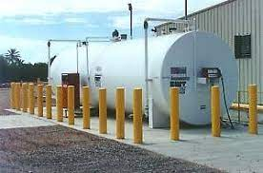

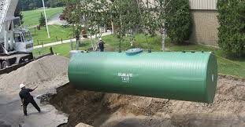
Past GASB Statements Implemented
GASB Statement No. 83, Certain Asset Retirement Obligations
Friendly Reminder:
  Email will come from Kevin Willis (Kevin.Willis@miamidade.gov)
  Email is normally sent in December of each year requesting departments to please provide us with the following:
    ARO Request Form
    GASB 83 Certification

Slide 13
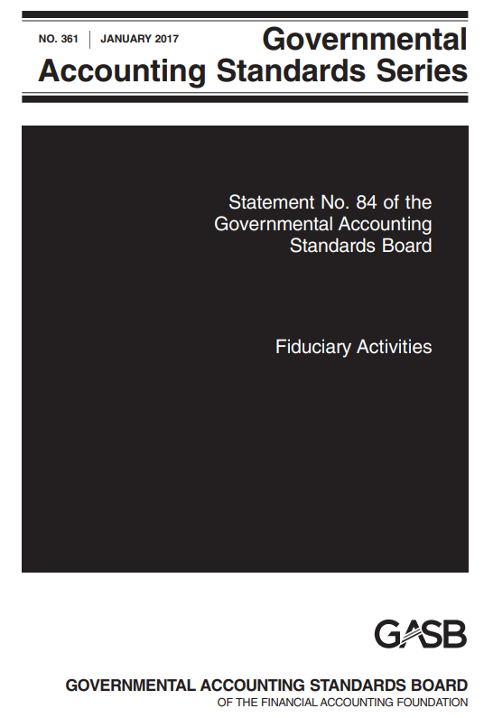
GASB Statement Implemented in FY 2021
GASB Statement No. 84, Fiduciary Activities
  Implemented during FY 2021
  The primary objective of this Statement was to enhance consistency and comparability of fiduciary activity reporting by state and local governments
  Certain governmental funds became fiduciary, and certain fiduciary funds changed to a different type of fund
  Determination Memo and flow chart is available upon request from Joanne Paul (Joanne.Paul@miamidade.gov)

Slide 14
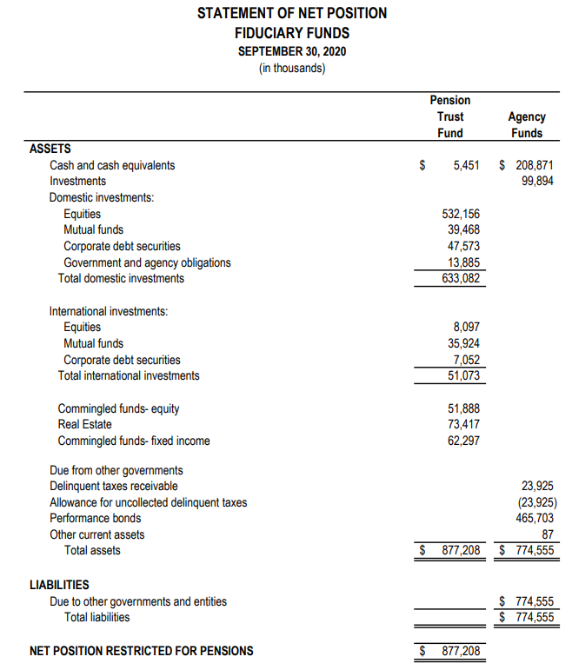
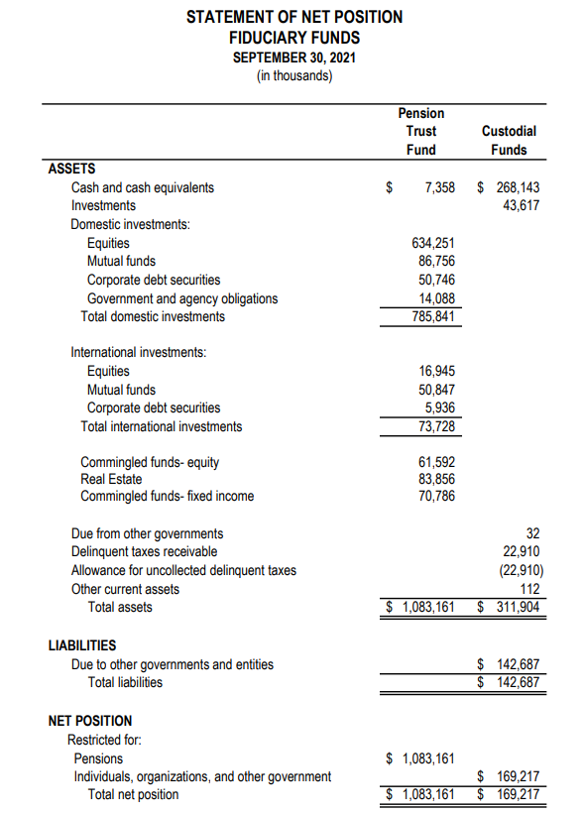
PRE and POST
GASB 84 Presentations
PRE
POST

Slide 15
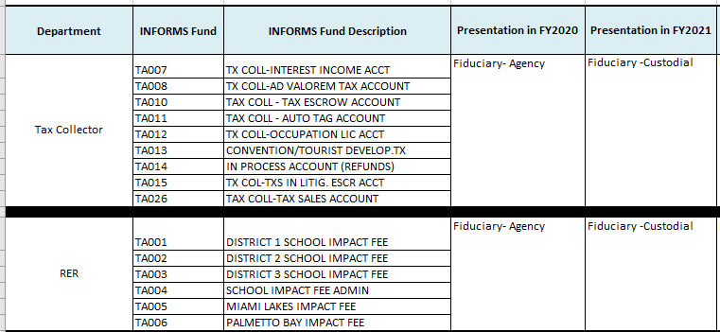
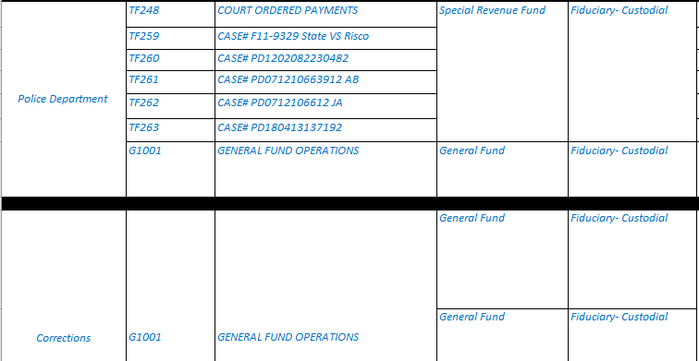
GASB 84 Fund Changes Examples

Slide 16

GASB Statement Implementation for FY 2022
GASB 87, Leases
Finance has executed an agreement with RGP for consulting services to assist with the lease implementation
Implementation Goals:
  Finance has obtained the list of all department lease liaisons
  Any changes to department lease liaisons notify Gabriel Pena (Gabriel.Pena@miamidade.gov)
  County department liaisons should establish and maintain open and timely communication with consultants, who are the subject matter experts in Leases

Slide 17
Fund Folders
Fund folder preparers are to submit their working papers and corresponding support in electronic format.
Deadline: November 18, 2022
As we did last year, each fund folder preparer will receive an excel spreadsheet template, rolled forward FY 2022 with INFORMS chartfields
Each file will have the following tabs:
  Checklist
  Fund
  SPO Journal Entry
  INFORMS JE Form

Slide 18
Fund Folders, continued
Each file will have the following tabs:
  Checklist - Working Papers Checklist, this tab will contain a checklist that will help guide you in providing all the required items to Finance (e.g. Trial Balance report, Revenues & Expenditures report etc.). Please sign-off on each item, as they are completed.
  Fund – Tab to input period 12 balances and adjustments, in the corresponding columns, as needed.
  SPO Journal Entry - Tab for any Statement Presentation Only (SPO) entries to be entered in period 990 of the CAFR FULL Ledger
  INFORMS JE Form - Adjusting Entries tab to be entered in period 913 of the ACTUALS ledger
  The preparer can add as many additional sheets as needed, but please do not remove/delete any of the original sheets provided.

Slide 19
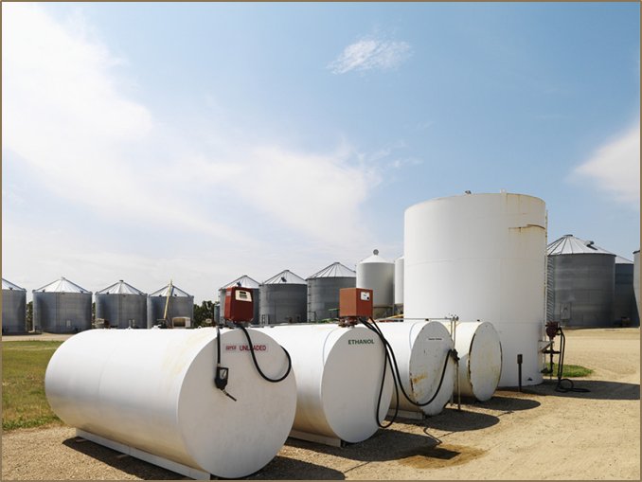
Storage Tanks
For departments that manage storage tanks:
  It is the department’s responsibility to make sure that the storage tank list is up-to-date.
  The list can be found in the Finance Department website as part of the State of Florida Certification of Financial Responsibility and Storage Tank Local Government Bond Rating Test (http://www.miamidade.gov/finance/library/financial-responsibility-certification.pdf).
  Finance will be sending bi-annual confirmations to departments requesting sign offs that listing of storage tank is complete.
  Serial numbers will be a new request going forward
  Any changes to the list (additions or deletions) should be sent to Gabriel Ruffino at Gabriel.Ruffino@miamidade.gov

Slide 20
General Accounting
Melvin Cartagena and Girsi Andreu
Controller Division

Slide 21

Discussion Items
INFORMS Operational Changes
Important Dates
Start of System Entries (Post Closing Entries)
Year-End Accruals
Vehicle Capital Leases
Accounts Receivables
Bank Reconciliations
Petty Cash

Slide 22
INFORMS Operational Changes-Reminder
All journal entries are done electronically.
  Please make sure the proper support is included as part of the attachments.
  Transactions related to inter-departmental billing, accounts payable, and deposits should be recorded in their respective submodule.
    Corrections/Adjustments
      Accounts Payable – corrections should be processed using an AP journal voucher.
      Inter-departmental billing - corrections related to chartfield values (fund, department, account, grant, project) should be processed using a journal entry.
        All others should be done via the billing module.
      Billing external customers and Accounts Receivable related to open items – All corrections should be done in the submodule.
      Accounts Receivable Direct Journals (Deposits not associated to open items) - corrections related to chartfield values (fund, department, account, grant, project) should be processed using a journal entry.
        All others should be done via the AR module, these include corrections to bank codes/bank GL accounts, and ‘AR items’.

Slide 23








Important Dates
(Deadlines and Cut-Offs)
Items | Due Date | Notes
Signature Authorization Forms | September 26, 2022 | Forms indicate who they should be delivered to in Finance.
Deposits for cash and checks on hand Friday, September 30, 2022, or before | October 14, 2022 | Processed in INFORMS AR Module. Deposit accounting date must be September 30, 2022.
Interdepartmental Billing and Journal Entries cut-off | October 12, 2022 | Entries affecting other Departments.
Accruals cut-off | October 14, 2022
Intradepartmental Journal Entries cut-off | October 14, 2022 | Entries affecting your own Departments.
Grant adjustment Journal entries cut-off | October 14, 2022
Fund Financial Statement Folders | November 18, 2022 | Submit in electronic format only to Gabriel Ruffino. Please follow provided checklist and sign off. Important: include detailed variance analysis narrative.

Slide 24






Important Dates
(Billing and Reports)
Items | Notes
Payroll accruals | Will be posted by September 30, 2022
Final Year-End Reports | Available for self-service Thursday, October 20, 2022

Slide 25
Reports and Queries
Report | Query Name
Ledger Inquiry | Inquiry Screen within GL module
Budget to Actual Comparison | MD_GLR270_BDGT_ACTUALS_COMPARE
Budget to Actuals Encumbrances | MD_GLR242_BUDGET_TO_ACTUALS
Budget - Actual by Rollup Acct | MD_GLR242SUM_BUDGET_TO_ACTUALS
Revenues Budget to Actuals | MD_GLR249_REVENUE_VARIANCE_RPT
Trial Balance Report | MD_GLR246_TRIAL_BALANCE_REPORT
Transaction Summary | MD_GLR222_TRANSACTION_BY_MONTH
Revenue and Expenditure | MD_GLR203_REVENUE_EXPENDITURE
Project Life To Date Balances | MD_GLR226_PC_LIFE_TO_DATE_QRY
Rev and Exp Capital Projects | MD_GL0002_REVENUE_EXP_CAP_PROJ

Slide 26
Start of System Entries (Post Closing Entries)
Goal - Reduce number of post-closing adjusting entries or Start Of the System entries (SOS).
Review adjusting entries posted in FY 2021/Mo. 913 in INFORMS for possible adjustments in FY 2022, and process entries before closing whenever possible.
Provide adequate supporting documentation and clear description with entries. All SOS entries are audited.
Reminder: If moving expenses from one fund to another include description, journal entry number, and check number, for each line. Needs to be traceable.

Slide 27
Accounts Payable Accruals
The deadline to submit AP Accruals via GL Journal entry is Friday, October 14th. As support for the GL Journal Entries, please attach the query used to determine the accruals and indicate which invoices are being accrued for.
We are in the process of designing a query which will include all AP items not fully approved. This query will list all potential AP Liabilities to be analyzed for accrual, which are currently found in the below existing queries.
Voucher Status | Query
Pre-Edit Error & Voucher Build | Quick Inv Pending VCH Build
Unposted | Vouchers Pending Approval
Error | Vouchers in Error
Voucher Exceptions | Budget Check Errors
*PO Vouchers (GAS, CON, & REL) and adjustment vouchers not approved by the department by the deadline will be DELETED. Therefore, they will not appear in the queries beginning, 10/6/2022 until they are re-triggered after the PO Rollover.

Slide 28

Accounts Receivable (A/R) (non-grant related)
Review A/R as of 9/30/22 and related revenues to ensure that only amounts expected to be collected by December 31,2022 are recognized as revenue.
Revenues related to A/R’s not expected to be collected by December 31,2022 must be reclassed as Unavailable Revenue (Account 2244000000). Refer to GASB 65.

Slide 29

Bank Reconciliations
Cash and checks on hand on September 30, 2022, must be entered in the AR module no later than October 14, 2022 with an 09/30/2022 accounting date.
Electronic funds transfers (i.e. ACH, Wires) posted to our bank on September 30, 2022 or prior, must be entered in the AR module no later than October 14, 2022 with an 09/30/2022 accounting date
Departments performing their own Book to Bank reconciliations (monthly bank reconciliations) must reconcile all bank transactions in INFORMS no later than October 14, 2022.
Book to Bank reconciliations are due October 21,2022.
  Must include signature of the reviewer and a copy of the bank statement.
  Prepare on a timely basis throughout the year – deadline is 15 business days after month-end but not before the fiscal-month closing. Avoid Management Letter comment

Slide 30



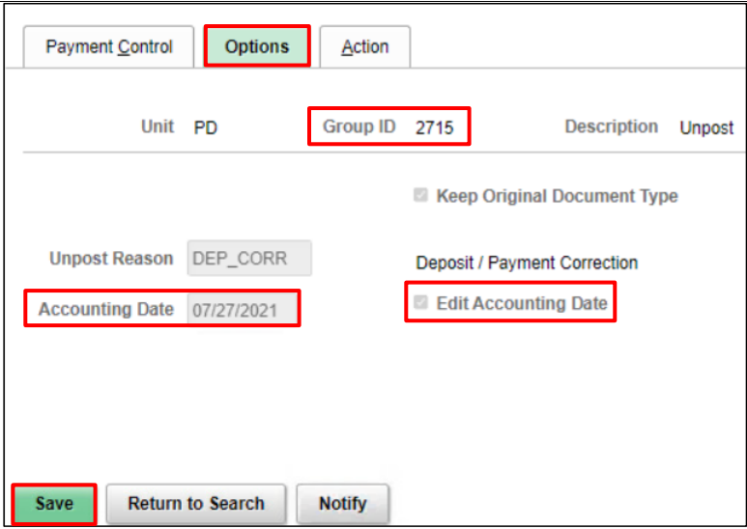
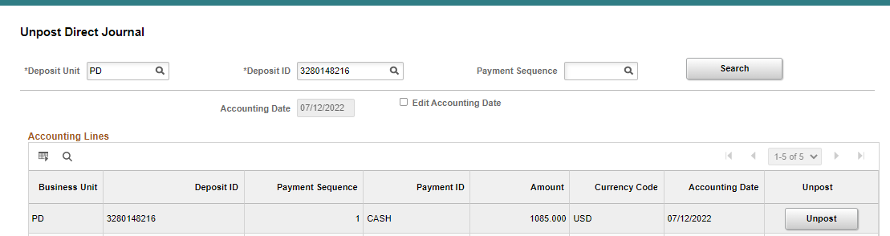
Bank Reconciliations (cont.)
IMPORTANT FYE REMINDERS:
When unposting a Direct Journal deposit or a deposit applied to an AR Item or Customer it will automatically default to the original Accounting Date. However, if the Accounting Date is within a closed period the user is required to select Edit Accounting Date and change it to the next available open period and then Unpost (Figure 2 & 3). For all deposits on or prior to September 30th, 2022, please make sure you are entering a September 2022 Accounting Date to ensure the unpost accounting entries are posted to Fiscal Year 2022.
Figure 1
Figure 3
Figure 2

Slide 31
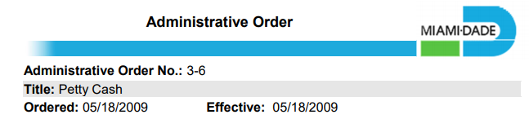

Petty Cash
(Administrative Order No. 3-6)
As stipulated in the AO, departments are responsible for:
  establishing written departmental Petty Cash Fund procedures
  ensuring a secured on-site storage facility to safeguard the funds
  immediately notifying the Finance Director of changes in custodian via “Petty Cash/Change Fund Change Form”
  performing independent verifications of petty cash usage and balances at least annually
  Link to Administrative Order No. 3-6: https://www.miamidade.gov/ao/home.asp?Process=completelist

Slide 32
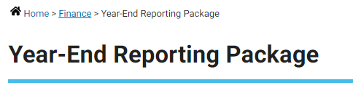

End of Year Package
YE Package and forms will be available on the web:
http://www.miamidade.gov/finance/year-end.asp

Slide 33
Single Audit and FEMA
Maria Hernandez
Controller Division

Slide 34

Single Audit
All grants must be balanced by Friday, October 14 (last day for grant journal entries and approval of temporary bills)
It is critical that you review and balance your grants in a timely fashion. We will review post-closing entries (formerly period 13) on a case-by-case basis and will only allow entries that are material and absolutely necessary.
Aliane emailed Single Audit workpapers and Grant Understanding Questionnaire with instructions on August 23, 2022
Single Audit workpapers and Grant Understanding Questionnaire are due to Finance no later than November 21, 2022. Scan and email Single Audit Workpapers & supporting documentation to Aliane Casaus in the Finance Department.

Slide 35
Single Audit (continued)
Single Audit Work-Papers:
Use Single audit work-papers that were provided to you.
Make sure to include a copy of the full grant agreement/contract and BCC Resolution. If the agreement/contract does not contain an ALN number, you must reach out to the agency to confirm the ALN number and provide the confirmation email.
Single Audit contact: Aliane Casaus or Maria Hernandez.

Slide 36
Single Audit- Continued
Reminder- Approve Grant Temporary Bills for the grant types listed below by October 14, 2022
GRANT_NOMATCH –Automatic no matching
GRANT_MATCH – Automatic with matching
CAPITAL_GRANT – Automatic with matching capital only
Please note that once Temporary Bills are approved and posted, an entry to record the Due From will be automatically generated in the grant. You do not need to record a journal entry.

Slide 37

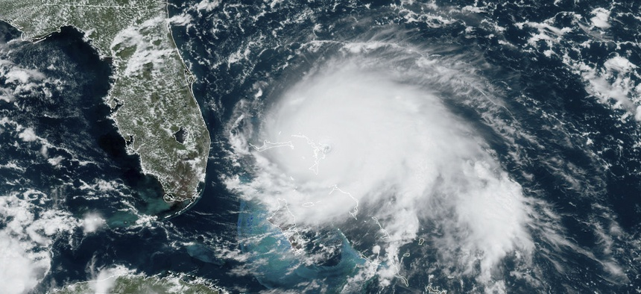
HURRICANE IRMA- FEMA PA
Hurricane Irma:
Currently, we are working with departments that require local match entries, final inspection reports, request for information from the State, and time extension submissions.
There are currently 15 projects that require the departments to transfer expenditures to the grant. Emails were sent to them with the chart fields to use. These need to be recorded as soon as possible.
As of 7/31/22, 221 projects have been obligated totaling $258.6 million; 213 projects have been paid totaling $217.8 million; 2 projects are pending obligation totaling $151 K; and two projects are under appeal.

Slide 38
HURRICANE IRMA- FEMA PA
Hurricane Irma Reminders:
Comply with Request for Information (RFI) for your projects. Failure to comply will lead to a determination memo which will require an appeal in order to recover those revenues.
Promptly complete the steps required by the State in order to receive payment once a project is obligated.
When you receive a final inspection form, after the close-out meeting, please sign and return to us promptly so it can be submitted to the State.
If your project is expiring, please submit a signed time extension request form to us.
Hurricane Irma Contacts- Sandra Gonzalez, Lisset Elliott, and Maria Hernandez

Slide 39
COVID 19 - CRF
COVID-19:
The Coronavirus Relied Fund (CRF) period of performance ended on 12/31/21.
Finance is working with OMB and Hagerty on the close-out of the CRF grant. Once all expenditures are reviewed, it will be determined if any departmental expenditures will be reclassed to the CRF grant for the period of 10/01/2021 to 12/31/2021.
Any chargebacks for ineligible items under CRF have been communicated to the departments and the budget analyst or will be communicated before year-end.
The total of $474 million will be completely allocated by year-end.

Slide 40
COVID 19 – FEMA PA
COVID-19:
The County decided to reduce its’ COVID-19 work effective 7/1/22. COVID-19 expenditures after 7/1/22 will be absorbed by the departments. However, Hagerty is still working on projects for expenditures that were incurred prior to 7/1/22 and may contact you for information.
OMB has requested that all vendor payments and labor hours for COVID-19 be processed no later than 9/30/22. Remember that any time for work performed from 6/13/22 to 7/1/22 should be entered in the new Force Account Reporting System in INFORMS, including equipment and materials.
Please refer to email sent by OMB on 6/17/22 for more information.
COVID-19 Finance Contacts- Ninoska Mendoza, Lisset Elliott, and Maria Hernandez

Slide 41
Fixed Assets - Reminders
Physical Inventories were due to ISD on 7/31/22. If your department requested an extension, your inventory is due on 9/30/22. There are no additional extensions.
The acquisition of a capital assets through the procure-to-pay process, needs to be indicated in the P.O., receipts and / or AP Voucher so an asset is created in the Asset Management Module.
The preferred way is when the PO is created. If the asset is not flagged in the PO or at the time of payment, it must be manually added.
Many departments are not creating their Assets in the Asset Management Module, because the assets are not being flagged properly in the procure-to-pay process.
Construction in Progress (CIP) assets relating to capital projects, should be created in the Project Costing Module and the transactions be assigned to the CIP asset.

Slide 42
Fixed Assets - Reminders
For FY 2022, Central Finance is creating capital assets and CIP assets in the Project Costing & Asset Management modules for the General Segment Departments, so we can close FY 2022. However, we need the departments to flag capital assets correctly going forward to ensure proper recording of capital assets
Enterprise funds are responsible for identifying and creating their assets in INFORMS
If you need assistance, please reach out to the INFORMS team. The points of contact in case of questions or if additional training is needed are:
  Marlene Amaro – Project Costing Module
  Marilyn Crucet – Asset Management Module
Additionally, the following job aids are available:
  FIN 202 - Asset Management Accounting
  FIN 209B – Capital Projects

Slide 43
Capital Assets - Reminders
The following reports are available from INFORMS and may be used to reconcile your capital assets:
Report Name | Description | Report type
MD_AM0255_ASSET_DETAIL_REPORT | Asset Detail Report | Schedule Query
MD_AM0259_ENT_ASSET_DETAIL_RPT | Enterprise Asset Detail Report | Schedule Query

Slide 44
Business Solutions Update
Annual INFORMS Security Update
Security Request Form - Finance\SCM Roles; PCARD Roles
INFORMS Rollout R4/R5 – Business Intelligence

Slide 45
CONCLUSION

