Slide 1
Finance Department Year-End Presentation FY 2023
Accounts Payable September 7, 2023
Disclaimer: Please note that the audio and other information sent during the webinar will not be recorded. Please refrain yourself from hitting the record button if you are a participant.

Slide 2
Agenda
Introduction
Construction Payable
Fixed Assets
Accounts Payable
Special Services
Travel
P-Cards
Questions
Enter questions in the chatbox
FAQ document will be distributed

Slide 3
Introduction
Welcome
Finance Department Team Changes
Barbara Gomez, Director, Finance Department
Madelin Rizzo, Assistant Director, Finance Department
Vivian Delgado, Assistant Director, Finance Department
Leany Perez, Director of Accounting and Reporting
Stephanie Campaniony, Financial Reporting Manager
Maria De Renzis, Assistant Section Manager
Finance is temporarily located on the 25th floor
Official Days for Cashiering Services – TUESDAYS - FRIDAYS
Payment Runs:
ACH – MON - FRI
CHECKS GOA – TUES & THUR
CHECKS SSC – WED
TRAVEL ADVANCES & REIMBURSEMENTS - WED

Slide 4
Capital & Construction Payable Section

Slide 5
Capital & Construction Payments Deadlines
Construction Payments Cut-Off:
Email Francisco Garcia at FKG@miamidade.gov all construction invoices by Friday, September 29, 2023 at noon.
If submitting invoices for services rendered in fiscal year 2023, please remember to process purchase order increases and reclassifications prior to September 29th, 2023. POs must be in “Dispatched Status” to be able to process the invoices
Recurring errors causing voucher rejections:
Invoice Remit to Address on the voucher does not match the Remit to Address on the vendor’s invoice. This error can be prevented by checking the invoice address in INFORMS under Finance/Supply Chain, Payables Operations, Accounts Payable WorkCenter, Supplier Inquiry screen. To avoid payment delays, the Construction cover sheet will be revised to include the supplier’s remit to address and the INFORMS location. The change will be effective the beginning of next fiscal year.
Some departments don’t open the invoice attachment before approving the vouchers. This is evident with some of the errors the Capital Construction Group encounters at the voucher level. For example, utilizing incorrect purchase order chartfields on the voucher. We ask departments to always open the attachments (the invoice support) to compare them with the voucher information entered in INFORMS.
Departments are responsible for tracking their payments’ progress. Sometimes departments take time to realize that an action is needed on their part to continue the payment process. We encourage departments to continue to familiarize with the system invoice search options to check the status of their payments.

Slide 6
Other Important Construction Reminders
The cut-off date for departments to approve the reclassification of expenses via journal voucher in the AP Module is Thursday, October 12th at Noon.
If needed, retainage payable can also be reclassed or reduced by accessing the Retainage Tracker by Supplier table in the Accounts Payable WorkCenter. The Retainage Maintainer role is needed to perform the transaction, which will generate a journal voucher.
Some capital journal entries require OMB approval. Please submit your end of year journal entries as soon as possible to allow sufficient time for such review and approval. The deadline for all G/L journal entries is Thursday, October 12th at 9:00pm.
6

Slide 7
Fixed Assets Reminders
Physical Inventories were due to ISD on 8/31/23. If your department requested an extension, your inventory is due on 9/30/23. There are no additional extensions.
The acquisition of a capital assets through the procure-to-pay process needs to be indicated in the P.O.
If the asset is not flagged in the P.O. it must be manually added.
Many departments are not creating their assets in the Asset Management Module, because the assets are not being flagged properly in the procure-to-pay process.
Construction in Progress (CIP) assets relating to capital projects, should be created in the Project Costing Module and the transactions be assigned to the CIP asset.
7

Slide 8
Fixed Assets Reminders
For FY 2023, Central Finance will create capital assets and CIP assets in the Project Costing & Asset Management modules for the General Segment Departments. However, we need the departments to flag capital assets correctly going forward to ensure proper recording of capital assets in INFORMS.
Enterprise funds are responsible for identifying and creating their assets in INFORMS
If you have questions about the fixed assets process, please contact our Section (Capital Construction). For INFORMS assistance, please review the available training materials or place a ticket with the HelpDesk at 305-596-4357 and a member of the INFORMS Team will assist you.
Additionally, the following job aids are available:
https://www.miamidade.gov/global/humanresources/training/informs.page
FIN 202 - Asset Management Accounting
FIN 209B – Capital Projects
8

Slide 9
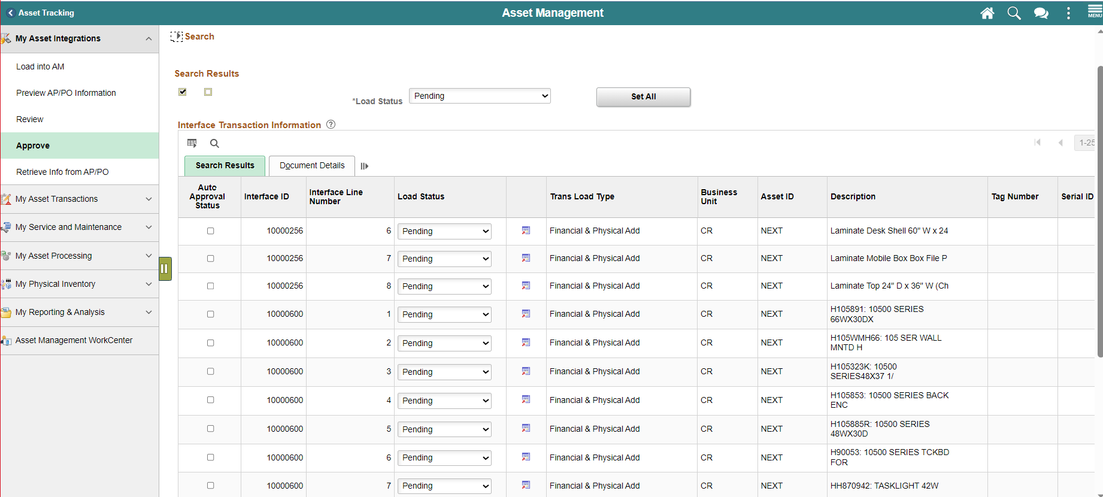
Fixed Assets Reminders
Each department’s Asset Managers are responsible for checking the Asset Management module regularly to review and approve assets created through the interface process. We are seeing many transactions pending to be reviewed by the departments. If transactions are not approved through this process, they will need to be added manually, which creates more work.
The INFORMS Asset Management FIN 202 Job Aid – Approving Assets Created Via Interfaces describes the above approval process.
Below is the screen print for the AM assets that need to be approved:
9

Slide 10
Accounts Payable Section

Slide 11
Important Dates
2024 Forms are due Monday, September 25, 2023
Forms are located at: http://intra.miamidade.gov/finance/forms.asp
Accounts Payable Wire Transfer Authorized Signatures Form
Travel Authorized Signatures Form
Accounts Payable Liaisons Form
Accounts Payable Purchasing and Travel Card Liaisons Form
Accounts Payable Travel Liaisons Form
*All Individuals listed on Authorized Signature Forms must read through AP Procedure 606 prior to signing.

Slide 12
Important Dates
Monday, Sept 18th – Stop Payments/Cancellations, Affidavits & documentation need to be submitted to Special Services
Friday, Sept 22nd – Last day for Departments to approve TERs for FY23
Friday, Sept 22nd - Last day for Departments to “Verify” p-card transactions charged up to September 4th
Monday, September 25^{th -} Single Payment Vouchers including reissues need to be fully approved at department level
Wednesday, Sept 27th – Last day to drop FY23 interface files. FY24 files can be submitted beginning Monday, Oct 9th
Friday, Sept 29th (Noon) – Cutoff for construction invoices to be received by FIN Construction group
Monday, Oct 2nd (Noon) – Cutoff for scanning all FYE 2023 invoices
Wednesday, Oct 4th (Noon) – Cutoff for final approval of Payment Requests, PO invoices (including receipt creation), adjustment vouchers (credit memos) and wires/ACH Debits by Departments
Saturday, Oct 7th – PO Rollover Process begins(INFORMS Team)
Thursday, Oct 12th (Noon) – Cutoff to approve Journal Vouchers by Departments
Thursday, Oct 12th (9:00PM) – Cutoff for Accrual GL Journal Entries
Thursday, Oct 20th – FY 23 Reports available for Self Service
12

Slide 13
Indicating Old vs New Year
During the time of October 1 – 4, Departments should suspend processing invoices for 2024 and focus on getting as much of FYE 2023 items processed to avoid large accruals.
Finance Shared Services will be processing all invoices that meet the October 2nd deadline. Invoices received after the cutoff will be held until AP finishes processing FYE 2023 on October 6th.
Departments must identify the applicable FY for all invoices processed between October 1st and October 4th , must be identified as FYE 2023 or FYE 2024.
Indicate in Comments
Indicate in Invoice Description
AP will be changing the Accounting Date for FY23 invoices between Oct 1 – Oct 4.
FY 23 invoices that are not scanned by October 2nd or approved by the department by October 4th at noon, should be accrued.
To facilitate the PO Rollover Process: PO Vouchers (GAS, CON, & REL), adjustment vouchers, and quick invoices not approved by the department by October 4th will be DELETED. This includes vouchers in error. Once the PO Rollover takes place, previously deleted vouchers will be re-triggered.

Slide 14
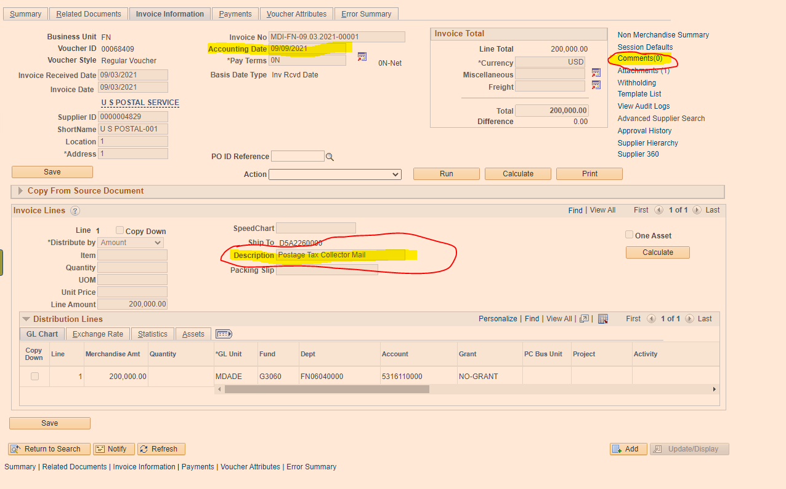
Indicating Old vs New Year

Slide 15
Accounts Payable Accruals
The deadline to submit AP Accruals via GL Journal entry is Thursday, October 12th . As support for the GL Journal Entries, please attach the report used to determine the accruals and indicate which invoices are being accrued for.
For accrual purposes, the ‘AP Open Payable Report’ from the AP Workcenter will be provided to all departments after AP closes FY23. This report will list all potential AP Liabilities to be analyzed for accrual.
*PO Vouchers (GAS, CON, & REL) and adjustment vouchers not approved by the department by the deadline will be DELETED. Therefore, they will not appear in queries beginning 10/6/2023 until they are re-triggered after the PO Rollover.
Note this report is a good tool to view all invoices by Business Unit, and recently has been updated to include aging.

Slide 16
SPECIAL SERVICES

Slide 17
Special Services Overview
The Special Services section processes all type of refunds.
Refunds may occur for numerous reasons such as: tax overpayments, refundable deposits for reservations at Parks & Recreation facilities, witness fees, or any other miscellaneous refunds and payments such as the Save Our Senior checks.
Special Services refund payments can only be issued via check. They are processed in INFORMS as Single Payment Vouchers.
Single Payment Vouchers online INFORMS training: FIN201 – Accounts Payables: Create and Process non-PO Vouchers Guide, Lesson 2. https://www.miamidade.gov/global/humanresources/training/informs.page

Slide 18
Special Services – Important Dates
Stop Payments/Cancellations, Affidavits & documentation need to be submitted to Special Services by Monday, September 18th.
Single Payment Vouchers including reissues need to be fully approved at department level by Monday, September 25th.
Please email all supporting documentation to: (FIN) SSC Group
fin-sscg@miamidade.gov

Slide 19
TRAVEL

Slide 20
Travel General Information
The transition of Travel to INFORMS effective 7/1/22 does not represent a change to the Travel Policies and Procedures. This transition only changed the way travel requests are prepared and approved.
BPW Recording and PowerPoint Presentation
https://secure.miamidade.gov/employee/informs/business-process-workshop-rollout-2.page
Training Materials
FIN 214 – Travel and Expenses: Travel Authorization
FIN 215 – Travel and Expense Report
https://www.miamidade.gov/global/humanresources/training/materials-rollout-2.page
Travel Policy and Procedures can be found at
http://intra.miamidade.gov/managementandbudget/procedures.asp
For travel related inquiry/request, email (FIN) Travel Group
FIN-TG@miamidade.gov

Slide 21
Travel – Important Dates
All Fiscal Year 2023 County travel need to be fully approved by Friday, September 22,2023.
Please ensure all INFORMS Travel Expense Reports (TERs) are fully approved at the Department Level, and their related supporting documentation is attached to the request.
Paper travel documents (non-county employees and previously approved exceptions) Please forward complete travel packages to Finance. Travels occurring on/or before September 30 - place a 2023 notation on Travel Request Form (TRF) and/or on Travel Expense Reports (TER) if “old year” expense (FY 2023) or “new year” expense (FY 2024), for proper posting of expenditure.

Slide 22
Travel Policy & Procedures Key Reminders
All TERs MUST be associated/linked with the corresponding Travel Authorization (TA).
TERs are to be submitted within 5 working days of the end of a trip per AO 6-1.
INFORMS Pre-paid expense definition: Expenses paid with County funds. Expenses paid by the traveler are NOT pre-paid expenses. They should be coded as ‘check’ and are considered for calculating travel advances.
Recommendation: designate a limited group individuals at the department level to specialize in preparing travels in accordance with the MDC Travel Policy.
To reduce the number of errors: train your staff by reviewing the resources available online, and guidance provided by central finance.
We encourage the use of MDC P-cards to pay for travel expenses when applicable.
Please review all ‘pending’ TAs for which the travel date has passed. These will not be able to be submitted in INFORMS, and need to be denied or deleted as the TA is encumbering funds.
When applicable, before denying/deleting print-screens can be saved to document any approvals obtained and attachments can also be downloaded to be used as supporting documentation for expense reports.

Slide 23
Travel Policy & Procedures Key Reminders
Travel agent fees - are NOT reimbursable expenses (except in extreme and unusual cases, which must be accompanied by a memo signed by the Department Director stating the savings and benefits to the County)
All Authorization forms initiated in INFORMS must include proof of three airfare quotes demonstrating that the most economical fare was purchased.
Purchase of the Collision Damage Waiver insurance is required on rental vehicles.
Travel expenditures not allowed, include but are not limited to - seat upgrades and/or seat reservations, airline upgrades, tips, porter charges, valet parking, etc. (Refer to pg. 46 of the Travel Policy and Procedures for further guidance)
It is the traveler’s and the department travel liaison’s responsibility to keep track of the approval flow of Travel Authorizations in INFORMS to ensure that the Travel Authorization is fully approved prior to the travel date. Travelers who travel without a proper approval are in violation of the County Travel Policy.

Slide 24
Travel Policy & Procedures Key Reminders
Cash Advances: A comment MUST be added to the Travel Authorization.
Conference hotel exceeding the daily maximum – The allowable lodging rate may be exceeded if proof of conference hotel location is attached to the travel request. If lodging is not at a conference hotel and exceeds the maximum allowable rate, a justification memo from the Department Director/designee needs to be attached to the travel documents stating why it is in the best interest of the County to pay for the traveler to stay at the selected hotel.
Definition of MDC Immediate Vicinity - Lodging expense reimbursements are not provided for travel within the immediate vicinity of Miami Dade County, defined as the area between West Palm Beach and Marathon Key.
Approvals – Travel requests are now approved electronically through INFORMS.
Travel documents are no longer routed to OMB Budget Analysts. They are systematically budget checked.
Group travels are no longer routed to the Mayor’s Office for approval.
Approval & Submittal
Travel Authorizations must be fully approved before the travel occurs as INFORMS will not allow approval after the travel begins.
Travel expenses cannot be incurred until Travel Authorizations are approved by the Department Director.

Slide 25
Travel & Expenses Module Queries
Helpful queries available in Query Viewer

Slide 26
Purchasing/Travel Cards

Slide 27
P-Card General Information
The transition of P-card to INFORMS effective 7/5/22 does NOT represent a change to the P-Card Policies and Procedures. This transition only changed the way p-card transactions are prepared, reconciled and approved.
BPW Recording and PowerPoint Presentation
https://secure.miamidade.gov/employee/informs/business-process-workshop-rollout-2.page
Training Materials - FIN 213 – Reconcile and Approve P-Card Transactions
https://www.miamidade.gov/global/humanresources/training/materials-rollout-2.page
For p-card related inquiries, requests, and overrides please email (FIN) P-CardAdmin at fin-pcadmin@miamidade.gov
Please submit all p-card applications and exception memorandums to (FIN) P-Card Applications at finpcardapplications@miamidade.gov

Slide 28
P-Card Important Dates
September 4, 2023 is the last statement posted to INFORMS for FY23.
September 22, 2023 is the deadline for departments to update transactions to ‘verified’ status which will be closed and post to FY 23.
Any transactions that are rejected and not re-verified by the deadline will need to be accrued as they will not post into FY23.
Transactions in ‘initial’ and ‘staged’ status as of COB September 22, 2023 will be posted to FY 2024. *These should be accrued via GL Journal*
October 12, 2023, noon, is the deadline for departments to approve Journal Vouchers (JVs).
Transactions from September 5th through September 30th should be accrued via GL Journal entry by October 12, 2023. All accruals must be reversed in FY24.
Accruals should debit the department expense chartfields, and CREDIT the below structure:
October 5th, 2023 is the first statement of the new FY and includes transactions dated September 5th through October 4th. These transactions will be closed and posted via the p-card module after FY23 is closed.

Slide 29
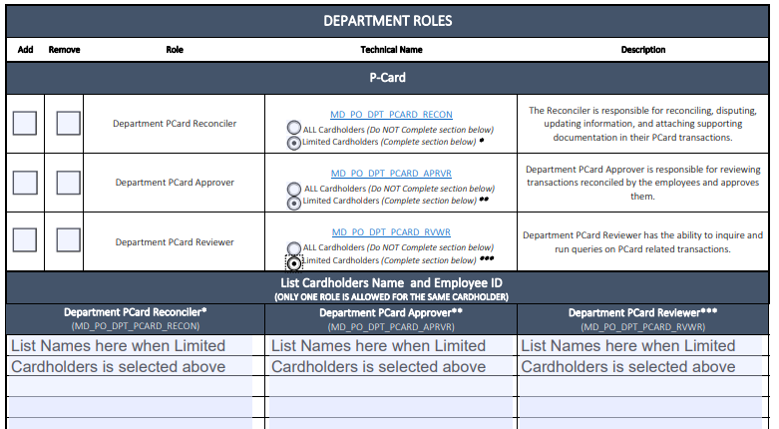
P-Card Security
P-Card roles are assigned to users upon requests from the Department by completing the INFORMS security form, found in the link below:
https://www.miamidade.gov/technology/library/informs/security-form-solely-p-card-roles.pdf
The Department p-card Reconciler role must be assigned to ALL new cardholders.
If the ‘ALL Cardholders’ option is not selected, list all cardholders the user will be performing their role for (reconciling, approving, reviewing).

Slide 30
P-Card Policy – Prohibited Items
Certain types of purchases are strictly prohibited by the P-Card policy. Such purchases include, but are not limited to:
Personal purchases of any kind (personal purchases are defined as purchases of goods or services intended for non-work-related use or use other than for official County business)
Donations or gifts to a charity, gift to an entity, floral arrangements or political contribution.
Fuel for personal cars, since use of personal vehicle expenses are compensated via mileage reimbursement, in accordance with A.O. 6-3.
Gift cards (unless allowed by specific programs and/or funding sources), stored value cards, calling cards, pre-paid cards or similar products
Entertainment type venues/establishments
Food and/or beverages for internal meetings or employee gatherings are prohibited. Food and/or beverages for community events or meetings are permitted only if specifically allowed by funding source.
Alcoholic beverages
Tobacco products

Slide 31
P-Card Policy – Prohibited Items
Goods and services available on an existing County contract
Purchase of computers, iPhones, iPads and other wireless communication devices which are done via ITD, in accordance with A.O. 5-5.
Non- Emergency maintenance on County vehicles, handled by ISD Fleet Management Division.
Please immediately notify a Finance Department P-Card Administrator if a cardholder terminates employment with the County or transfers to another department.
Refer to the P-Card Policies and Procedures on the Finance Department website:
http://intra.miamidade.gov/finance/purchasing-card.asp

Slide 32
P-Card – Key Reminders
Review daily transactions carefully and question items that do not appear to be for the proper use of public funds and/or not eligible.
Please make sure all transactions are reconciled/approved timely, right after they are loaded to INFORMS.
When cards are used for travel related expenses, the Informs Travel Authorization needs to be properly authorized by the Department Director or designee prior to using the p-card. The approved Travel Authorization is needed for override requests and must be uploaded to INFORMS as supporting documentation of expenses paid with the p-card. The Travel Approval document must include the breakdown of the total expenses for the travel and the INFORMS approval path to show the date it was fully approved.
If sales taxes were charged, please try to get reimbursed or provide proper documentation as support as to efforts employed.
Authorized signers cannot approve their own P-card transactions. INFORMS will not allow the same user be assigned as a reconciler and approver proxy for the same cardholder.
The cardholder or employee receiving the products or services should sign (or an equivalent, e.g. email) and date the receipt/invoices as acknowledgement that the products and services were received in accordance with purchasing terms.

Slide 33
P-Card Module Queries
Helpful queries available in Query Viewer

Slide 34
Conclusion

