Slide 1
Finance Department Year-End Presentation FY 2021
September 17, 2021
Disclaimer: Please note that the audio and other information sent during the webinar will be recorded. By participating in this webinar, you automatically consent to such recording and to subsequent use of the recording.

Slide 2
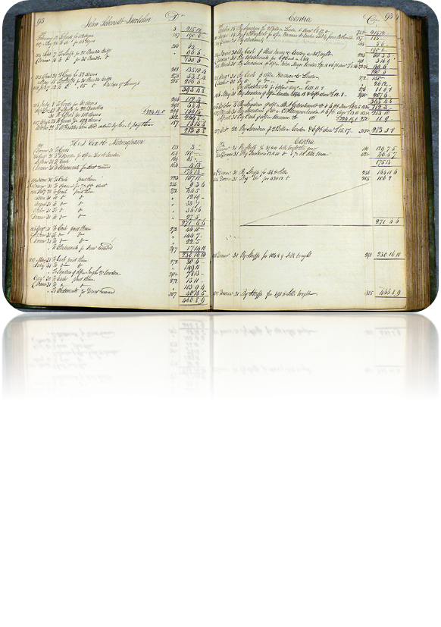
AGENDA
Financial Reporting
Speakers: Leany Perez, Eric Herrera and Gabriel Ruffino
General Accounting
Speakers: Melvin Cartagena and Erica Olson
Single Audit and FEMA
Speakers: Maria Hernandez
Questions
Enter questions in chatbox
FAQ document to be distributed

Slide 3
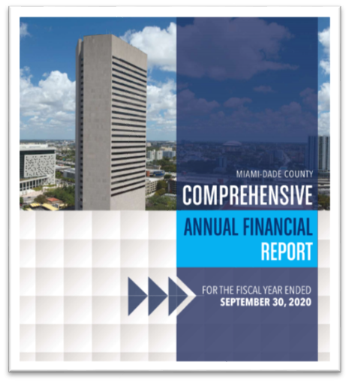
Financial Reporting
Eric Herrera and Leany Perez
Controller Division

Slide 4
Discussion Items
Introduction
Prior Year Audit Results
Prior Year Audit Lessons Learned
Management Representation Letter
Current GASB Statement
New GASB Exposure Draft/Pronouncements
Internal Control Review Project
Fund Folders
Storage Tanks
Conclusion

Slide 5
Introduction/Opening Remarks
Finance Team Changes
New Management, Staff and Roles
Madelin Rizzo, Controller
Eric Herrera, Financial Reporting Manager
Joanne Paul, Finance Auditing and Reporting Administrator
RSM US, LLP (External Audit) Team Change
New Lead Auditors
Chantelle Knowles, Manager
Michelle Diaz, Audit Supervisor
Key External Audit Dates
RSM Interim Audit Fieldwork (Approximately: September 7, 2021 – September 30, 2021)
RSM Year-End Audit Fieldwork (Approximately: December 1, 2021 – June 30, 2022)
INFORMS Impact – working with 2 systems for this audit (6 months in FAMIS)
Inquiry access will be provided to external auditors in INFORMS

Slide 6
Prior Year Audit Results

Slide 7
Prior Year Audit Lessons Learned
Departmental Audit Liaisons
Provide name of 1 or 2 department lead who will act as departmental audit liaisons for purposes of providing supporting documents and answering auditors’ follow up questions
FY 2020 List of contacts will be sent for your review, provide changes by September 30, 2021
Timing of Audit Deliverables
Provide supporting documentation in a timely manner in order to avoid auditors’ follow up emails
Review of Audit Supporting Documentation
Review of departmental supporting documents (e.g. journal entries; purchase orders; invoices; proof of payments (ACH/direct deposit, copy of check, lockbox transaction detail); bank statements; grant award documents; adopted budget ordinance; resolution/ordinance) should be performed prior to being uploaded
**IMPORTANT** - Redact all personal and/or sensitive information (e.g. SSN, Credit Card Numbers, Health Information, Bank Account Numbers, Other Types of Protected Personal Information)
Submittal of Supporting Documentation
Please upload supporting documents directly to the auditors’ website and avoid emailing supports

Slide 8
Prior Year Audit Lessons Learned (continued)
Accounts Receivable (AR)
GASB 65 requirement - Revenues related to AR’s not expected to be collected within our ‘period of availability’ must be reversed and recorded as Unavailable Revenue.
The County’s period of availability is 90 days for non-grant related AR and 1 year for grant related AR
Improvements noted - prior year audit finding was dropped, but we must continue to monitor to prevent future findings
Adjustments should be made as part of the year-end close process
Departments must analyze and record unavailable revenue for revenue accounts that they do not expect to collect within the County’s availability period of 90 days (e.g. by December 31st) and 1 year for expenditure driven (reimbursement) grants and intergovernmental revenues.

Slide 9
Management Representation Letters
Continuing last year’s approach:
FY 2021: Audited departments attest to the accuracy of the following:
Financial Statements
Completeness of Information
Recognition, Measurement and Disclosure
Subsequent Events
Expected Due Date: January 14, 2022

Slide 10
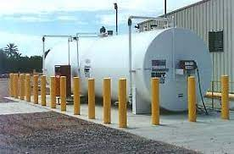
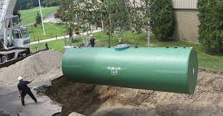
Current GASB Statements
GASB Statement No. 83, Certain Asset Retirement Obligations
Friendly Reminder:
Email is normally sent in December of each year requesting departments to please provide us with the following:
ARO Request Form
GASB 83 Certification

Slide 11
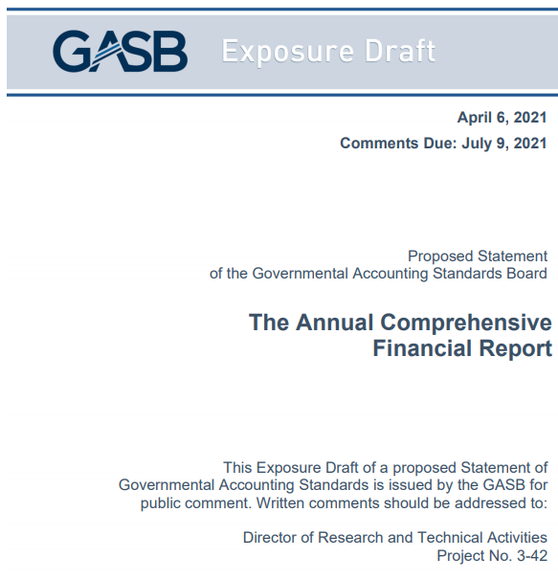
New GASB Exposure Draft
On April 13, 2021, the GASB proposed to change the
“Comprehensive Annual Financial Report” (CAFR)✗
to
“Annual Comprehensive Financial Report” (ACFR)✓
GASB stakeholders raised concerns that the existing acronym for the report, when pronounced, sounded like a profoundly offensive term.

Slide 12
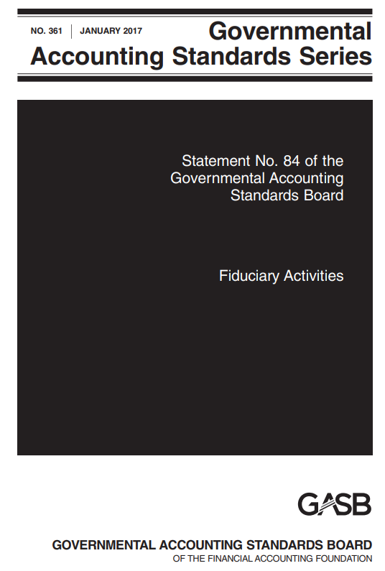
New GASB Pronouncement
GASB Statement No. 84, Fiduciary Activities
Effective Date: The requirements of this Statement are effective immediately FY 2021
The primary objective of this Statement is to enhance consistency and comparability of fiduciary activity reporting by state and local governments
Possible for funds to become fiduciary, or fiduciary funds to change to a different type of fund
Current Agency funds:
Will mostly become “Custodial Funds”
Custodial funds require a statement of changes
Some may be converted to other fund types

Slide 13
New GASB Pronouncement (continued)
GASB Statement No. 84, Fiduciary Activities
First step, department lead accountants should review the activities in the funds relevant to their respective departments and determine – based on the decision trees in the following slides - if there are potential fiduciary activities
The potential fiduciary activity that the department will be evaluating could also be currently recorded in a fund other than a custodial fund (e.g. general fund, special revenue fund, permanent fund, etc.)
Finance is working on preparing an evaluation form in Excel that will walk you through the questions from the flowcharts. Training will be scheduled to walk you through the form once is it is complete.

Slide 14
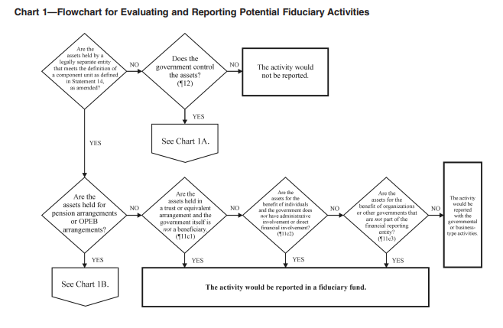
New GASB Pronouncement (continued)
Example – Chart 1

Slide 15
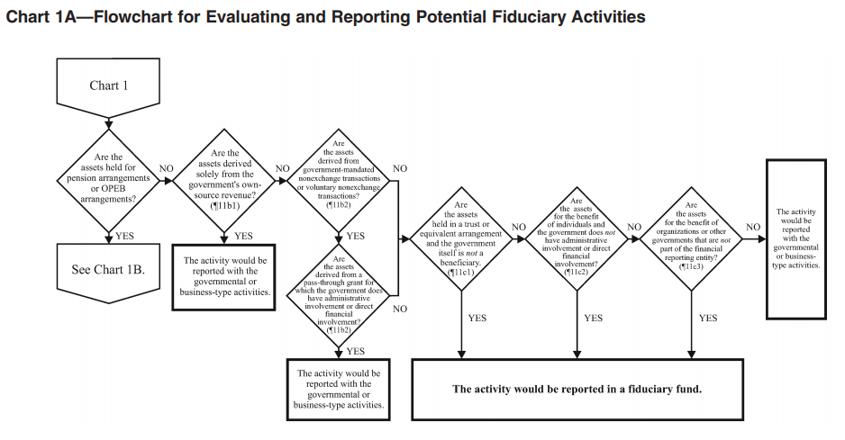
New GASB Pronouncement (continued)
Example – Chart 1A

Slide 16
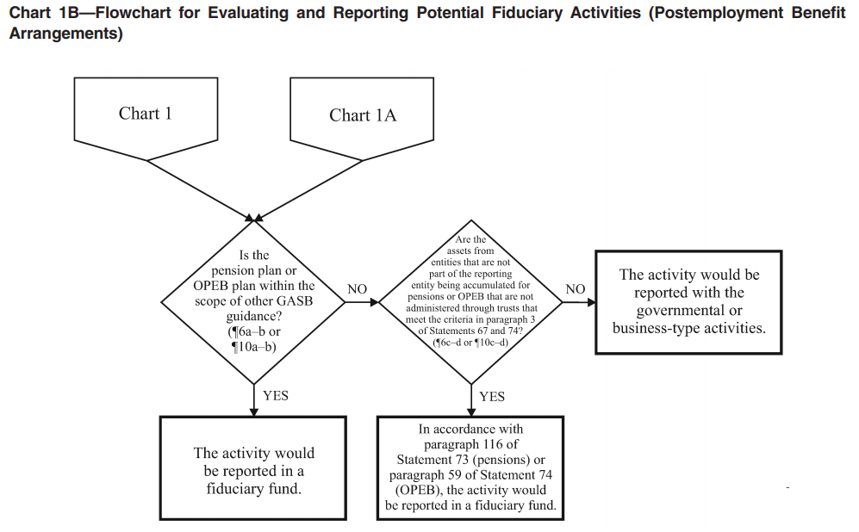
New GASB Pronouncement (continued)
Example – Chart 1B

Slide 17
New GASB Pronouncement (continued)
GASB Statement No. 87, Leases
Effective Date: The requirements of this Statement are effective FY 2022
Single model for lease accounting based on the foundational principle that leases are financings of the right to use an underlying asset
No more operating or capital leases
Generally, all leases should be presented on the face of the balance sheet. For example:
County as a lessee:
Dr. Lease Asset
Cr. Lease Liability
County as a lessor:
Dr. Lease Receivable
Cr. Deferred Inflow of Resources

Slide 18
New GASB Pronouncement (continued)
Both the lessee and the lessor will be required to calculate the present value (PV) of the future lease payments and must maintain an amortization schedule for each of those leases
GASB 87 defines lease as: “A contract that conveys control of the right to use another entity’s nonfinancial asset as specified in the contract for a period of time in an exchange or exchange-like transaction.”
“Contract” replaces “agreement” to require that a lease – whether written or verbal – be legally enforceable
Lessee has the right to determine the asset’s nature and manner of use while obtaining the asset’s present service capacity
Investments reported at fair value are excluded
A lease term must have an end date
Both parties must exchange something of equal value

Slide 19
New GASB Pronouncement (continued)
Steps for implementation of GASB 87, Leases:
Create 3 distinct planning phases to help departments navigate how to best provide the correct data for implementation:
Phase 1 = Identify
Phase 2 = Data Collection
Phase 3 = Evaluation
PHASE 1 – IDENTIFY
Departments must assign designated personnel who will ultimately be the point of contact and responsible for gathering all lease contracts executed by their respective departments
Name(s) and contact information of individual(s) must be submitted to Gabriel Pena Gabriel.Pena@miamidade.gov by 9/30/2021

Slide 20
New GASB Pronouncement (continued)
PHASE 2 – DATA COLLECTION
Finance will request departments to provide updated lease data for FY 2021
Lease data worksheet/questionnaire will be provided to departments in October 2021
Finance will create a central data depository in Microsoft SharePoint where each department personnel will be able to upload their respective department’s lease contracts and relevant information
PHASE 3 – EVALUATION
Evaluate and identify leases based on GASB 87 criteria
Extract key criteria from submitted contracts for proper financial statement presentation. More information will be provided when available
*Tentative* - Finance is seeking consultant services to assist with implementation

Slide 21
New GASB Pronouncement (continued)
**EXAMPLE**
Lease contract questionnaire for Department's Directors – Please respond “Yes” or “No”
Section 1:
Is the requisition for the lease of equipment or property?
Section 2:
Is the requisition for any of the following criteria(s):
Intangible assets (i.e.: software)
Biological assets
Inventory
Repairs
Janitorial services
Professional and consulting services (no equipment provided for free)
Memberships
Supplies where equipment is not provided for free
Employees rewards and recognition
Is the requisition for an agreement that is less than 12 months, including renewal options?

Slide 22
New GASB Pronouncement (continued)
Lease contract questionnaire for Department's Directors – Please respond “Yes” or “No” (Continued)
Section 3:
Is the requisition for an agreement that provides equipment for free to be used by the department or the County?
Does the department plan on exercising the renewal option?
Does the agreement include an option to purchase the physical assets (equipment)?
Does the department plan to purchase the physical asset (equipment)?

Slide 23
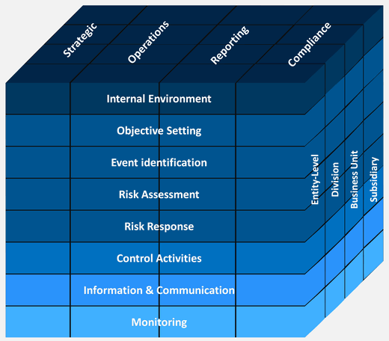
Internal Control Review Project
Phase 1 - Documentation and process flows are complete for INFORMS implementation phase 1
Phase 2 - Plante Moran consultants will be performing post-implementation review beginning November 2021
Phase 3 - Segregation of duties review is in process. Currently INFORMS roles are being reviewed for potential issues or concerns.
Possible changes to role assignments within Departments and/or documentation regarding justifications may be forthcoming.

Slide 24
Fund Folders
Fund folder preparers are to submit their working papers and corresponding support in electronic format.
Deadline: November 29, 2021
As we did last year, each fund folder preparer will receive an excel spreadsheet template, rolled forward FY 2021 with INFORMS chartfields
Each file will have the following tabs:
Checklist
Fund
Journal Entry (former “White Forms”)
SPO Journal Entry
INFORMS JE Form (former “Pink Sheets”)

Slide 25
Fund Folders, continued
Each file will have the following tabs:
Checklist - Working Papers Checklist, this tab will contain a checklist that will help guide you in providing all the required items to Finance (e.g. Trial Balance report, Revenues & Expenditures report etc.). Please sign-off on each item, as they are completed.
Fund – Tab to input period 12 balances and adjustments, in the corresponding columns, as needed.
Journal Entry (former “White Forms”) - Tab for any Dade-County Adjustments (D.C. ADJ.).
SPO Journal Entry - Tab for any Statement Presentation Only (SPO) entries.
INFORMS JE Form (former “Pink Sheets) - Adjusting Entries tab
The preparer can add as many additional sheets as needed, but please do not remove/delete any of the original sheets provided.

Slide 26
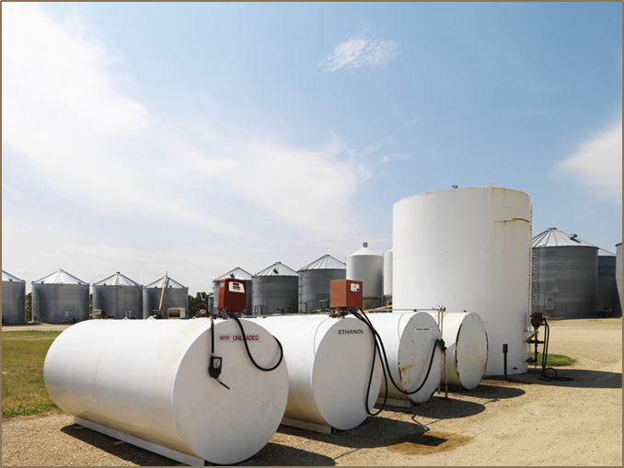
Storage Tanks
For departments that manage storage tanks:
It is the department’s responsibility to make sure that the storage tank list is up-to-date.
The list can be found in the Finance Department website as part of the State of Florida Certification of Financial Responsibility and Storage Tank Local Government Bond Rating Test (http://www.miamidade.gov/finance/library/financial-responsibility-certification.pdf).
Finance will be sending confirmations to departments requesting sign offs that listing of storage tank is complete.
Serial numbers will be a new request going forward
Any changes to the list (additions or deletions) should be sent to Gabriel Ruffino at Gabriel.Ruffino@miamidade.gov

Slide 27
General Accounting
Melvin Cartagena and Erica Olson
Controller Division

Slide 28
Discussion Items
INFORMS Operational Changes
Important Dates
Start of System Entries (Post Closing Entries)
Year-End Accruals
Vehicle Capital Leases
Accounts Receivables
Bank Reconciliations
Petty Cash

Slide 29
INFORMS Operational Changes
All journal entries are done electronically.
Please make sure the proper support is included as part of the attachments.
Transactions related to inter-departmental billing, accounts payable, and deposits should be recorded in their respective submodule.
Corrections/Adjustments
Accounts Payable – corrections should be processed using an AP journal voucher.
Inter-departmental billing - corrections related to chartfield values (fund, department, account, grant, project) should be processed using a journal entry.
All others should be done via the billing module.
Billing external customers and Accounts Receivable related to open items – All corrections should be done in the submodule.
Accounts Receivable Direct Journals (Deposits not associated to open items) - corrections related to chartfield values (fund, department, account, grant, project) should be processed using a journal entry.
All others should be done via the AR module, these include corrections to bank codes/bank GL accounts, and ‘AR items’.

Slide 30
Important Dates (Deadlines and Cut-Offs)
Items | Due Date | Notes
Signature Authorization Forms | September 27, 2021 | Forms indicate who they should be delivered to in Finance.
Deposits for cash on hand Thursday, September 30, 2021, or before | October 26, 2021 | Processed in INFORMS AR Module. Deposit accounting date must be September 30, 2021.
Interface cut-off | October 22,2021 | All interfaces except those related to AP
Interdepartmental Billing and Journal Entries cut-off | October 26, 2021 | Entries affecting other Departments.
Accruals cut-off | October 27, 2021
Intradepartmental Journal Entries cut-off | October 29, 2021 | Entries affecting your own Departments.
Grant adjustment Journal entries cut-off | November 1, 2021
Fund Financial Statement Folders | November 29, 2021 | Submit in electronic format only to Gabriel Ruffino. Please follow provided checklist and sign off. Important: include detailed variance analysis narrative.

Slide 31
Important Dates (Billing and Reports)
Items | Notes
Automated Charges- FY 2021 (energy, telephones, mobile equipment) | To be processed no later than October 26, 2021
Payroll accruals | Will be posted by September 30, 2021
Final Year-End Reports | Available for self-service Monday, November 8, 2021

Slide 32
Reports and Queries
Report | Query Name
Ledger Inquiry | Inquiry Screen within GL module
Budget to Actual Comparison | MD_GLR270_BDGT_ACTUALS_COMPARE
Budget to Actuals Encumbrances | MD_GLR242_BUDGET_TO_ACTUALS
Budget - Actual by Rollup Acct | MD_GLR242SUM_BUDGET_TO_ACTUALS
Revenues Budget to Actuals | MD_GLR249_REVENUE_VARIANCE_RPT
Trial Balance Report | MD_GLR246_TRIAL_BALANCE_REPORT
Transaction Summary | MD_GLR222_TRANSACTION_BY_MONTH
Revenue and Expenditure | MD_GLR203_REVENUE_EXPENDITURE
Project Life To Date Balances | MD_GLR226_PC_LIFE_TO_DATE_QRY
Rev and Exp Capital Projects | MD_GL0002_REVENUE_EXP_CAP_PROJ

Slide 33
Start of System Entries (Post Closing Entries)
Goal - Reduce number of post-closing adjusting entries or Start Of the System entries (SOS).
Review adjusting entries posted in FY 2020/Mo. 13 in FAMIS (screens 6400 -Trial Balance & 6750 - Income Statement) for possible adjustments in FY 2021, and process entries before closing whenever possible.
Provide adequate supporting documentation and clear description with entries. All SOS entries are audited.
Reminder: If moving expenses from one fund to another include description, document reference number, and check number, for each line. Needs to be traceable.

Slide 34
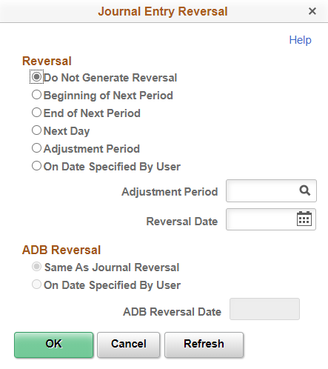
Year End Accruals
Cash is received or paid later
Review prior year accruals and determine whether reversal is required.
Accrue FY 2021 invoices not processed by Accounts Payable deadline of October 7-8, 2021 but for which goods and services were received prior to September 30, 2021.
Do not accumulate old year invoices for payment in the New Year.
If an audit adjustment is proposed by the external auditor, we will notify you of amount of accrual.
INFORMS has a reversal option for journal entries which will reverse an accrual entry based on your indication.

Slide 35
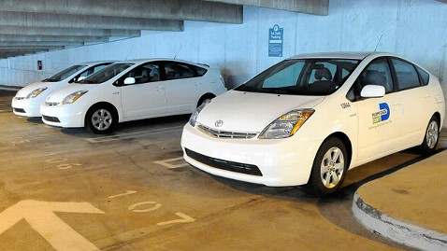
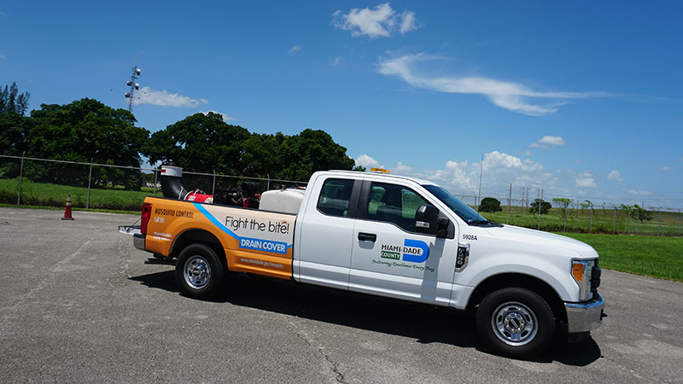
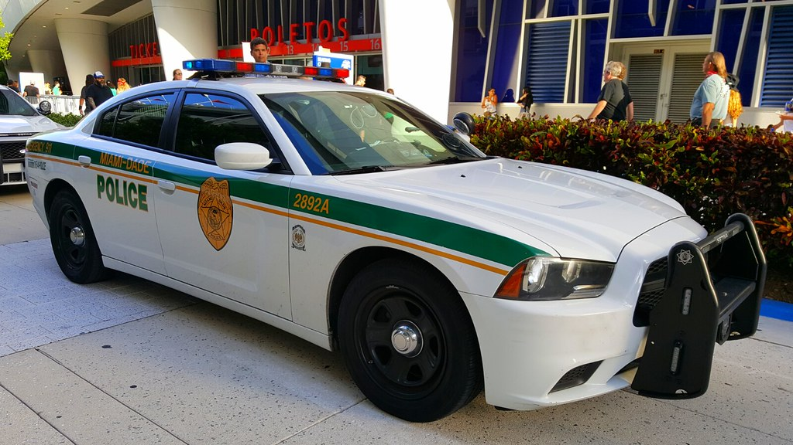
Vehicle Capital Leases
Departments under the Vehicle Capital Lease program must submit reimbursement packages to Bond Administration no later than September 30, 2021, in order to post in FY 2021. These reimbursement must be processed prior to closing.

Slide 36
Accounts Receivable (A/R) (non-grant related)
Review A/R as of 9/30/21 and related revenues to ensure that only amounts expected to be collected by December 31,2021 are recognized as revenue.
Revenues related to A/R’s not expected to be collected by December 31,2021 must be reclassed as Unavailable Revenue (Account 2244000000). Refer to GASB 65.

Slide 37
Bank Reconciliations
Reconciling bank transactions and monthly bank reconciliations are now performed in the INFORMS bank reconciliation module.
Bank transactions must be reconciled in INFORMS by October 26, 2021.
Book to Bank reconciliations (monthly bank reconciliations) are due November 17,2021.
Must include signature of the reviewer.
Prepare on a timely basis throughout the year – deadline is 30 days after month-end. Avoid Management Letter comment.

Slide 38
Petty Cash (Administrative Order No. 3-6)
As stipulated in the AO, departments are responsible for:
establishing written departmental Petty Cash Fund procedures
ensuring a secured on-site storage facility to safeguard the funds
immediately notifying the Finance Director of changes in custodian via “Petty Cash/Change Fund Change Form”
performing independent verifications of petty cash usage and balances at least annually
Link to Administrative Order No. 3-6: https://www.miamidade.gov/ao/home.asp?Process=completelist

Slide 39
End of Year Package
YE Package and forms will be available on the web:
http://www.miamidade.gov/finance/year-end.asp

Slide 40
Single Audit and FEMA
Maria Hernandez
Controller Division

Slide 41
Single Audit
All grants must be balanced by Monday, November 1 (last day for grant journal entries)
Aliane emailed Single Audit workpapers on August 27,2021 along with a list reports that are available in INFORMS.
MD_GLR246_TRIAL_BALANCE_REPORT- Trial Balance
MD_GLR222_TRANSACTION_BY_MONTH- Transaction Inquiry
MD_PCR228_PROJRES_INQ_PIV- Project Transaction Inquiry
MD_GRANT_TRANSACTION_INQ- Grant Transaction Inquiry
It is critical that you review and balance your grants in a timely fashion. We will review post-closing entries (formerly period 13) on a case-by-case basis and will only allow entries that are material and absolutely necessary. Making changes to the SEFA resulted in last year’s Management Letter comment.
Single Audit workpapers are due to Finance no later than November 22,2021. Scan and email Single Audit Workpapers & supporting documentation to Aliane Casaus Finance.

Slide 42
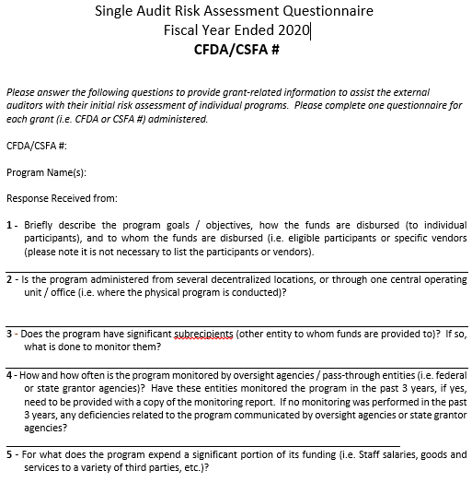
Single Audit (continued)
Single Audit Work-Papers:
Use Single audit work-papers that were provided to you.
Make sure to include a copy of the grant agreement indicating the contract number and CFDA or CSFA number.
The Single Audit Grant Understanding Questionnaire was already sent out and is due to the Finance Department by November 22,2021. Scan and email questionnaires to Aliane Casaus.
This year there is a new end-of-year form for the grant liaisons; we will use this contact information for the Single Audit and provide it to the auditors for any Single Audit inquiries.
Single Audit contact: Aliane Casaus or Maria Hernandez.

Slide 43
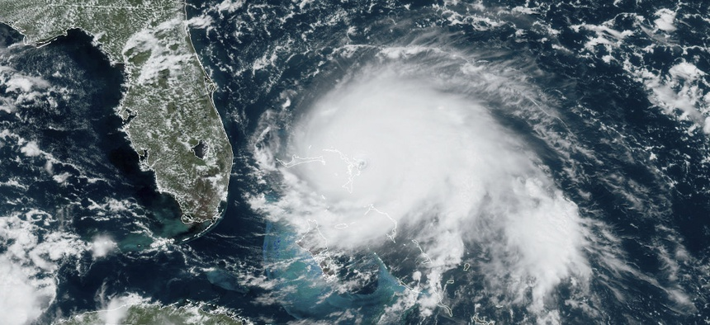
FEMA
Hurricane Irma:
During this fiscal year, the FEMA unit has been working closely with departments as new projects are obligated.
Currently, we are working with departments that require local match entries.
All departments with pending entries have been contacted, however, more projects may be obligated prior to September 30th. We request your continued timely response to our requests.
All journal entries must be completed no later than October 26,2021.

Slide 44
FEMA
Hurricane Irma Reminders:
Comply with Request for Information (RFI) for your projects. Failure to comply will lead to a determination memo which will require an appeal in order to recover those revenues.
Promptly complete the steps required by the State in order to receive payment once a project is obligated.
As of 7/31/21, 211 projects have been obligated totaling $230.5 million; 201 projects have been paid totaling $192.1 million; and 11 projects are pending obligation totaling $18.4 million.
If you have any questions, you may reach out to your FEMA liaison in the Finance Department or Norma Roig.

Slide 45
FEMA
COVID-19:
The County continues to work with Hargerty Consulting on COVID-19 disaster relief.
Hagerty is reviewing expenditures charged to your COVID index code in FAMIS and your COVID project in INFORMS in order identifying which expenditures are covered by FEMA PA and which expenditures are covered by CRF.
I sent an email asking departments to review expenditures in their COVID projects by September 24th so Hagerty has time to review and allocate to the appropriate grant.
Hargerty is also reviewing DARs for eligibility and allocation. Remember to only use preapproved activities on your DARs.
Some expenditures will be transferred to the Special Revenue fund prior to year end. Finance is working with OMB and Hagerty to determine which expenditures will be moved.
Once this is determined, we will inform you which expenditures will be moved.

Slide 46
FEMA
COVID-19:
Hagerty continues to reached out to some departments with request for information. Please respond to these requests as soon as possible so that they can make the correct determination and we can record the expenditures in the correct grant.
It is very important that we record the expenditures in the corresponding grant. If we are unable to identify the grant, the expenditure may remain in your department’s fund and affect your budget.
The County continues to submit projects to FEMA and to date has received $198.3 million FEMA PA reimbursements for COVID-19 eligible expenditures.
In February of this year, FEMA declared 100% federal funding for eligible COVID-19 costs through September 30, 2021. No local match is required.
In Fiscal year 2020, the County spent $163.4 million of the CRF funds received. The remainder will be spent by 12/31/21 on various County Programs and departmental expenses.
If you have any questions please contact Norma Roig or Maria Hernandez.

Slide 47
CONCLUSION

