Slide 1

LABOR RELATIONS DIVISION
Front-Line Supervisory Training

Slide 2
Labor Relations Roles
Negotiate Collective Bargaining Agreements (CBA)
Interpret/Advise on CBAs
Facilitate Labor Meetings
Coordinate/Facilitate Mayor’s Labor Summits
Provide Guidance/Recommendations on County Policies & Procedures (i.e. Administrative Orders (AO) Implementing Orders (IO), Ordinances, Personnel Rules, Leave Manual, etc.)
Chair/Coordinate eight (8) Employee Appeals:
Discipline Appeals
Performance Evaluation Appeals
Job Abandonment Appeals
Short-Term Disability Appeals
Career Service Grievance Appeals
Name Clearing Hearing Appeals
Classification Appeals
Employee Protection Ordinance (Section: 2-56.28.17)

Slide 3
Topics Of Discussion
Sexual Harassment
Americans with Disabilities Act (ADA) - (Reasonable Accommodation)
Family Medical Leave Act (FMLA)
Paid Parental Leave
Delegation of Authority for Disciplinary Action
Failure of Probation
Informal and Formal Counseling
Record of Counseling Review
Progressive Disciplinary Action
Personnel Related Settlements/Memorandums of Understanding
eDiscipline
Performance Evaluations
Employee Grievances
Arrest Log Tracking
Scheduling Physical Examinations and Drug/Alcohol Tests
Fitness for Duty

Slide 4

You Are A Supervisor

Slide 5
SEXUAL HARASSMENT

Slide 6

Sexual Harassment and the Law
Title VII—1964: Civil Rights Act
Federal legislation prohibiting sexual discrimination in employment; file with Equal Employment Opportunity Commission (EEOC). Types of remedies: Monetary compensation for back pay, lost benefits, and damages; compensatory (e.g. emotional distress) and punitive damages; possible job reinstatement.

Slide 7
Civil Rights Act
1972 Amendment
  Sexual harassment is a:
  Form of sex discrimination
  Violation of federal law

Slide 8
EEOC Guidelines
Sexual Harassment is defined as:
  “unwelcome sexual advances, requests for sexual favors, and other verbal or physical conduct of a sexual nature.”

Slide 9
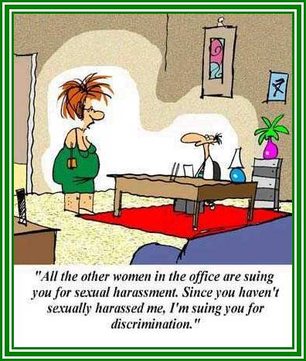

Slide 10
EEOC Criteria
Criteria 1: Quid Pro Quo
Submission to such conduct is made (either explicitly or implicitly) a term or condition of an individual’s employment or academic work, or rejection of such conduct is used as the basis for employment or academic decisions affecting the individual.

Slide 11

Quid Pro Quo
“Something for something”
Harasser has position of power
or authority over the person
being harassed
Refusal to submit will tangibly
affect the individual’s term
or conditions of employment

Slide 12
EEOC Criteria
Criteria 2: – Hostile Work Environment
  Such conduct unreasonably interferes with an individual’s work or academic performance or creates and intimidating, hostile, or offensive working or
  educational environment.

Slide 13
June 1999
New EEOC Guidance
Result of 2 Supreme Court decisions:
Burlington Industries, Inc. v. Ellerth - 524 U.S. 742 (1998)
Faragher v. City of Boca Raton - 524 U.S. 775 (1998)
Both addressed sexual harassment but also drew upon standards set forth in cases involving harassment on other protected basis.

Slide 14
Examples of Sexual Harassment
Direct or indirect threats or bribes for unwanted sexual activity
Sexual innuendoes and comments
Sexually suggestive sounds or gestures such as sucking noises, winks or pelvic thrusts
Repeatedly asking a person out for dates
Ogling or leering, staring at a woman’s breasts or a man’s derriere
Rating a person’s looks or sexuality

Slide 15

Examples of Sexual Harassment (cont’d)
Name-calling, such as “babe”
Sexual ridicule
Pervasive displays of pictures, calendars, cartoons, or other materials with sexually explicit or graphic content

Slide 16

Examples of Sexual Harassment (cont’d)
        PHYSICAL
A neck / shoulder massage
Impeding or blocking movements,
touching, patting, pinching, or any
other unnecessary or unwanted
physical contact
Touching an employee’s hair, clothing or body
Brushing up against a person

Slide 17
Do’s
Be assertive
Provide a clear and emphatic objection every time the unwelcome conduct happens
Keep documentation
If you choose, confront the harasser
Continue to report to work
Make an official complaint if the behavior does not stop

Slide 18
Don’ts
Don’t attempt to retaliate
Don’t make yourself guilty of insubordination
Don’t socially or emotionally isolate yourself

Slide 19
Intent vs. Impact

Slide 20
Intent vs. Impact
Is my intent the same as the impact?
Is my behavior welcome?

Slide 21
Handling the
Sexual Harassment Complaint
Take the report seriously.
Listen, sympathize, but don’t judge.
Don’t delay.
Respond to concerns.
Document.
Follow up on the complaint.
Avoid using “dangerous words.”

Slide 22
Handling Sexual Harassment
Telling someone that their behavior is unwanted or offensive is the most important first step in stopping sexual harassment.
Why?
Puts the person on notice
Gives them the opportunity to change

Slide 23
Employee Responsibilities
Right to be free from harassing behavior
Responsibility to complain about harassing behavior

Slide 24
Supervisor Responsibilities
Let your employees know you take this issue seriously & the institution will respond promptly.
Take a proactive stance in preventing unlawful harassment.
Take appropriate action in a timely manner, don’t delay.
Document. Write a detailed summary of the complaint.
Follow up on the complaint. Check with the complainant the next day to ensure he or she is getting needed assistance.

Slide 25
Dangerous Words
When responding to a complaint, be careful that these words don’t come out of your mouth:
It’s just teasing—no big deal.
I know he/she didn’t mean anything like that.
It’s your fault for dressing so provocatively.
You need to learn to handle these things.
Just ignore it.
He/she puts his/her arms around everyone.
Why can’t you learn to accept a compliment?
You must have wanted it, otherwise you would have told him/her no.
That’s how they do things where he/she comes from.
It’s just a joke. Lighten up.

Slide 26
CONSEQUENCES
Employee productivity losses
Increased absenteeism
Court awards, settlements and fees
Damage to institutional image
Deterioration of staff morale
Psychological distress, compromised wellness
Compromised spiritual & moral integrity
Termination

Slide 27
Complaint Procedure
Let your employees know you take this issue seriously
Take a proactive stance in preventing unlawful harassment
Take appropriate action in a timely manner
Remember, you are liable if you knew or should have known
The same standard applies to harassment by a non-employee third party

Slide 28
Retaliation
You are protected against retaliation for exercising your right to complain or for testifying or assisting in an investigation or hearing.

Slide 29
Confidentiality
All complaints will be kept confidential
Records established as a result of an investigation are not to be retained in employee personnel file

Slide 30
Implementing Order No. 7-45
Equal Employment Opportunity Policy Prohibiting Unlawful Discrimination, Harassment or Retaliation
Miami-Dade County will not tolerate adverse treatment of employees because they report harassment or provide information related to such complaints. The County, in exercising reasonable care to prevent and promptly correct harassment or retaliation for reporting harassment, will protect victims from further unlawful harassment and retaliation.

Slide 31
Implementing Order No. 7-45
Equal Employment Opportunity Policy Prohibiting Unlawful Discrimination, Harassment or Retaliation (cont'd)
DEFINITION:
Unlawful harassment consists of unsolicited, offensive or retaliatory behavior based on race, sex, color, national origin, religion, age, disability, ancestry, marital status, pregnancy, sexual orientation, or an employee’s exercise of their constitutional or statutory rights. It does not refer to occasional comments of a socially acceptable nature to a reasonable person; it refers to behavior that is not welcome, that is personally offensive, that lowers morale, and that, therefore, interferes with the work environment.

Slide 32
Implementing Order No. 7-45
Equal Employment Opportunity Policy Prohibiting Unlawful Discrimination, Harassment or Retaliation (cont’d)
Offensive comments about an employee’s race, sex, color, national origin, religion, age, disability, ancestry, marital status, pregnancy, sexual orientation, or the exercise of their constitutional or statutory rights constitutes unlawful harassment when:
submission to such conduct is made either explicitly or implicitly a term of an individual’s employment,
submission to or rejection of such conduct by an individual is used as a basis for employment decisions affecting such individual,
such conduct has the purpose or effect of unreasonably interfering with an individual’s work performance or creating an intimidating, hostile or offensive working environment.

Slide 33
Implementing Order No. 7-45
Equal Employment Opportunity Policy Prohibiting Unlawful Discrimination, Harassment or Retaliation (cont'd)
Harassment may also take the form of adverse employment actions, such as termination, demotion, or other adverse employment decisions which effect an employee’s working conditions, if such actions are taken on the basis of an employee’s:

Slide 34
Implementing Order No. 7-45
Equal Employment Opportunity Policy Prohibiting Unlawful Discrimination, Harassment or Retaliation (cont'd)
RACE
SEX
COLOR
NATIONAL ORIGIN
RELIGION
AGE
DISABILITY
ANCESTRY
MARITAL STATUS
PREGNANCY
SEXUAL ORIENTATION
or an employee’s exercise of their constitutional or statutory rights.

Slide 35
Implementing Order No. 7-45
Equal Employment Opportunity Policy Prohibiting Unlawful Discrimination, Harassment or Retaliation (cont'd)
Employment actions that are based on an employee’s performance or other legitimate reasons are not harassment.

Slide 36
COMPLAINT PROCEDURE
Employees who believe they have been the subject of harassment prohibited by this Administrative Order, must notify the County’s Office of Fair Employment Practices or their Departmental Affirmative Action Officer and, if they choose, may file a formal complaint with the County’s Office of Fair Employment Practices.
Employees may, if they desire, also report such incidents of unlawful harassment to their supervisor but are under no obligation to do so.
Employees are encouraged to report harassment before it becomes severe or pervasive. This will facilitate early mediation and effective resolution of potential unlawful harassment complaints.

Slide 37
COMPLAINT PROCEDURE (cont'd)
All complaints of harassment, subsequent investigations and corrective actions shall be handled on a confidential basis to the extent possible under the law. Protective measures will be instituted to protect the complainant. Miami-Dade County has established procedures for resolving, filing and processing complaints of unlawful harassment.
If the investigation confirms the existence of unlawful harassment, the Fair Employment Practices Office will pursue prompt corrective action, including remedial relief for the victim, and appropriate disciplinary action against the offender.

Slide 38
ETHICS ADMINISTRATIVE ORDER NUMBER 7- 42
Sections 4.02 and 4.05(b) of the Miami-Dade County Home Rule Amendment and Charter
POLICY:
It is a guiding principle of Miami-Dade County to provide a government that is “honest, ethical and fair to all.”
The purpose of this Administrative Order is to codify existing procedures relating to ethics awareness and training of County employees.

Slide 39
ASK YOURSELF…
“Would I want what I say or do to appear in the local paper or on the TV news?”

Slide 40

WHAT YOU NEED TO KNOW:
Employer and Employee Rights
Legal Standard
How to Keep Your Position
Common Employee Issues
Don’t Make Me Write You Up!

Slide 41
Americans with Disabilities Act
Reasonable Accommodation
The Americans with Disabilities Act of 1990 (ADA) prohibits an employer from discriminating against “qualified individuals with disabilities.” A qualified individual is an individual who satisfies the employer’s valid requirements for the job and is able to perform the essential functions of the job, with or without reasonable accommodation. To comply with these provisions, the employer must determine:
The essential functions of the job;
Whether a disabled person, with or without accommodation, is qualified to perform these duties;
Whether a reasonable accommodation can be made for a qualified individual; and,
If an accommodation is needed to allow the qualified employee to perform the duties of the job competitively, whether such an accommodation can be reasonable made.

Slide 42
Reasonable Accommodations
Making existing facilities used by employees readily accessible to an individual with a disability;
Restructuring a job;
Modifying work schedules;
Acquiring or modifying equipment;
Providing qualified readers or interpreters; or
Adjusting or modifying examinations, training, or policies

Slide 43
Reasonable Accommodation Procedures Employee Responsibility
Request the appropriate Reasonable Accommodation form from the DPR/Department Representative; form available on miamidade.gov in HR forms.
Complete the Reasonable Accommodation Request Form.
Submit Reasonable Accommodation Request Form to the DPR/Department Representative; to include, required supporting documentation (i.e., medical documents).

Slide 44
Reasonable Accommodation Procedures
Department Representative Responsibilities
Keep clear and continuous communication with employee regarding reasonable accommodation process.
Review the Essential Job Functions/job description of the employee’s classification.
Confirm the need for reasonable accommodation – Review medical documentation/supporting documents and maintain confidentiality of all medical records.
Identify potential accommodations.
If approved, make accommodation within a reasonable time – Consider accommodation most appropriate for both the employee and employer.
Note: By granting a reasonable accommodation, the Department does not take a position as to whether an individual is disabled under the ADA.

Slide 45
Reasonable Accommodation Procedures
Department Representative Responsibilities (cont'd)
Consult FEP and Labor Relations for assistance for the following reasons:
Review does not show a potential appropriate accommodation by the Department.
Contact the Fair Employment Practices (FEP) if an undue financial hardship exists within the Department.
For all other undue hardships and/or departmental denials, forward completed reasonable accommodation package to Labor Relations for review (include all supporting documents, essential job functions, medical documentation, etc. via fax to maintain confidentiality).
Reasonable accommodation denials are subject to review by the Miami-Dade Disability Review Panel.

Slide 46
Family Medical Leave Act (FMLA)
FMLA entitles eligible employees to take unpaid, job-protected leave for specified family and medical reasons under the same terms and conditions as if the employee had not taken leave. Eligible employees are entitled to:
Twelve (12) unpaid workweeks in a 12-month period for:
  the birth of a child and to care for the newborn child within one year of birth
  the placement with the employee of a child for adoption or foster care and to care for the newly placed child within one year of placement
  to care for the employee’s spouse, child, or parent who has a serious health condition
  a serious health condition that makes the employee unable to perform the essential functions of his or her job
  any qualifying exigency arising out of the fact that the employee’s spouse, son, daughter, or parent is a covered military member on “covered active duty;” or
Twenty-six (26) workweeks of leave during a single 12-month period to care for a covered service member with a serious injury or illness if the eligible employee is the service member’s spouse, son, daughter, parent, or next of kin (military caregiver leave)

Slide 47
Family Medical Leave Act (FMLA) (cont’d)
A. An “eligible employee” is an employee of a covered employer who:
1. Has been employed by the employer for at least 12 months.
2. Has been employed for at least 1,250 hours of service during the 12-month period immediately preceding the
commencement of the leave.
3. Is employed at a worksite where 50 or more employees are
employed by the employer within 75 miles of that worksite.

Slide 48
FMLA (29 CFR 825.117 )
(cont’d)
B. “The Medical Necessity for” employee seeking intermittent FMLA leave or leave on a reduced leave schedule:
1. Employees needing intermittent FMLA leave or leave on a reduced leave schedule must attempt to schedule their leave so as not to disrupt the employer’s operations.
In addition, an employer may assign an employee to an alternative position with equivalent pay and benefits that better accommodates the employee’s intermittent or reduced leave schedule.

Slide 49
FMLA (cont'd.)
C. Light Duty and FMLA Choice:
1. In the case of an occupationally injured employee who is returned to work with restrictions, the employer may offer light or transitional duty.
If the employee is eligible for FMLA, he or she may choose between the light duty job and FMLA leave.
However, refusing light duty may cause forfeiture of worker’s compensation wage loss benefits.

Slide 50
FMLA (cont'd.)
C. Light Duty and FMLA Choice
2. Employees entitled to FMLA leave for their own serious health condition are not permanently disabled to qualify for the protections of the American with Disabilities Act (ADA).
However, if an employee does qualify for the protections of the ADA, there may be an obligation on the employer to provide reasonable accommodation upon expiration of an FMLA leave to provide additional leave.
Note: The US Court of Appeals for the Eleventh Circuit has ruled that an indefinite leave is not a reasonable accommodation under the ADA.
Forms available on miamidade.gov in HR forms.

Slide 51
Paid Parental Leave
Paid Parental Leave shall be authorized in accordance with Miami-Dade Ordinance No. 24-117 to care for a newborn, newly-adopted child, or newly-placed foster child or children.
Eligible employees will be provided up to twelve (12) weeks of paid leave:
First six weeks - 100%
Remainder six weeks - 50%
This provision is subject to any modifications or revocations by the Board of County Commissioners to Ordinance 24-117, in accordance with Article X of Chapter 11A.
See Personnel Payroll Coding for eligibility and effective dates.
https://www.miamidade.gov/humanresources/library/paid-parental-leave-request.pdf

Slide 52
Delegation Of Authority For
Disciplinary Action (AO 7-16)
In accordance with Section 2-47 of the County Code, an employee may be suspended, reduced in grade or dismissed by a Department Director or the director’s designee. Department Directors are specifically authorized to request approval of the delegation of discipline authority solely in accordance with Administrative Order 7-16: Administration and Delegation of Authority to Discipline, to provide an appropriate distribution of administrative authority and an affirmation of specific responsibilities to supervisors in order to increase their accountability for disciplinary action.
In an effort to standardize and ensure the proper administration and delegation of authority to discipline, a delegation of authority for disciplinary action form should be completed by every department annually, in order to obtain the Mayor’s approval for the following disciplinary actions:
Written Reprimands
Suspensions
Failure of promotional probations
Note: The ability to dismiss or reduce in grade (demotion) applies to only the Director or “Acting Director” who has been officially designated in the absence of the Director.

Slide 53
Delegation Of Authority For
Disciplinary Action (AO 7-16) (cont’d)
In order to streamline and expedite the discipline process, the following delegation of authority is recommended:
  Written Reprimand – Division Chief
  Suspension (10 Days or Less) – Deputy/Division Director
  Suspension (20 Days or more) – Director
  Demotion – Director
  Dismissal – Director
Note: Department Directors must submit a Delegation of Authority for Disciplinary Action memorandum to the Mayor for approval, requesting delegation of authority to suspend, reprimand, or fail promotional employees’ probations.

Slide 54
Delegation Of Authority For
Disciplinary Action (AO 7-16) Form (cont’d)

Slide 55
Standardization of Disciplinary Action
(AO 7-47)
AO 7-47 applies to employees of the classified service and/or certified bargaining agents that expressly enter into a Memorandum of Understanding (MOU) to consent to the implementation of this policy for discipline administered after the MOU is executed. However, AO 7-47 is not applicable to bargaining unit members that are sworn personnel whose discipline is governed by Florida State Statutes and/or current departmental policies, or non-bargaining unit (Exempt) employees.
In order for counseling or discipline to be effective in changing an employee’s behavior, it must be presented in a timely manner. By establishing the following time frames, employees will be properly and timely placed on notice of their deficiencies to improve workforce performance and effectiveness.
  Records of Counseling should be presented to an employee within 30 calendar days from the date when the supervisor or management becomes aware of the violation(s).
  Disciplinary Action Reports should be presented to an employee within 90 calendar days from the date when the supervisor or management becomes aware of the violation(s). The 90 days shall be tolled for the following reasons:
  1. The employee is on approved leave;
  2. A state of emergency declared by the Mayor/Governor;
  3. The employee is incapacitated and/or otherwise unavailable;
  4. The employee’s representative is unavailable;
  5. An ongoing criminal, Ethics and/or Office of the Inspector General investigation.
  6. Or different established time frames via the MOU between the Union and the Department.

Slide 56
Failure Of Probation
  Non-performance/Remedial measures/Plan of action:
  Entrance and promotional appointments serve a one (1) year probationary period
  Regular employee/supervisor meetings
  Are goals and objectives being met
  Discuss performance deficiencies and implement a Performance Improvement Plan (PIP)
  Allow a reasonable amount of time to show improvement
  Offer additional training as needed
  Document coaching & counseling sessions quarterly (MDPD & MDCR conduct monthly performance evaluations)
  When the employee has been placed on notice of their non-performance, the Department proceeds as follows:
  The employee is to be informed in writing of the reason(s) for termination or demotion
  Failure of probation is final and binding and may not be appealed

Slide 57
Failure Of Probation (cont’d)
  Violation of County/Departmental rules and procedures that warrants a ROC and/or DAR such as the following, and any other applicable violations:
    An arrest
    Positive drug/alcohol result
    Workplace Violence
Note: Exempt and classified employees may be subject to termination and/or demoted to a prior classification, if applicable, in which the employee has gained classified service rights. However, an untimely failure of probation will result in an employee becoming permanent in the classification.

Slide 58
Personnel Authorized
To Fail Probations
Department Director
  Probationary employee who does not have classified rights to another position; therefore, resulting in separation from Miami-Dade County
Department Director and/or Director Designee
  Promotional probationary employee who holds permanent status in a lower classification
  Recommend that departments notify Recruitment, Testing and Career Development four (4) weeks prior to the failure of probation so they can identify when, where, and who the employee should contact when reporting to their former classification

Slide 59
Informal And Formal Counseling
Informal Counseling – (Verbal Counseling)
    Note: The employee is to be informed that he/she is being verbally counseled and the counseling should be documented on a Personnel Record Summary
    Formal Counseling – (Record of Counseling (ROC))
    Note: Recommended that the following referrals are noted on the ROC, if applicable: Employee Support Services (ESS), Family Medical Leave Act (FMLA), Paid Parental Leave, Americans with Disability Act (ADA)
Note: Absent disciplinary action or further formal counseling, within a two (2) year period of the issuance of formal counseling the ROC can be marked “No Longer in Effect” upon request by the employee, and/or when automatically required by the employee’s collective bargaining agreement.

Slide 60
Record Of Counseling Review
To ensure that records of counseling are being administrated in accordance with Administrative Order 7-3: Disciplinary Action, employees may request in writing within seven (7) calendar days of the date the Record of Counseling (ROC) was issued, to have the ROC reviewed by the Department Director or his/her designee for appropriateness only. If the written review request is not submitted timely, employees forfeit the right to have the ROC reviewed and it will be finalized accordingly and placed in the employee’s personnel file. The following applies to the ROC review process:
Not to be considered an appeal
Not a scheduled meeting
Relevant facts/evidence presented by management and the reason(s) submitted by the employee will be reviewed
The Director/designee will advise the employee in writing, within ten (10) calendar days of his/her decision
The Director/designee’s decision is final and not subject to further review or to the grievance process
Note: If a department has an existing policy and/or procedure for reviewing/evaluating ROCs, they are to continue with the current practice and are not subject to comply with this review process.

Slide 61
Record Of Counseling
Review Decision

Slide 62
PROGRESSIVE DISCIPLINE
DISCIPLINE:
Progressive
and
not Punitive

Slide 63
PROGRESSIVE DISCIPLINE (cont'd)
DISCIPLINE:
When disciplining for changes in behavior, absenteeism, etc...
Remember ....
Document in the narrative you provided the employee with information regarding:
FMLA
ADA
Miami-Dade County ESS

Slide 64
Progressive Disciplinary Action
Investigate
    Gather evidence, information, and relevant documents
    Arrest affidavit, if applicable
    All violations must be corroborated by sufficient evidence
    Incidents occurring outside the workplace require nexus to employment
Witness interviews and written statements
Employee interview and/or written statement
    Weingarten Rights – (Employees right to have representation)
    Collective Bargaining

Slide 65
Steps In The Disciplinary Process
Review Administrative Orders / Collective Bargaining Agreement / County Personnel Rules:
Disciplinary action presentation meeting
Employee response to Disciplinary Action Report (DAR)
Recommended action based on the factors below:
    Seriousness of the violation
    Length of service and previous disciplinary record
    Attitude and conduct of employee throughout the disciplinary process
http://www.miamidade.gov/ao/home.asp
http://www.miamidade.gov/humanresources/labor-relations-collective-bargaining.asp

Slide 66
Department Director Discretion
Each Department regulates the levels of discipline based on their operational needs.
Department Directors have the ability to increase or decrease recommended discipline from lower management.
    Mitigating factors
    Aggravating factors
    All deviations from recommended discipline need to be justified in writing in order to show objectivity.

Slide 67
Recommended Levels
Of Progressive Disciplinary Action
To alleviate costly arbitration hearings, the following progressive discipline levels are being proposed for performance and departmental/County violations
  Verbal Counseling
  Record of Counseling (ROC)
  Written Reprimand (DAR)
  Written Reprimand (DAR)
  Ten (10) Day Suspension (DAR)
  Twenty (20) Day Suspension (DAR)
  Demotion (DAR)
  Dismissal (DAR)
  Forfeiture of Annual/Compensatory Time to be Doubled
  Other final actions
  Settlement Agreement
  Resignation in lieu of Discipline

Slide 68
Appealable Disciplines
Written reprimands are appealable only to the Department Director/Designee
Suspension ~ Demotion ~ Dismissal are appealable through the following hearing forums:
  Code of Miami-Dade County, Section 2-47 Hearing Examiner (Recommendation to the Mayor)
  Provisions of applicable Collective Bargaining Agreement Arbitrator (Binding Arbitration)

Slide 69
Settlement Agreements And
Memorandums Of Understanding
In order to maintain orderly operations within Miami-Dade County, the following actions are to be routed through the People and Internal Operations Department for review and recommendation prior to being executed and/or implemented by any Department Director:
Written settlements of any filed grievances arising from collective bargaining agreements, or matters that affect terms and conditions of employment
Settlement of any arbitrations arising from grievances of collective bargaining agreements or matters that affect terms and conditions of employment
Memorandums of Understanding between certified collective bargaining agents and Miami-Dade County

Slide 70
Exempt/Non-Bargaining Unit
Employees
Exempt employees may be subject to termination and/or demotion to a prior classification, if applicable, in which the employee has gained classified service rights. Therefore, before a final action is taken departments must verify if employee has classified service rights, which would require a DAR to be issued.

Slide 71
eDiscipline
eDiscipline is the electronic process in which all formal counselings and progressive disciplinary actions will be created and stored. eDiscipline will consist of the following standardized forms and correspondences:
Disciplinary Action Reports
Records of Counseling
Discipline letters, memorandums and settlement agreements

Slide 72
Managing And Coaching Performance
Year-round process (Annually, Quarterly, Monthly)
Regular employee/supervisor meetings
Are goals and objectives being met
Discuss performance deficiencies
Allow opportunity to improve
Offer training as needed
Document coaching & counseling sessions
Employee should not be surprised by ratings
Every employee should be evaluated – Exempt, Permanent, Probationary, and Part-Time

Slide 73
Writing The Evaluation
The evaluation should be fair, accurate, objective, and timely
Use behavioral feedback to support your ratings for performance factors
Focus on observed behaviors not judgments
Use specific facts
Use specific examples
Balance of positive and negative
Ratings and examples supported by documentation
Human Resources offers the following trainings for supervisors on documenting and performance evaluations
  Proactive Performance Appraisals

Slide 74
Overall Rating Of Unsatisfactory Or Needs Improvement
Employee not eligible for a merit increase
Unsatisfactory rating: merit deferred 6 months
Needs Improvement rating: merit may be deferred for less than 6 months
Performance Improvement Plan
Identify the behavior(s) to be corrected
Set clear expectations and include future goals
Identify support and resources available
Specify consequences for lack of improvement

Slide 75
Special Circumstances
Supervisor Transfer/Retirement – Prior to a supervisor transferring and/or retiring, they must complete a performance evaluation for each employee he/she supervised for the majority of the employee’s evaluation period
Employee Transfer – Prior to an employee transferring to another division and/or department, an employee must be evaluated if four or more months of their evaluation period has elapsed
Rater and Reviewer Disagreement – In the event that the Rater or Reviewer disagrees with the comment(s) and/or overall rating of an employee’s performance evaluation, the Division Director or Department Director will make the final decision to resolve the discrepancy. The only exceptions for a Reviewer to have the Rater change the evaluation are for objectivity and accuracy

Slide 76
Career Service Grievances
Available to permanent, probational, and regular part-time employees who are not covered by a Collective Bargaining Agreement
Employees covered by a Collective Bargaining Agreement where the union has declined to process the grievance
Employees covered by a union contract but elect this grievance procedure

Slide 77
Grievance Procedures And
Collective Bargaining Agreement Compliance
Employees filing a collective bargaining grievance: the issue must be based on a provision of the Collective Bargaining Agreement (CBA)
Departments should also refer to the respective CBA when generating responses to ensure compliance and prevent violations that may be grievable such as:
    Refusal to process an application or appeal
    Follow time limits
    Permit an employee a right of representation (Weingarten Rights)
    Denial of a right to receive a reply

Slide 78
Grievance Exceptions
The grievance procedure is not applicable to the following:
Formal and informal counseling – (Verbal counseling and ROC)
Disciplinary action appeals - (DARs for Written Reprimands)
Performance Evaluation appeals
Classification and job description appeals
Disability determinations
Those matters for which an alternate appeal process is provided
  Name Clearing
  Reclassification
  Job Abandonment
  Short/Long Term Disability
  Accident Review Committee

Slide 79
When Was The Last Time
You Read:
The Collective Bargaining Agreements
AFSCME Contracts 2023-2026
GSAF Contracts 2023-2026
IAFF Contract 2023-2026
PBA Contracts 2023-2026
Do you have COPIES of all the
Collective Bargaining Agreements (CBAs)?

Slide 80
MANAGEMENT RIGHTS

Slide 81


MANAGEMENT AUTHORITY
Establish
Implement
Revise
Modify
Policies and Procedures
Rules and Regulations to include:
Administrative Orders
Personnel Rules
Pay Plan
Departmental Rules and Regulations

Slide 82

MANAGEMENT AUTHORITY
(cont'd)
Discipline or discharge employees for proper cause in accordance with applicable sections of:
The Miami-Dade County Code,
County Personnel Rules, and
Department Rules and Regulations

Slide 83
MANAGEMENT DETERMINES
Mission and Objectives of the Departments
The methods, means and number of personnel needed to carry out departmental responsibilities;
Actions necessary to carry out services during a declared emergency by the County Mayor
Notes:
Header is in the blue area.
Delete space after out in 2nd bullet

Slide 84

MANAGEMENT
Determines the work of the employees
Determines the amount of work needed
Relieves employees from duty
Reduces their hours of work
Reasons as the County shall determine is essential in accordance with County Rules and Regulations

Slide 85

MANAGEMENT CONTROLS
Operations and Shifts
Improvement in methods, operations or facilities
Hire
Promote
Promotional criteria
Transfers
Assignments
Overtime

Slide 86
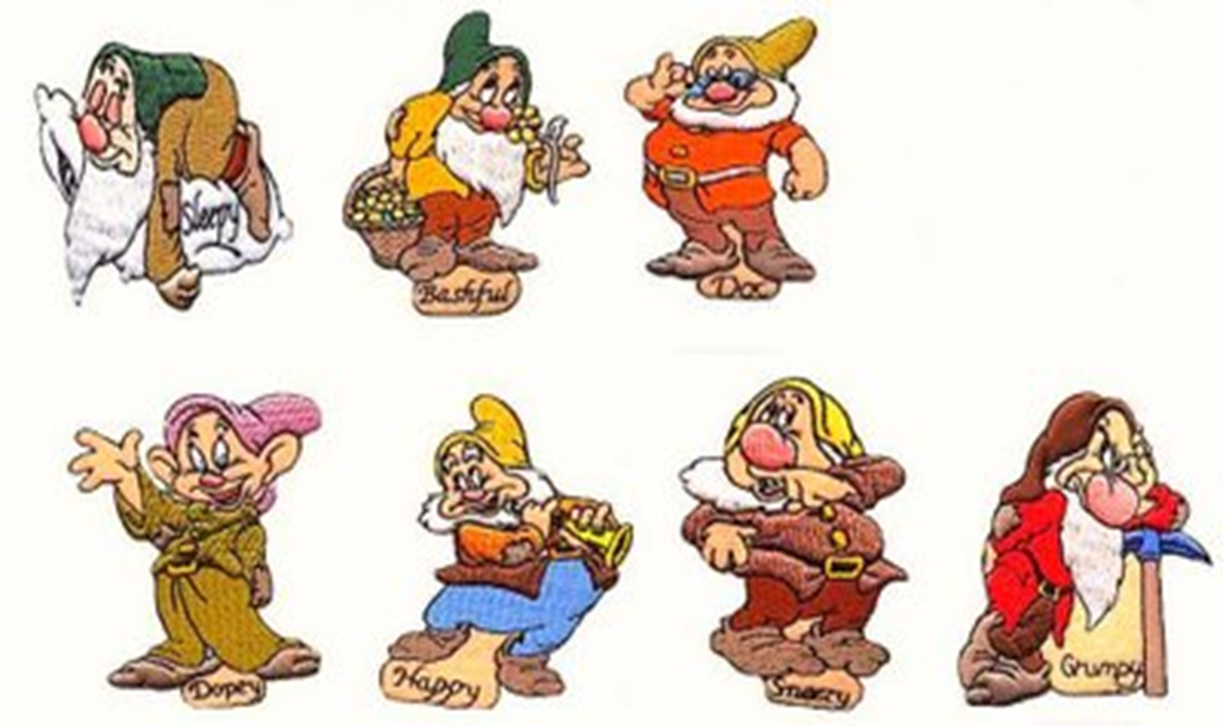
“Management and
The Seven Dwarfs”

Slide 87

“Management and
The Seven Dwarfs”(cont’d)
Management of the Seven personalities......
Dopey: the youngest, sweetest, and silliest of the seven. He is clumsy and he/she simply "never tries to speak".
Grumpy: the grouchiest and the leader of the group, even though he is supremely devoted to the beautiful Snow White Management.
Doc: the only one of the dwarfs to wear glasses and often mixes up his words; presumably the most intellectual.
Happy: the most joyous of the dwarfs...

Slide 88

“Management and
The Seven Dwarfs” (cont’d)
Bashful: evokes his bashful nature through a classic pose of shyness and is often embarrassed by the presence of any attention directed at him.
Sneezy: frequently shown with one finger underneath his nose, as if trying to stifle a sneeze; sickly....
Sleepy: always tired and appears laconic in most situations; wears a perpetually sleepy looking, heavily lidded expression on his face.
The dwarfs’ occupation is working in the diamond mines Department under your supervision.

Slide 89

SUPERVISOR DID YOU...
NOTICE YOUR SUBORDINATES??
TELL YOUR SUBORDINATES WHAT YOU EXPECT FROM THEM??
IDENTIFY TO YOUR SUBORDINATES THEIR RESPONSIBILITIES??
TRAIN YOUR SUBORDINATES AS TO THEIR RESPONSIBILITIES AND EXPECTATIONS??
DOCUMENT??
DID YOUR SUBORDINATES SIGN OFF ON YOUR WRITTEN EXPECTATIONS??

Slide 90
SO SUPERVISORS.......
IS IT FAIR.....
or can you now DISCIPLINE your subordinates?

Slide 91
Arrest Log Tracking
The Arrest Log Application tracks the disposition of cases for County employees that have been arrested
The Miami-Dade Police Department notifies HR, via a memo, when a county employee is arrested for both misdemeanors and felonies. The employee’s department is also notified
The arrest information will be entered by Labor HR personnel. If an employee is arrested, according to Administrative Order No.: 7-39, the employee must notify the Department Director or his/her designee
The departments review the charges and determine the appropriate administrative action to be taken. Labor Management personnel must be contacted to determine the appropriate action. There are various actions that may be taken from “none” to “written reprimand” to “suspension” to “dismissal”

Slide 92
Arrest Log Tracking
(Continuation)
Once the case has been to court, the final disposition of the case is recorded. At this point, the case may be closed. If the employee had been suspended and is acquitted of the charges, the employee may be reinstated and the employee may receive back pay. This entire process may be lengthy and each case must be reviewed and updated by the departments at least every 30 days. The application includes an aging and escalation process to monitor the status of pending cases. If a record has not been updated within 30 to 60 to 90 days, an email is generated by the arrest tracking system and sent to the designated recipients depending on “age” of the record
Reports of open and closed cases may be printed. Departments will have permitted access only to employees within their department

Slide 93
Medical Assessment Guidelines
For Scheduling Physical
Examinations And Drug/Alcohol Tests
The Labor Relations and Employee Records Division, People and Internal Operations Department, coordinates all County sponsored physical examinations and/or drug/alcohol tests
County department’s authorized personnel are responsible for scheduling physical examinations appointments and tests for their applicants and employees using the HR Medical Scheduler Program https://w85iap.miamidade.gov/Medical/main/home.jsp
Appointment schedules are sent to the County’s medical services provider each business day at 12:00 p.m., for medical services for the following day, by the Labor Relations Unit

Slide 94
Reasonable Suspicion Tests
Using established guidelines (Administrative Order 7-29), reasonable suspicion tests may be scheduled by the department with authorization by a designated Division Director or higher position. The Labor Relations Unit will approve personnel who have the authority to authorize reasonable suspicion tests.

Slide 95
Fitness For Duty
Miami-Dade County is committed to providing a safe work environment for all employees. Generally speaking, a fitness-for-duty evaluation is a medical examination of a current employee to determine whether the employee is physically or psychologically able to perform the job.
To be fit for duty means that an individual is in a physical, mental, and emotional state which enables him/her to perform the essential task of his/her work in a safe and competent manner which does NOT pose a threat to the safety or health of self, co-workers, property, or the public at large.

Slide 96
Reasons For Fitness
For Duty Evaluation
Observed behavior with objective evidence of a problem.
Management has reasonable belief based on objective information, that an employee’s ability to perform the essential functions of the job in a competent and safe manner is impaired by a medical/psychological condition; or that the employee poses a direct threat to self or others due to a medical/psychological condition.
An employee expresses concern about his or her ability to perform their job duties or requests job accommodation(s).
An employee is returning to work after taking time off for a serious illness or injury.

Slide 97
Employee Participation
Employee must cooperate with evaluation and treatment to avoid administrative action
Failure to comply with the fitness for duty evaluation requirements (obey direct order) is insubordination, which could result in disciplinary action, up to and including termination
Evaluation process requires employees to provide the County’s examining physician, their medical records going back five (5) years

Slide 98
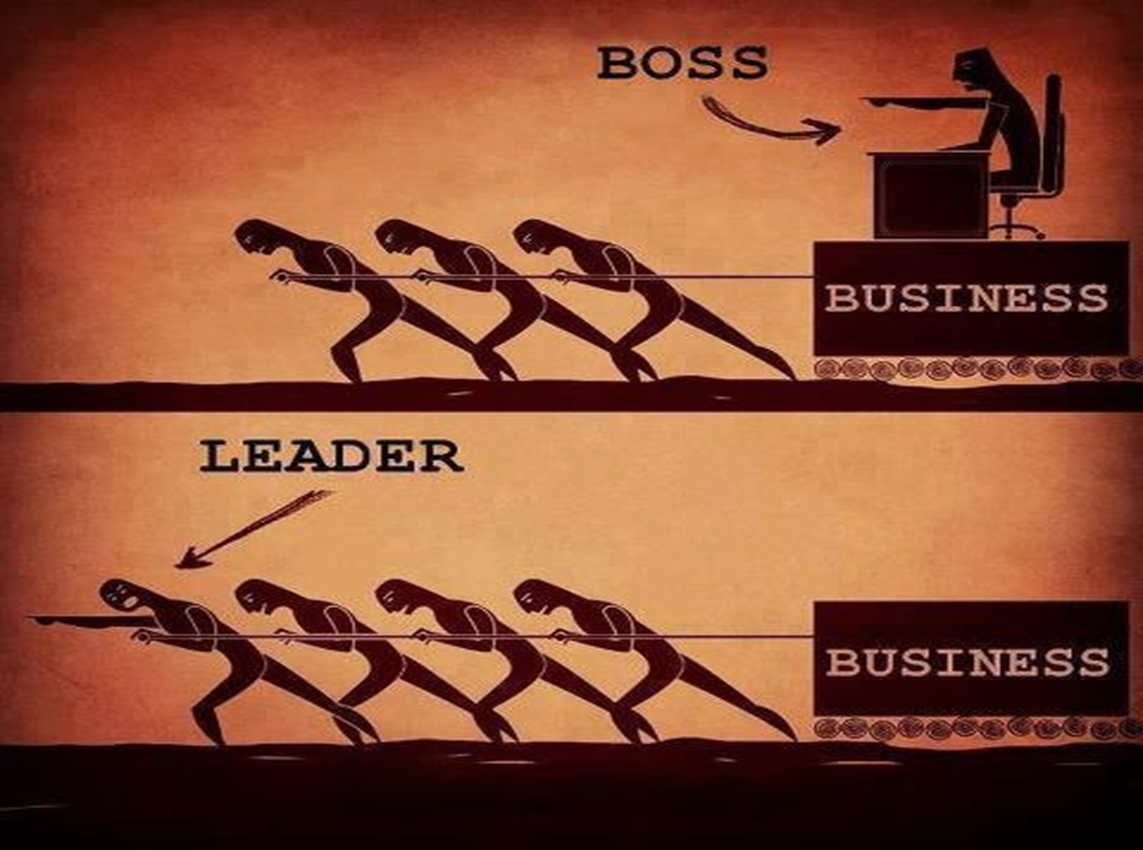

Slide 99

The Two Wolves
One evening an old Cherokee Indian told his
grandchild about a war that goes on inside people.
He said, 'My son, the war is between
two 'wolves' inside us all...
One is Evil. It is anger, fear, envy, jealousy, sorrow, regret, greed, arrogance, self-pity, guilt, resentment, inferiority, lies, false pride, superiority, and ego.
The other is Good. It is joy, peace, love, hope, serenity, humility, kindness, benevolence, empathy, generosity, truth, compassion and faith.'
The grandchild thought about it for a minute
and then asked his grandfather,
'Which wolf wins?'
The old Cherokee Grandfather replied:
The One You Feed!

Slide 100


Q & A

