Slide 1



Time Management
Supervisor Training
Approving Time and Absence in INFORMS

Slide 2
INFORMS
INFORMS is the County’s official payroll and attendance system of record
Accountability is placed on Employees to enter Time and Absence through Employee Self-Service and Supervisors to approve time through Manager Self-Service.
Audit trail/Tracking of changes.
Online editing to proactively mitigate potential mistakes.
Departmental HR liaisons are responsible for reviewing payroll closeout dashboards to ensure employees Time and Absence has been approved and all exceptions are cleared.

Slide 3
Purpose and Benefits to Business Process
The purpose and benefits of the Time Management business process include:
•Reduce paper processes (Electronic workflows)​.
•Real-time updates to time and absence entry and approvals.
•Employee Empowerment (Employee Self Service and Manager Self Service and mobile capabilities)​.
•Reduction of processing time​.
•Enhanced Reporting.

Slide 4

Deadlines
Payroll
Employees and Timekeepers should have all entries completed by noon Non-Pay Week Friday.
Part-Time employees should not project hours worked to prevent a possible overpayment.
Full-Time employees should only project their regular scheduled hours.
DPR’s and Supervisors are required to complete all approvals by Pay Week Monday at 11:00am.
Late Changes for Prior Pay Periods should be entered and approved by close of business Non-Pay Week Wednesday.

Slide 5
Payroll Lockout
There is a timesheet lockout for Employees and Timekeepers starting on Non-Pay Week Friday at 9:00pm and continues until Wednesday morning of Pay Week.

Slide 6
Learning Objectives
•Approve Time.
•View Forecast Balance.
•Enter Time on Behalf of Employee.
•Submit Absence on Behalf of Employee.

Slide 7
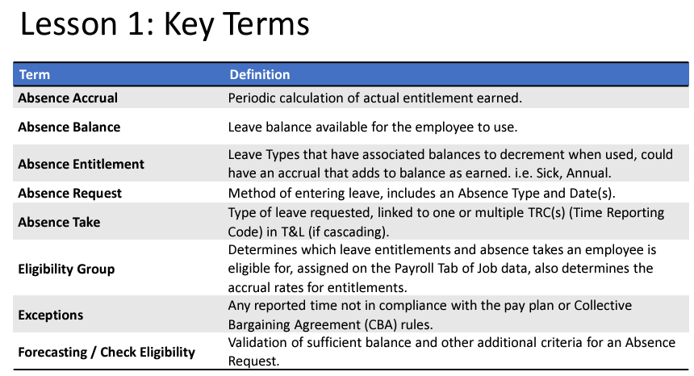

Slide 8
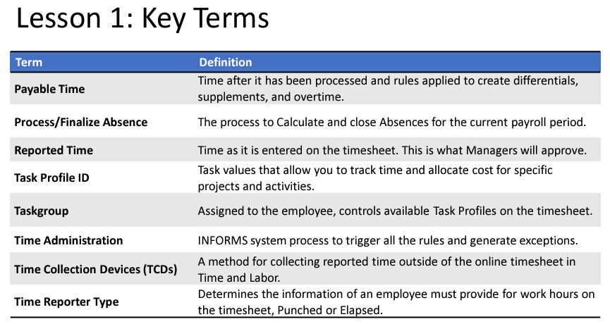

Slide 9
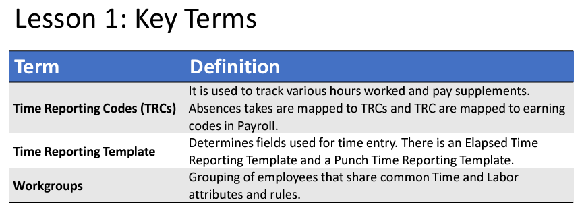

Slide 10
Lesson 1: Approve Reported Time​ and Absence
•Employees may not get paid if the reported time is not approved.
•If a manager is unable to review and approve an employee’s time, a Department Personnel Representative (DPR) can approve the time on the Manager’s behalf.
•Absence Balances displays the year-to-date absence balances for each absence type. These balances are from the most recent closed pay period and do not reflect accruals earned or hours taken after the pay period end date.

Slide 11
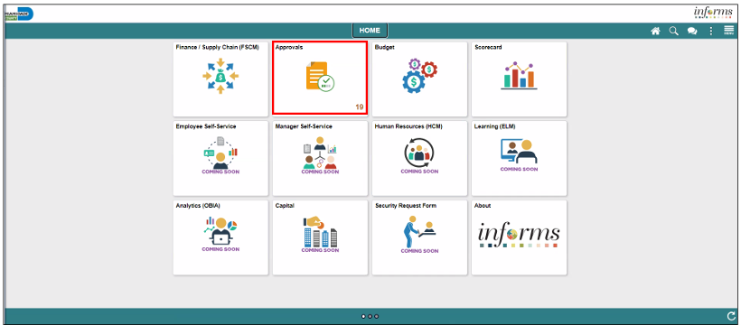
Lesson 1: Approve Reported Time​ and Absence Continued
The following outlines how to approve time through approvals:
1. Navigate to: Home > Approvals.

Slide 12
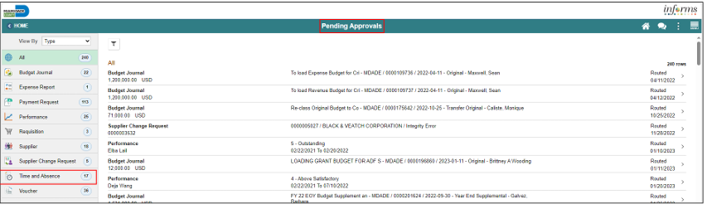
Lesson 1: Approve Reported Time​ and Absence Continued
2. The list of Pending Approvals will be available via Pending Approvals page.
3. Select Time and Absence to view the list whose time need to be approved.

Slide 13
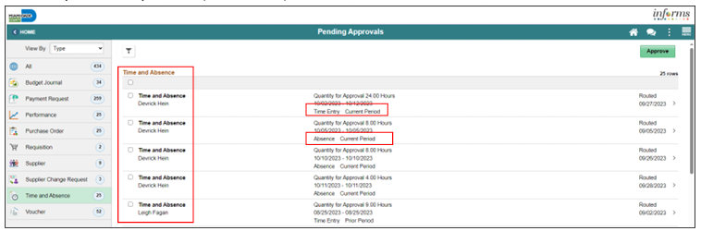
Lesson 1: Approve Reported Time​ and Absence Continued
Note: The new indicator feature will distinguish between Time entries and Absence entries and the corresponding period.

Slide 14
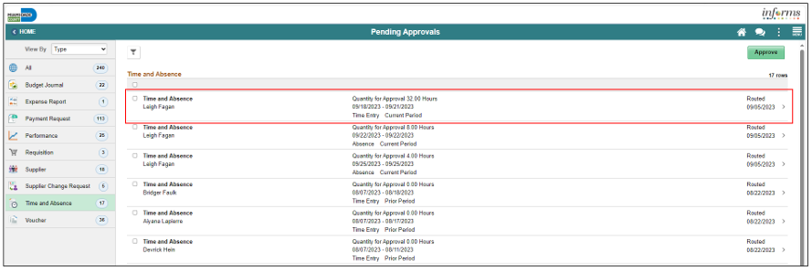
Lesson 1: Approve Reported Time​ and Absence Continued
4. To drill down into the time or absence entry, select the row in the Time Entry or Absence details section in which needs to be approved.

Slide 15
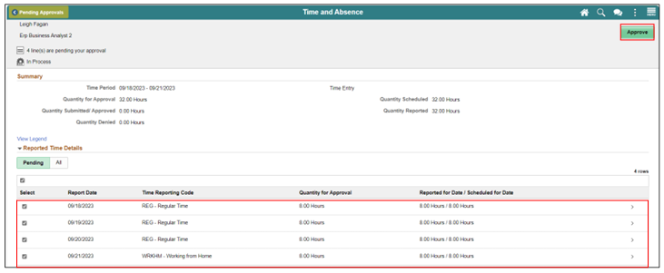
Lesson 1: Approve Reported Time​ and Absence Continued
5. Select the individual time entry lines or all time entry lines. Select the Approve button to approve this employee’s reported time or absence request. Select the Approve button to approve this employee’s timesheet.

Slide 16
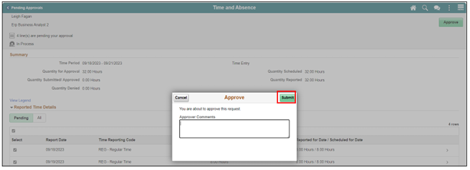
Lesson 1: Approve Reported Time​ and Absence Continued
6. An Approve window will appear to ensure all comments are included prior to submitting the employee’s reported time.
7. Select Submit.
Note: Once submitted, INFORMS will populate a message to inform the approver that they have Approved the request.

Slide 17
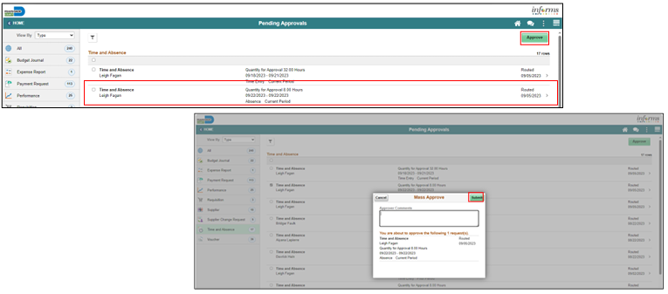
Lesson 1: Approve Reported Time​ and Absence Continued
8. When approving an Absence Request, simply select the absence on the Pending Approvals page that you would like to approve. Select Approve, enter any applicable Approver Comments and Submit. Finally, select OK.

Slide 18
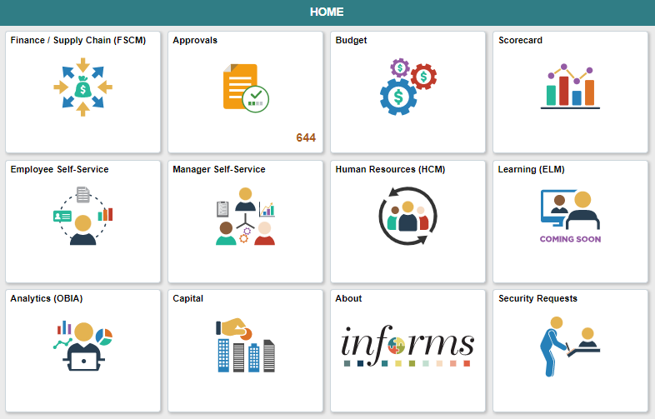
Lesson 1: Approve Reported Time​ and Absence Continued
The following outlines how to approve time through Manger Self Service:
1. Navigate to: Home > Manager Self Service.

Slide 19
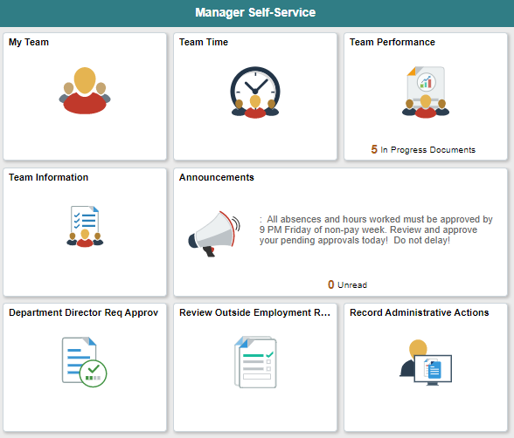
Lesson 1: Approve Reported Time​ and Absence Continued
2. Select the Team Time tile.

Slide 20
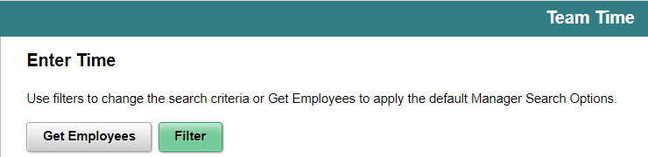
Lesson 1: Approve Reported Time​ and Absence Continued
3. Select Get Employees.

Slide 21
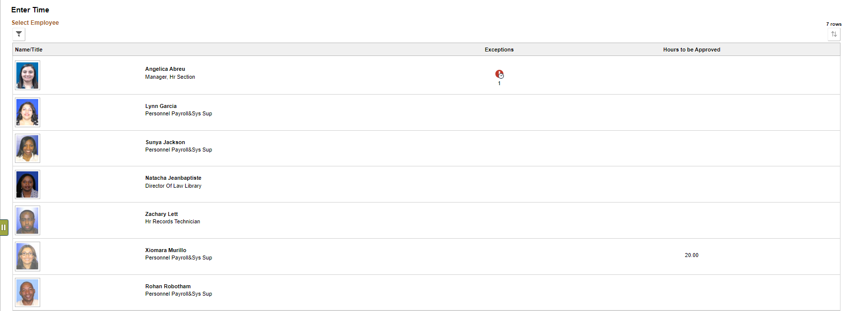
Lesson 1: Approve Reported Time​ and Absence Continued
4. Select the employee you want to review and approve.

Slide 22
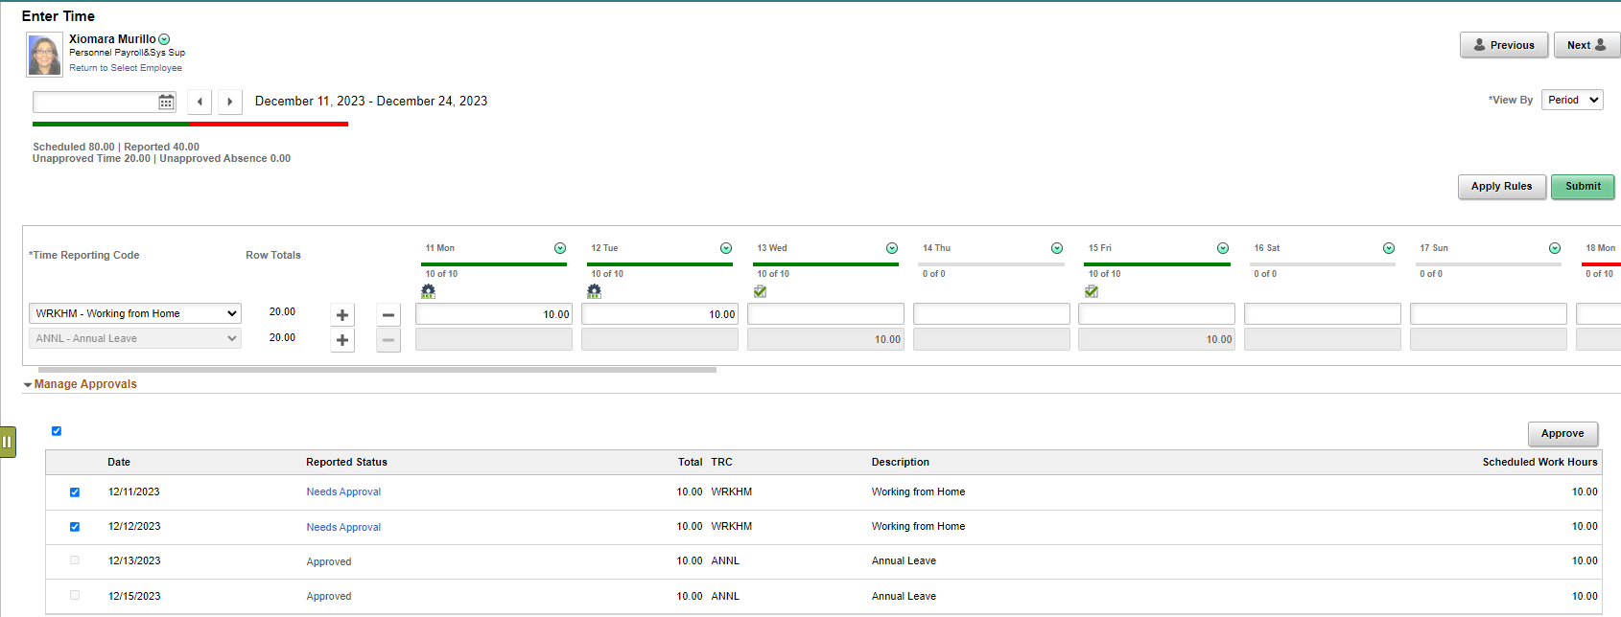
Lesson 1: Approve Reported Time​ and Absence Continued
5. The timesheet for the current pay period will be displayed. You can review and approve both, Time and Absence. Select the time to approve and click Approve.

Slide 23
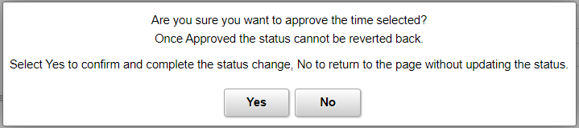
Lesson 1: Approve Reported Time​ and Absence Continued
6. A message window will populate Click Yes to approve.

Slide 24
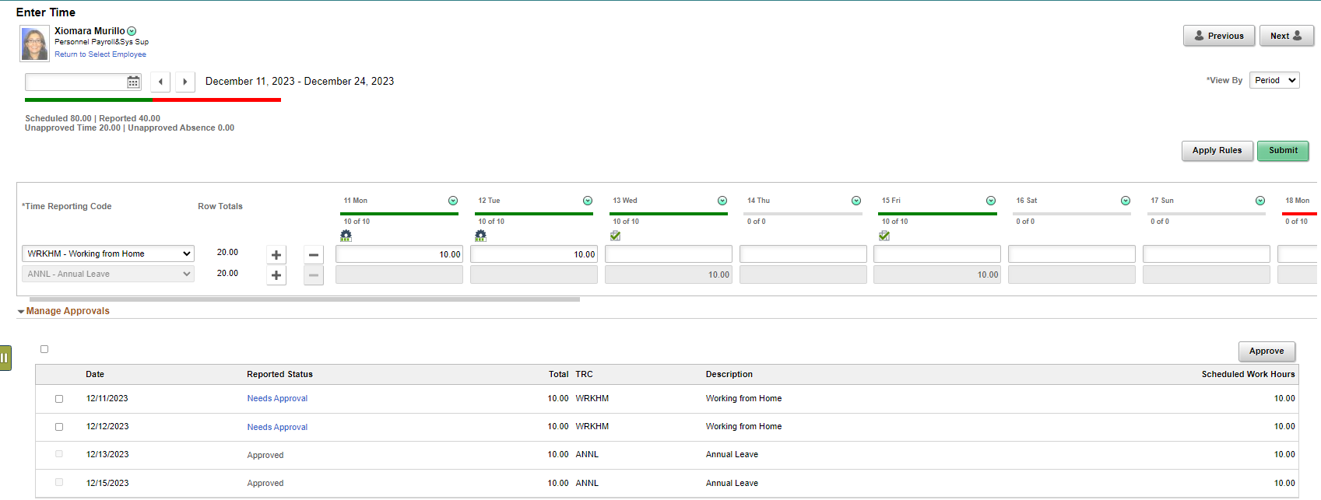
Lesson 1: Approve Reported Time​ and Absence Continued
7. Once time is approved, it will display a check mark showing that the time is approved. You can select Next to review and approve the next employee.

Slide 25
Lesson 2: View Forecast Balance
•Understand how absence balances displayed on the employee’s absence balance pages:
•Balances are from prior closed pay periods.
•Balances do not include accruals earned or hours taken after pay period.

Slide 26
Lesson 2: View Forecast Balance Continued​​​
•Managers can review Forecast Balance through the Manager Self Service tile. The Forecast Balance allows you to forecast a specific absence type for the employee as of a past or future date.

Slide 27
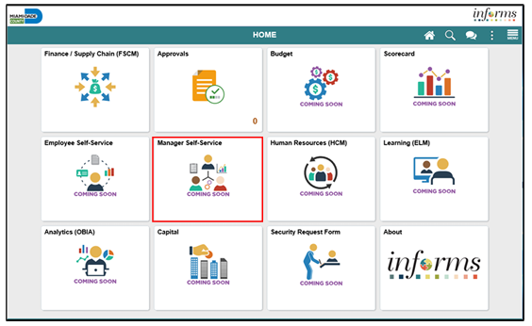
Lesson 2: View Forecast Balance Continued​​​
1. Login to the INFORMS and select Manager Self-Service tile from the home landing page.

Slide 28
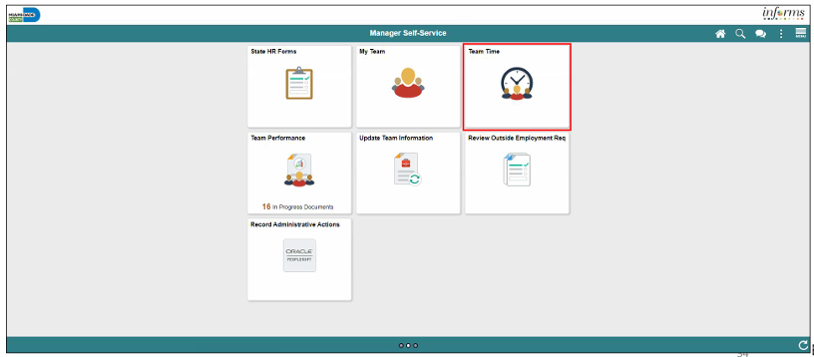
Lesson 2: View Forecast Balance Continued​​​
​​​​​​
2. Select Team Time.

Slide 29
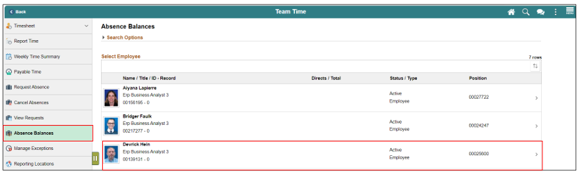
Lesson 2: View Forecast Balance Continued​​​
​​​
3. Select Absence Balances.
4. Select an employee’s absence balance record.

Slide 30
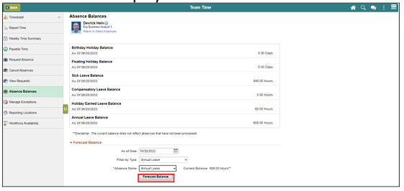
Lesson 2: View Forecast Balance Continued​​​
5. Scroll down and select Forecast Balance.
6. Select the date for which you want to forecast the balance in As Of Date.
7. Select the type of absence being forecasted in Filter by Type.
8. Select the type of absence in Absence Name.
9. Select Forecast Balance to display the forecasted balance details.

Slide 31
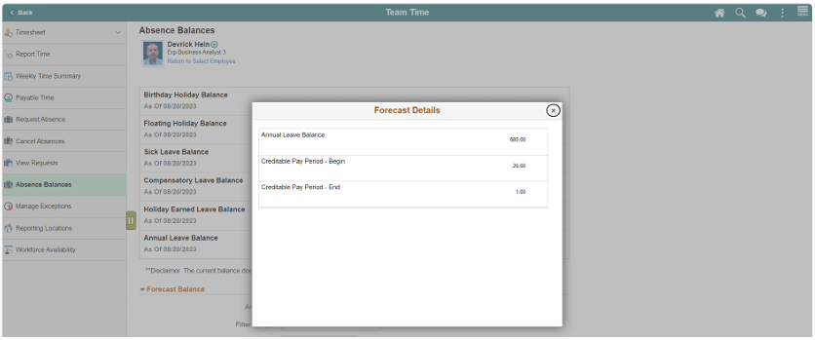
Lesson 2: View Forecast Balance Continued​​​
​​
The Forecast Details will display.

Slide 32
Lesson 3: Enter Time on behalf of Employee
• Acknowledge the difference between reported and payable time.
• Enter time on behalf of an employee using an elapsed timesheet.

Slide 33
Lesson 3: Enter Time on behalf of Employee
Timekeeping during the Current Period
•After an employee submits time through the timesheet, it is sent to the Manager for approval. Once the timesheet is approved, the time is processed for Payroll. The time that was submitted by the employee is known as reported time. Once the reported time is processed, it generates payable time.
•In the event that an employee is away and or unable to enter time or an absence, their Manager can enter the employee’s time on their behalf.

Slide 34
Lesson 3: Enter Time on behalf of Employee
•Reported time is considered time worked after an employee submits time through the timesheet.
•Payable time is the end product of the Time and Labor module. Payable time represents:
•The quantity of work performed, in hours or dollars.
•The time reporting code that controls how the employee is paid.
•The tasks to which time was reported by the employee.

Slide 35
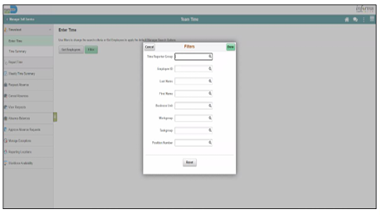
Lesson 3: Enter Time on behalf of Employee
Navigate to: Manager Self Service > Team Time > Enter Time
On the Enter Time: Timesheet Summary page, the Manager or Department Personnel Representative (DPR) can search for the employee that time must be submitted for.
Note: As a Manager or DPR, you may use the Report Time selection from the navigation to enter time for the current day.

Slide 36
Lesson 3: Enter Time on behalf of Employee Continued
2. Select Get Employees to see all employees or use the Filter and enter any of the search selection criteria indicated to filter and narrow down the search results. Then Select Done.
Note: If a Manager is using this functionality and Selects Get Employees, all employees the Manager manages, based on the Time Reporter Group, will be displayed. If a Department Personnel Representative (DPR) Selects Get Employees with no search criteria, all employees within their same security group will be listed. It is recommended that users enter at least a Department, Empl ID, or Business Unit, Taskgroup to narrow the search results.

Slide 37
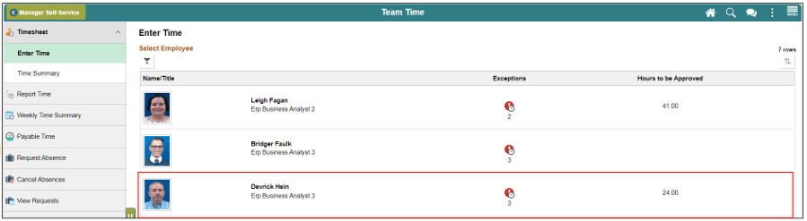
Lesson 3: Enter Time on behalf of Employee Continued
3. Review the search results under Enter Time page. Select the employee to open the employee’s timesheet.

Slide 38
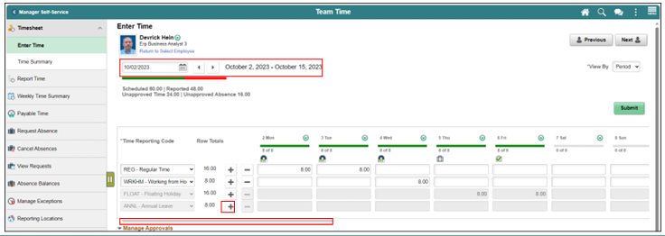
Lesson 3: Enter Time on behalf of Employee Continued
4. Review the employee’s timesheet for this period. Ensure you are in the correct Pay Period.
5. Select the ‘+’ button to add an additional line for a unique Time Reporting Code. Use the slider to view additional dates in the Pay Period.
Note: Although the Next Time Period link is available, the Department Personnel Representative (DPR) cannot enter future time on behalf of the employee.

Slide 39
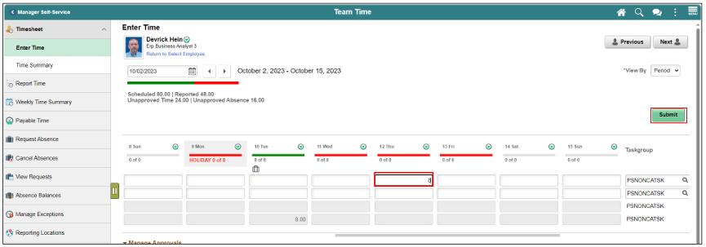
Lesson 3: Enter Time on behalf of Employee Continued
6. Enter desired hours and select submit.

Slide 40
Lesson 3: Enter Time on behalf of Employee Continued
7. For each line select the appropriate Time Reporting Code.
• The options will vary based on the employee’s job and tasks.
The following are some common time reporting codes used:
• REG – Regular Hours Worked
• OVT – Overtime

Slide 41
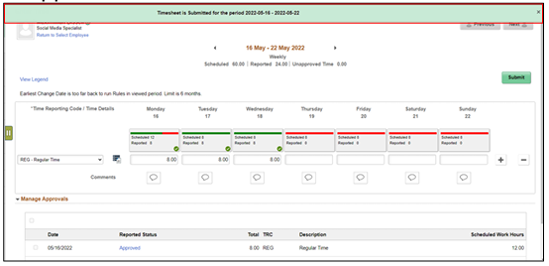
Lesson 3: Enter Time on behalf of Employee Continued
8. When all time and time reporting codes are entered, Select Submit. The following message will appear:
Note: Additional fields may be required on the timesheet based on the timesheet the department or employee uses. If additional fields are required, enter the applicable information before Selecting Submit. Once the Manager submits the time on behalf of the employee, the reported time is automatically approved.

Slide 42
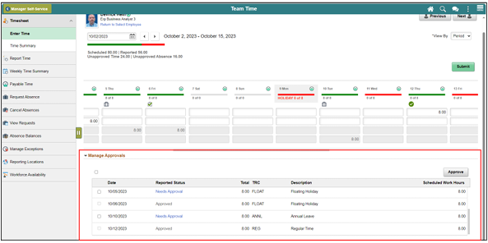
Lesson 3: Enter Time on behalf of Employee Continued
9. In the Manager Approvals section, the Reported Time Status will display:
• Date: The date for which the time was submitted.
• Reported Status: The status of the time that was submitted.
• Total: The total number of hours submitted for each TRC for the day.
• TRC (Time Reporting Code): The time reporting code associated with the status.
• Description: The description of the time reporting code.
Note: you can also approve time / absence in this section.

Slide 43
Lesson 4: Submit Absence on behalf of an Employee
•Enter an Absence on Behalf of an Employee using Absence Management

Slide 44
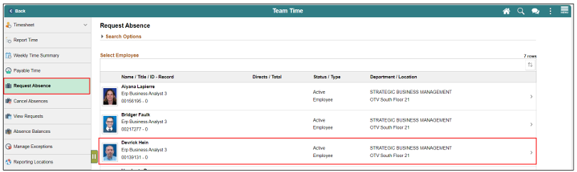
Lesson 4: Submit Absence on behalf of an Employee
The following steps outline how the Manager can submit an absence request on behalf of the employee if the employee is unable to report it.
Navigation: Homepage > Manager Self-Service > Team Time > Request Absence
Select Request Absence and then select an employee to submit absence on behalf of.

Slide 45
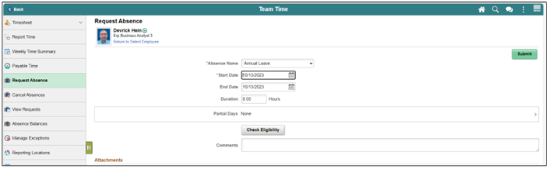
Lesson 4: Submit Absence on behalf of an Employee
3. Populate the absence request form.
• Absence Name
• Start Date
• End Data
• Duration
Note: Different absence type in the Absence Name field will require additional information. Partial leave can also be requested.

Slide 46
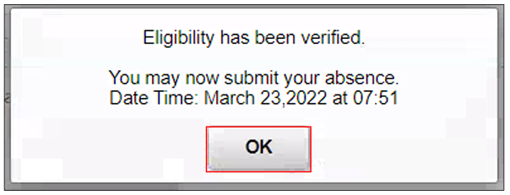
Lesson 4: Submit Absence on behalf of an Employee
4. Select Check Eligibility to check employee’s available balance and eligibility of the selected absence, then select OK.

Slide 47
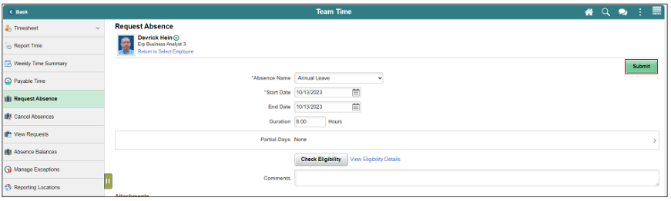
Lesson 4: Submit Absence on behalf of an Employee
5. Review the absence details and Select Submit.

Slide 48
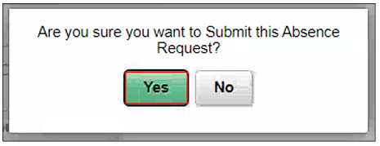
Lesson 4: Submit Absence on behalf of an Employee
6. Select Yes once prompted.

Slide 49

Congratulations on successfully completing the
Personnel Time & Attendance Training!

