Slide 1
SUPERVISORY TRAINING:
Addressing and Supporting Employee Mental Health in the Workplace
Presented by:
The Employee Assistance Program
Employee Support Services Section
Benefits and Employee Support Services Division
Human Resources Department

Slide 2
COURSE OVERVIEW:
Why Workplace Wellness Matters
How to Identify Mental Health and Substance Use Disorders
Impact of Mental Health and Substance Use Symptoms on the Workplace
How to support employees who are struggling with Mental Health and/or Substance Use Disorders
How to address Substance Use in the Workplace/Reasonable Suspicion
How can the EAP support you as a leader
Best Practices
Resources Available

Slide 3

What Do You Hope to Learn?

Slide 4
Health and Wellness
Health is a state of complete physical, mental and social well-being and not merely the absence of disease or infirmity. World Health Organization (WHO)
Wellness is not the absence of disease, illness or stress, but the presence of purpose in life, active involvement in satisfying work and play, joyful relationships, a healthy body and living environment, and happiness. Substance Abuse and Mental Health Services Administration (SAMHSA)

Slide 5

Mental Wellness
The WHO defines Mental Wellness as:
“a state of well-being in which the individual realizes his or her own abilities, can cope with the normal stresses of life, can work productively and fruitfully, and is able to make a contribution to his or her community.”
Notes:
Employee who is mentally well… why is that important? Impact and Engagement

Slide 6
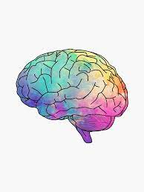
What is a Mental Health Disorder?
Notes:
Interfere with daily life, home and work, Depression, Anxiety, serious Mental Illness like psychotic disorders schizophrenia or bipolar disorder, or trauma

Slide 7
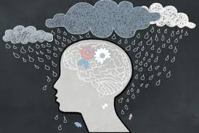
What is a Substance Use Disorder?

Slide 8
What are some signs and symptoms that may indicate mental health or substance use issues?

Slide 9
Signs and Symptoms
It’s easy to miss some early warning signs of mental illness in the workplace. There are some common signs that you should look out for:
      Long-lasting sadness or irritability
      Extremely high and low moods
      Excessive fear, worry, or anxiety
      Social withdrawal
      Dramatic changes in performance, attendance, eating or sleeping habits
      Frequent accidents
      Anger or Interpersonal conflict
Remember, if you spot one of these signs, it doesn’t always mean someone has a mental health issue. It could signal an underlying health problem or something else entirely.

Slide 10

Signs and Symptoms: Depression
Depression impacts 16% of adults during
their lifetime.
Warning signs include:
    Trouble sleeping, or sleeping too much
    Feeling sad
    Loss of interest in activities previously enjoyed,
    social withdrawal
    Difficulty concentrating and making decisions
    Changes in appetite, overeating or not eating
    enough
    Fatigue
    Restless activity or slowed movements and speech
    Feelings of worthlessness or guilt
    Thoughts of suicide or self-harm

Slide 11

Signs and Symptoms: Anxiety
Anxiety impacts 30% of adults during their lifetime.
Warning signs include:
    Excessive worry
    Feeling nervous, irritable or on edge
    Sense of impending danger, panic or doom
    Increased heart rate
    Panic attacks, Breathing rapidly (hyperventilation), sweating, and/or trembling
    Feeling weak or tired
    Difficulty concentrating
    Trouble sleeping
    Gastrointestinal (GI) problems

Slide 12

Signs and Symptoms: Trauma
Research estimates that roughly 5 percent of the US population—13 million adults—have PTSD.
Some signs/symptoms you may see in the workplace:
  Difficulty concentrating due to thoughts, flashbacks, fear or traumatic responses
  Hypervigilance/Easily startled
  Anger and low frustration tolerance
  Poor concentration
  Mood swings
  Fatigue
  Avoidance, shame and guilt

Slide 13
Signs and Symptoms: Substance Use Disorders (SUD)
Over 44 million Adults in the US meet the criteria for a substance use disorder.
Changes in performance
Frequent or patterned unplanned absences or tardiness (e.g., Mondays and Fridays, or immediately after payday)
Reduced job efficiency and productivity
Erratic or impulsive behavior
Poor judgment
Frequent accidents on the job
Mood swings, anger, defensiveness, argumentative behavior
Excessive use of sick leave
Complaints from co-workers or customers
Changes in behavior
Lack of coordination, staggering
Appearing confused or forgetful
Excessive use of mouthwash or breath mints
Falling asleep while on duty
Disheveled
Trembling/shaking
Restless/agitated
Changes in speech pattern
Strained relationships with co-workers
Belligerent, argumentative, or short-tempered, especially in the mornings or after weekends or holidays
Becoming a “loner”

Slide 14

Signs and Symptoms: Severity
We can classify symptoms into three levels of severity. An individual may be experiencing differing levels of severity for different symptoms simultaneously.
By identifying these signs before they reach a severe state and providing support, you can allow your employee to manage
their work life and personal life together effectively.
The levels of severity are:
    Mild: A few symptoms, with little effect on day-to-day
    Moderate: More symptoms that can make their daily life much more difficult than usual.
    Severe: Many symptoms that can make their daily life extremely difficult.

Slide 15
Understanding Mental Health and Substance Use Disorders
Substance Use Disorders (SUD) and Mental Health Disorders (MH) are very common
For 1 in 10 people, substance abuse leads to addiction.
Both Mental Health and Substance Use Disorders have some hallmarks:
Acute/Chronic
Progressive
Primary
Terminal

Slide 16
Fact or Fiction:
Mental health disorders are common within the US population.
1 in 6 people in the US struggle with a mental illness or substance use disorder.
Most people who need help for substance use get the help they need.
The largest age group in the US that is struggling with their mental health is 26-49.
45% of Alcohol Users are binge drinkers.

Slide 17
Incidence of Mental Health and Substance Use in the Workplace

Slide 18
Incidence of Mental Health Disorders
According to the 2023 National Survey on Drug Use and Health (NSDUH) by the Substance Abuse and Mental Health Services Administration (SAMHSA):
  An estimated 58.7 million adults aged 18 or older in the United States with AMI. This number represented 18% of all U.S. adults.
  The prevalence of AMI was higher among females (26.4%) than males (19.0%).
  Young adults aged 18-25 years had the highest prevalence of AMI (36.2%) compared to adults aged 26-49 years (29.4%) and aged 50 and older (13.9%).

Slide 19
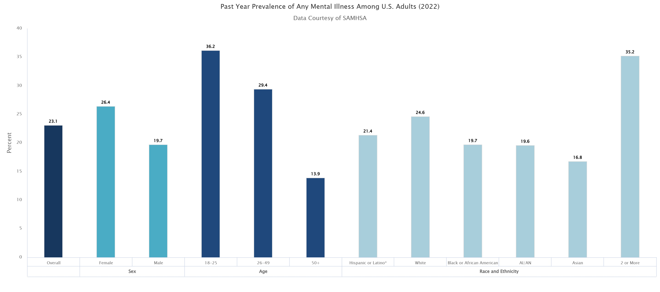
Incidence of Mental Health Disorders
**This is something to keep in mind as the newer generations are entering
the workforce.

Slide 20
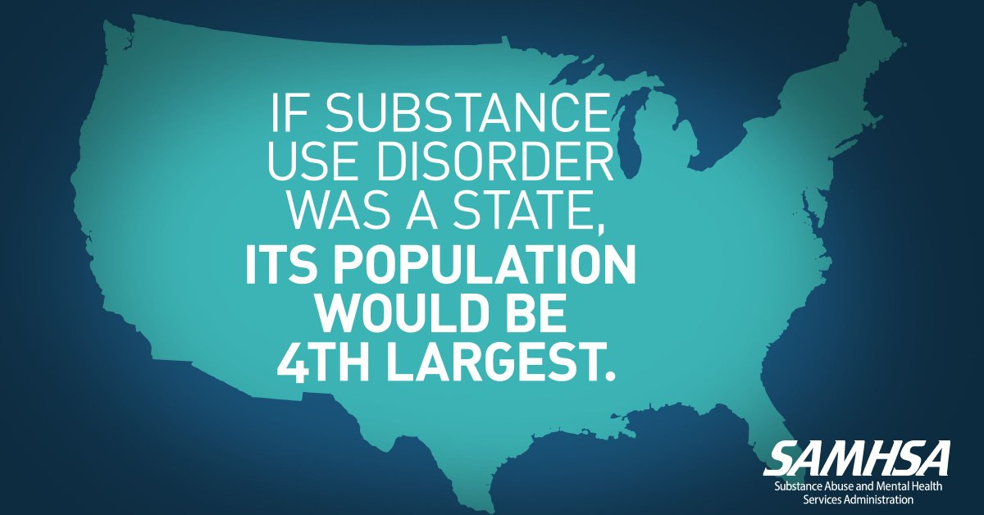

Slide 21
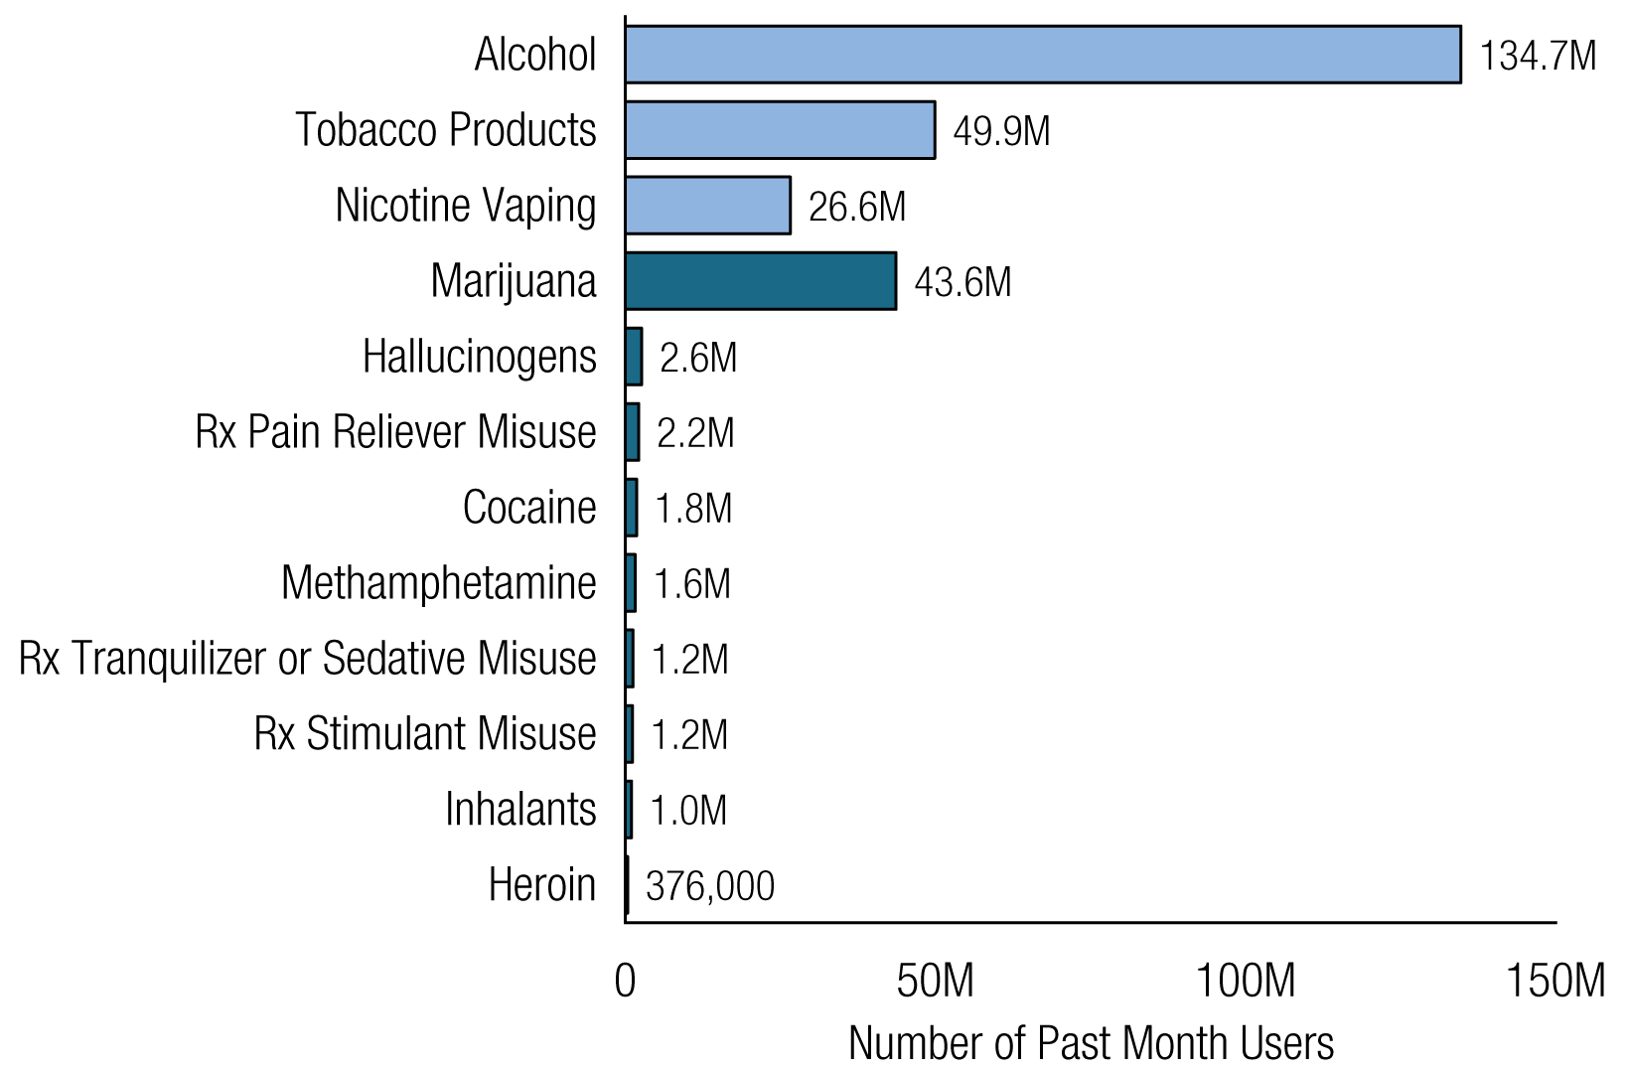
Incidence of Substance Use Disorders
2023 SAMHSA US Substance Use Statistics: Past Months Use, 12 yr. or older
    Rx = prescription.
    Note: The estimated numbers of current users of different substances are not mutually exclusive because
    people could have used more than one type of substance in the past month.

Slide 22
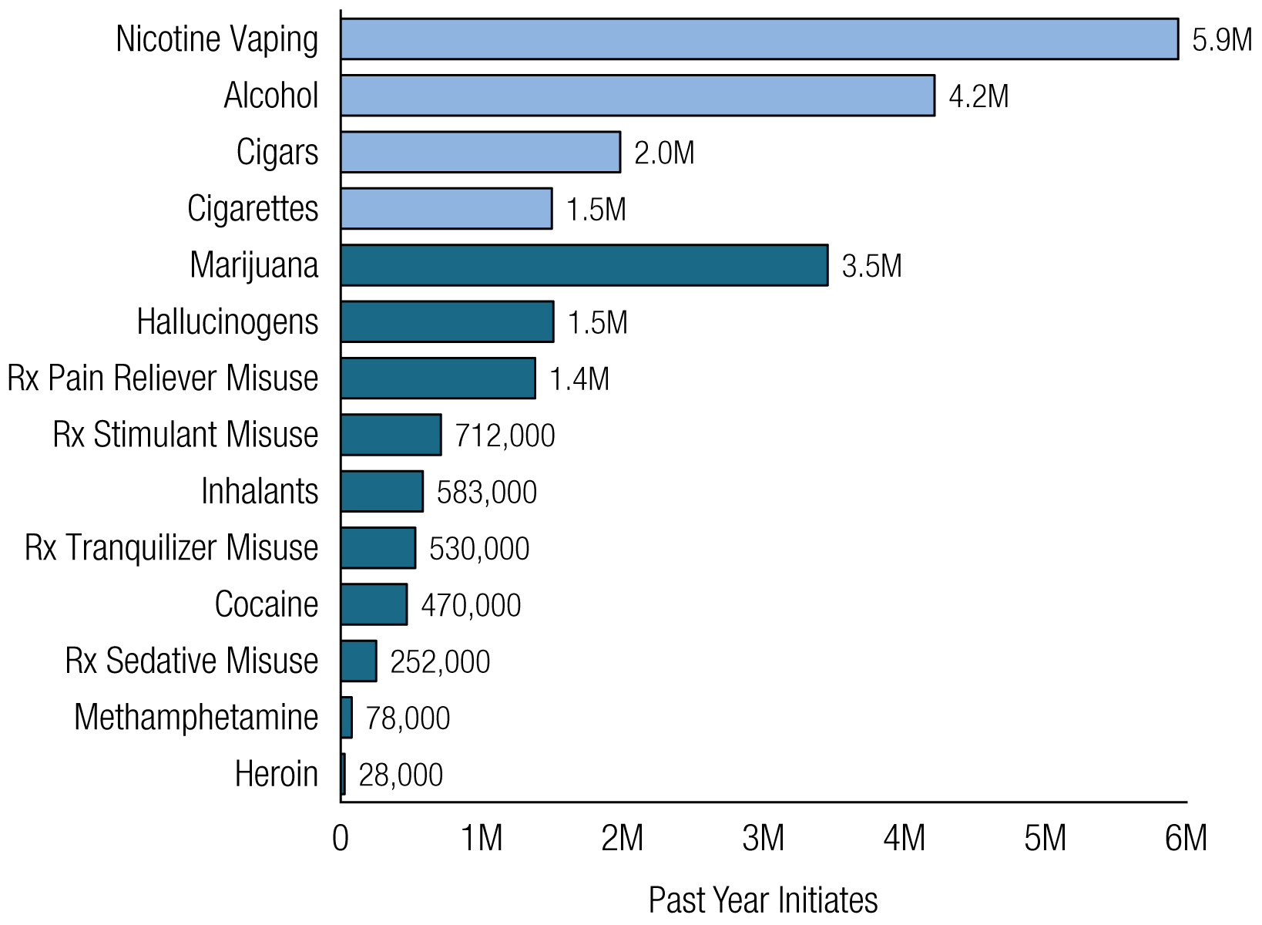
Incidence of Substance Use Disorders
2023 SAMHSA US Substance Use Statistics: Past Year Use, 12 yr. or older
    Rx = prescription.
    Note: The estimated numbers of current users of different substances are not mutually exclusive because
    people could have used more than one type of substance in the past month.

Slide 23
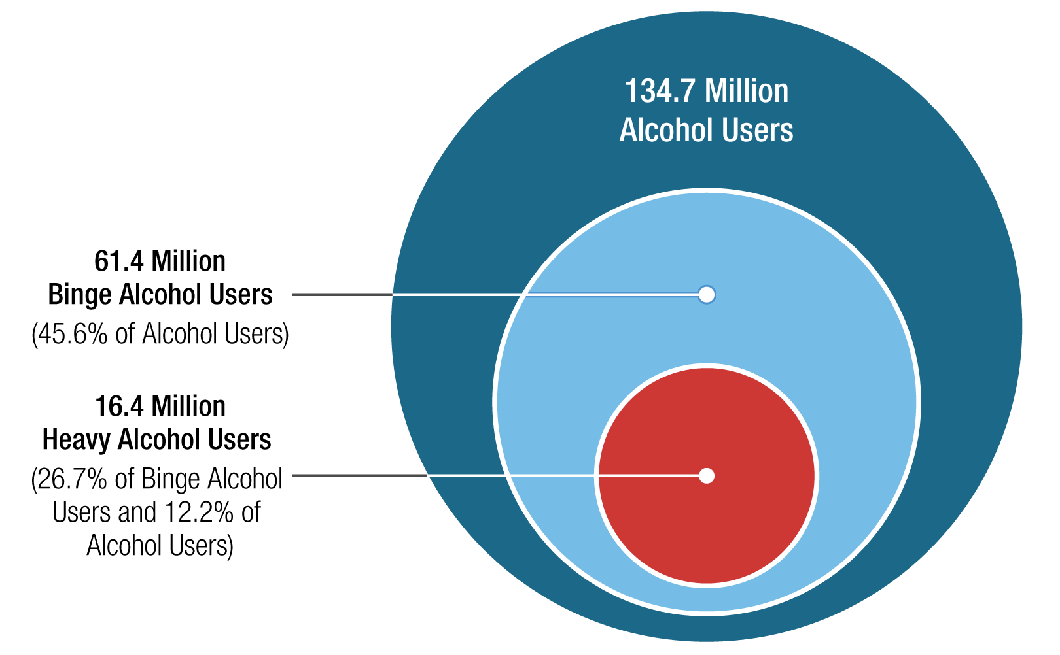
Incidence of Substance Use Disorders
2023 SAMHSA US Substance Use Statistics: Past Months Alcohol Use
Note: Binge Alcohol Use is defined as drinking five or more drinks (for males) or four or more drinks (for females) on the same
occasion on at least 1 day in the past 30 days. Heavy Alcohol Use is defined as binge drinking on the same occasion on 5 or
more days in the past 30 days; all heavy alcohol users are also binge alcohol users.

Slide 24
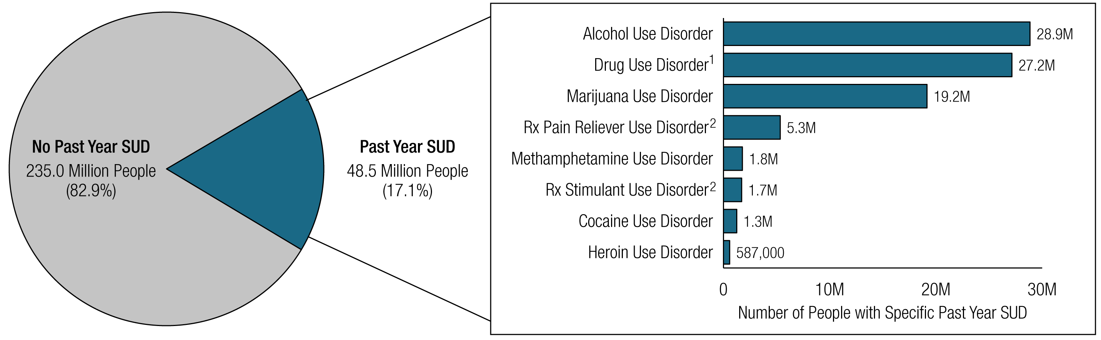
Incidence of Substance Use Disorders
2023 SAMHSA US Substance Use Statistics: Past Year Substance Use Disorder (SUD): Among People Aged 12 or Older; 2023
Note: The estimated numbers of people with substance use disorders are not mutually exclusive because people could have use disorders for more
than one substance.
¹ Includes data from all past year users of marijuana, cocaine, heroin, hallucinogens, inhalants, methamphetamine, and prescription
psychotherapeutic drugs (i.e., pain relievers, tranquilizers, stimulants, or sedatives).
² Includes data from all past year users of the specific prescription drug.

Slide 25
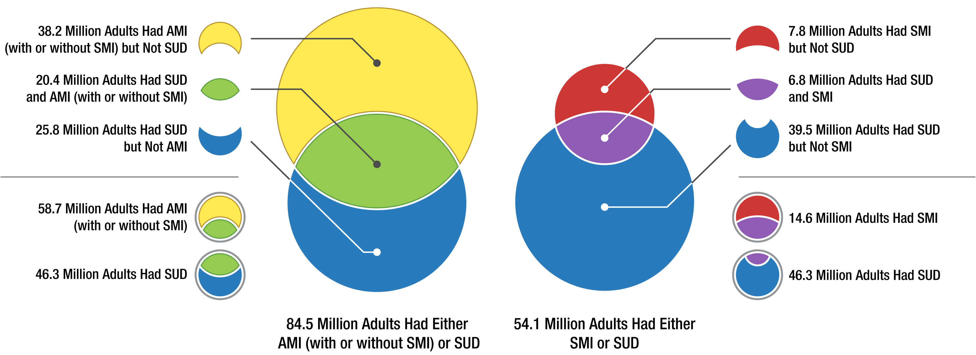
Incidence of Mental Health and Substance Use Disorders
2023 SAMHSA US Substance Use Statistics: Incidence of SUD/AMI/SMI, 18 yr or older
US population in 2023 was 334.9 meaning that very close to 1 in 4 people in US suffer with a mental health or substance
use disorder.
Key: AMI: All Mental Illness
SMI: Severe Mental Illness
SUD: Substance Use Disorder

Slide 26
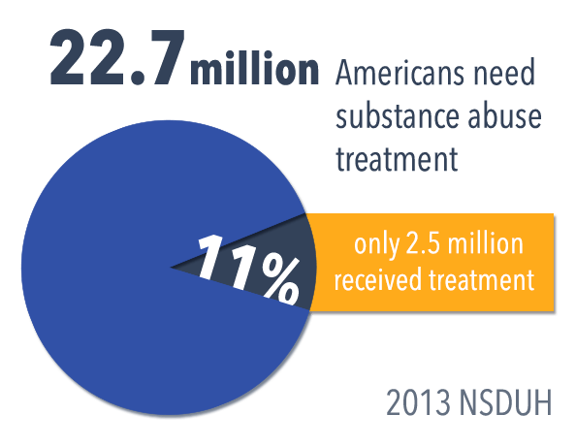
Over the last 10 years, do you think these numbers have increased or decreased?

Slide 27
Incidence of Mental Health and
Substance Use Disorders
Most Americans with substance use disorders don't receive treatment.
  Over 46.3 million Americans aged 12 and older had a substance use disorder in 2023, 14% of the population.
  Only 10% of whom received treatment, according to the latest National Survey of Drug Use and Health. (2021: 6%)

Slide 28
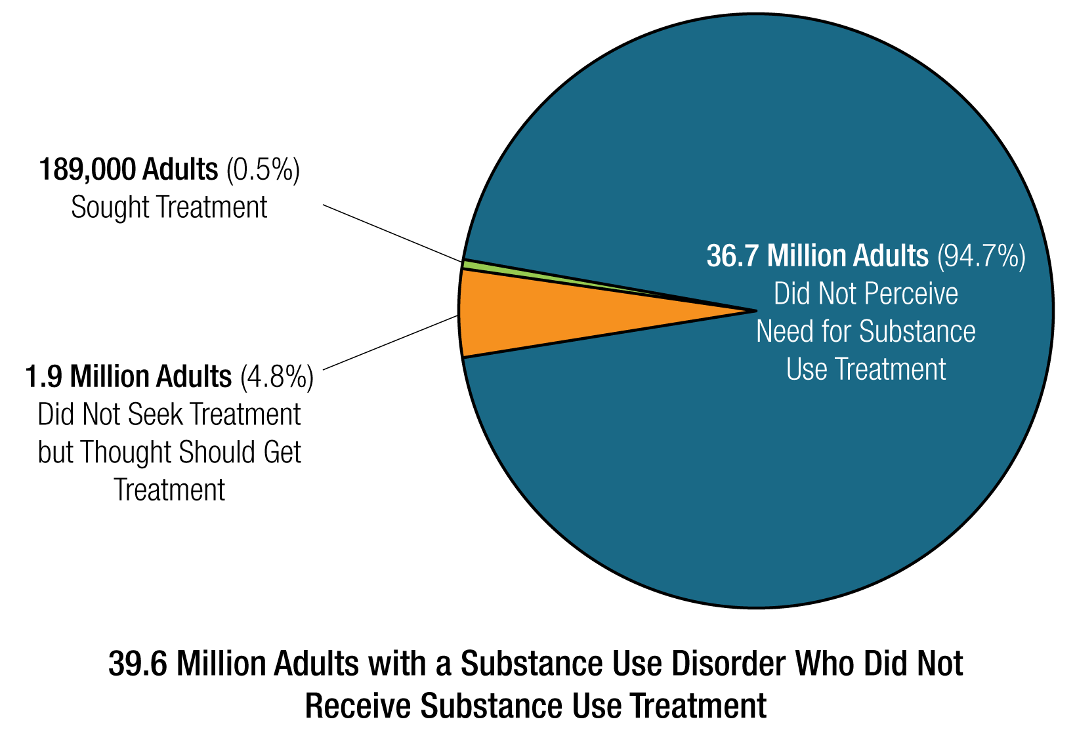

Slide 29
Incidence of Mental Health and
Substance Use Disorders
The same goes for mental health…
  In 2021, among the 57.8 million adults with AMI, 26.5 million (47.2%) received mental health services in the past year.

Slide 30
Fact or Fiction:
Mental health disorders are common within the US population. TRUE
1 in 6 people in the US struggle with a mental illness or substance use disorder. FALSE 1 in 4 people in the US struggle with MI or SUD
Most people who need help for substance use get the help they need. FALSE… Only 6% individuals that need help with SUD get the help they need.

Slide 31
Fact or Fiction:
The largest age group in the US that is struggling with their mental health is 26-49. FALSE, the largest age group in the US is struggling with their mental health is 18-25.
45% of Alcohol Users are binge drinkers. TRUE

Slide 32
So why is this important?

Slide 33
Impact of Mental Wellness in the Workplace

Slide 34
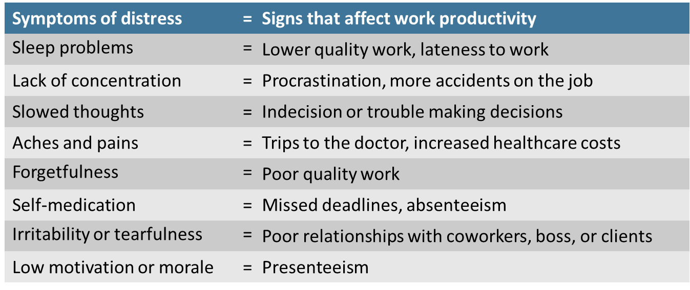
Mental Health Symptoms in the Workplace
When an employee struggles with untreated—or poorly treated—emotional distress or mental illness it can greatly impact work performance and productivity.

Slide 35
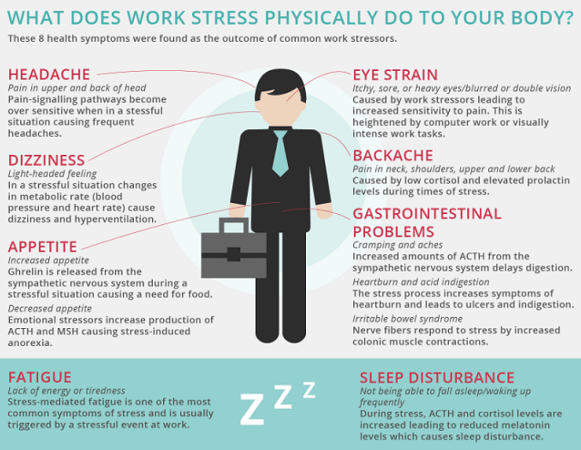
Mental Wellness: Emotional
Distress

Slide 36
Mental Wellness: Emotional Distress
Emotional distress affects business through the connection between mental and emotional health and productivity.
Emotional distress does not mean a mental illness exists, but distress can still negatively affect performance; left unaddressed, performance can worsen.
Excessive demands resulting in stress may contribute to difficulty managing emotions, focusing attention, making decisions, and thinking clearly or objectively.¹
Reduced distress can lead to enhanced resilience, strengths in employee satisfaction, recruitment and retention, absence reduction, work engagement, productivity, and financial performance.
Partnership for Workplace Mental Health, Employer practices for addressing stress and building resilience Arlington, VA Partnership
for Workplace Mental Health, August 2013). Available at www.workplacementalhealth.org/stress_whitepaper

Slide 37
Why focus on workplace mental wellness?
Investing in mental health is not just a moral obligation; it is a sound financial strategy.
The World Health Organization (WHO) estimates that depression and anxiety disorders cost the global economy approximately $1 trillion annually in lost productivity.1
This staggering figure highlights the direct link between employee mental health and overall organizational performance.
1.https://pmc.ncbi.nlm.nih.gov/articles/PMC9925363/#:~:text=The%20high%20disease%20burden%20further,trillion%20by%202030%20%5B2%5D.

Slide 38
Why focus on workplace mental wellness?
    Employee Productivity: A study by the McKinsey Global Institute found that for every $1 invested in mental health initiatives, companies can expect a return of up to $4 in improved productivity. This demonstrates a clear financial incentive for businesses to prioritize mental health. 2
    Absenteeism: According to the National Alliance on Mental Illness (NAMI), employees with untreated mental health conditions are 3 to 5 times more likely to miss work than their peers. On average, this results in a loss of 20.5 days of work each year per employee, significantly affecting overall productivity. 3
2.https://www.mckinsey.com/industries/healthcare/our-insights/mental-health-in-the-workplace-the-coming-revolution
3. https://www.nami.org/support-education/publications-reports/survey-reports/the-2024-nami-workplace-mental-health-poll/

Slide 39
Why focus on workplace mental wellness?
    Turnover Rates: Organizations that prioritize mental health see lower turnover rates. Gallup’s research indicates that companies with highly engaged teams experience 25% lower turnover. This not only saves on recruitment and training costs but also helps maintain institutional knowledge and stability within teams. 4
    Presenteeism: The CDC reports that presenteeism, where employees are physically present but unable to perform at full capacity due to mental health issues, can reduce productivity by 30% or more. This silent drain on resources underscores the need for proactive mental health support. 5
4. https://www.gallup.com/workplace/236927/employee-engagement-drives-growth.aspx
5. https://www.cdc.gov/pcd/issues/2016/15_0503.htm

Slide 40

What areas does workplace mental wellness impact?
Direct Impacts:
  Absenteeism
  Overtime pay
  Higher Insurance claims
  Increased insurance costs
  Worker’s compensation claims (5x higher)
  Accidents
  Workplace crime
217 million lost workdays due to productivity decline

Slide 41
What have we established so far?
Mental Health and Substance Use disorders are…..
The impact on the workplace and workforce is….
What did you find surprising?

Slide 42
How can you as a manager and leader impact Emotional Wellness within your worksite and team?

Slide 43
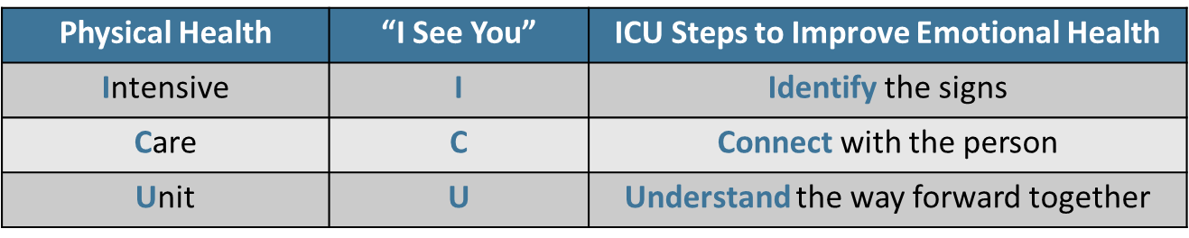
The ICU method
As people with a physical injury or illness may require help through an Intensive Care Unit, so people in distress or with a psychological/emotional injury or illness may require help from one another through the three steps of Identify, Connect, and Understand.
ICU thus becomes “I See You.”
Partnership for Workplace Mental Health, a program of the American Psychiatric Foundation (2014)

Slide 44

Employee Assistance Support
Supervisor engagement is Critical to the success of employees
Daily contact with the employee
  First opportunity to identify a
  potential employee issue
Early problem identification and referral skills
  Best chance of problem resolution for employees
  Increased health care cost savings
  Improved morale and team dynamics
  Focus on the employee as a person not just
  a worker

Slide 45
Employee Assistance:
Managers can create an environment where we equip our employees to recognize the signs of distress and refer each other to the resources already available.
  Our employee assistance program
  Our mental health and substance use disorder benefits
Interventions can help. The majority (65–80%) of those suffering from emotional distress or mental illnesses will get better with proper treatment—a success rate that exceeds many non-psychiatric illnesses.⁸
Health Care Reform for Americans with Severe Mental Illnesses: Report of the National Advisory
Mental Health Council. (October 1993). Produced in response to a request by the Senate
Committee on Appropriations, American Journal of Psychiatry 150: 10

Slide 46

Reality Check

Slide 47


Slide 48


Slide 49
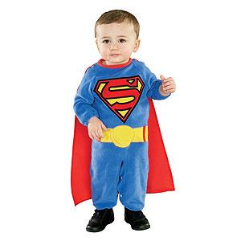
As supervisors you walk the line between support and being the Front Line of Safety

Slide 50

Observable Indicators of Probable Substance Use:
Face
Eye
Nose
Mouth
Hands
Arms
Body
Mood
Speech
Movement
State-of-Mind
Physical Symptoms

Slide 51

Face and Eyes:
Flushed or very pale face
Excessive sweating
Blood shot, watery eyes
Unusual movements
Dilated/constricted pupils
Extreme fatigue/falling asleep

Slide 52
Nose and Mouth:
Runny nose
Sores around nostrils
Dry mouth
Frequent swallowing

Slide 53

Body:
Shaking hands
Clamminess
Puncture marks
Tremors
Unusually sedate or calm
Odor or alcohol or marijuana

Slide 54
Speech:
Slurred or incoherent
Inappropriate verbal response
Verbal abusiveness
Pressured speech
Tangential speech

Slide 55

Physical:
Nausea
Vomiting
Hallucinations

Slide 56

Movement:
Unsteady gait
Impaired motor coordination
Over-reaction
Over-compensation

Slide 57
Mood:
Euphoric high
Excessive laughter/talkativeness
Highly excited/nervous/irritable
Withdrawal/depression
Extreme aggression/agitation

Slide 58

State of Mind:
Confusion
Disorientation
Impaired short-term memory
Responding to external triggers
Paranoia

Slide 59
Reality Check

Slide 61


Slide 62
By performing Reasonable Suspicion testing who are we protecting?
a) Employee
b) Employer
c) Public
d) All of the above

Slide 63
Reasonable Suspicion
A Reasonable Suspicion Drug/Alcohol test may be directed whenever a reasonable suspicion exist that an employee may be under the influence of a controlled substance, suffers from substance abuse or is in violation of County or departmental rules or regulations concerning the use of such substances. The decision must be based on observations concerning the appearance, behavior, speech, or body odors of the employee.
PLEASE NOTE: Reasonable Suspicion testing requires approval from a Division Director or higher authority within the employee’s concerned department.

Slide 64
Reasonable Suspicion
Based on any of the referenced considerations, the Department DPR shall request Reasonable Suspicion testing by notifying the Human Resources Department Labor Relations Section during normal business hours, Monday – Friday, 8:00 – 5:00 p.m.
A supervisor shall escort the concerned employee for testing at any of the three (3) designated Jackson medical facilities:
Jackson North Medical Facility - 100 NW 170th Street, Suite 405, Miami, Florida 33169
Park Plaza (Kendall) Medical Facility – 8900 SW 117th Avenue, Suite B-202, Miami, Florida 33186
Jackson Jefferson Reaves Facility- 1009 NW 5th Ave Miami, FL 33136

Slide 65

Types of Drug Testing at Miami-Dade County
Types of Drug Testing:
  Pre Employment- DOT, County (certain job classes)
  Random- DOT
  Post Accident- DOT
  Annual-County (certain job classes)
  Reasonable Suspicion- DOT, County
  Return to Duty- DOT
  Follow Up - DOT

Slide 66
Substances Tested
 | DOT | Miami-Dade County
THC | x | x
Cocaine | x | x
Amphetamines | x | x
Opiates | x | x
Opioids | x | x
PCP | x | x
ETOH | x | x
Methamphetamine |  | x
Benzodiazepines |  | x
Barbiturates |  | x

Slide 67
What is the #1 reason managers and supervisors do not address concerns regarding Substance Use?

Slide 68
Accuracy:
Do you have to be right without a reasonable doubt?
What if I’m wrong?
How do you face the employee if I drug test them, and the employee turns out to be negative?
What are the repercussions?

Slide 69
Does your employee have to test positive?
Your employee does not have to test positive to be correct in sending him or her in for a Reasonable Suspicion test
Even if an employee self discloses that he or she will be positive still send them in for testing
Know what your company protocols are beforehand – in the event you have a positive
Do not let employee drive to testing facility!

Slide 70

Key Points for Reasonable Suspicion
Document occurrence(s) that led to decision to test
Has to be authorized by Division Director or above
Consult your DPR and Labor
Review AO 7-29 Reasonable
Suspicion

Slide 71
What is a supervisor’s role in the addressing Mental Health and Substance Use in the Workplace?

Slide 72

Addressing the employee
Escort from the workplace discreetly
Should take place in a private office with supervisor and confirming party
Make sure that you have looped in Labor, Manager and your DPR
Tell the employee you are concerned, and they are being sent for a reasonable suspicion drug and alcohol test (if applicable)
Explain to the employee what next steps will be, referral to the EAP or substance testing
Respect the employee’s confidentiality

Slide 73
Some Reasons Supervisors May be Reluctant to Refer Employees for Support or Help
Compassion
Guilt
Friendship
Loyalties
Jeopardizing employee’s livelihood
Loss of employee confidence/support
Insecurities
  Fear for personal safety
  Do not like confrontation
  Lack of training on the referral and labor processes

Slide 74

Common Supervisor Pitfalls
Ignoring job performance problems, hoping they will go away or are temporary
Accepting excuses or apologies
Threatening disciplinary action without follow through
Giving advice or pep talks
Doing some of the employee’s work because he is in a bad spot or working around the person
Considering someone is “functional” who doesn’t affect you

Slide 75

Care-frontation vs. Confrontation:
Be confident, diplomatic and respectful
Don’t approach employee from a confrontation standpoint
Stick to the salient points – not subjective but objective
Give the employee the opportunity to describe and explain from their viewpoint
Suggest the employee seek help and support them in making the phone call to the EAP or support services
Send employee in for testing or fitness for duty, if applicable

Slide 76
The ICU method
As people with a physical injury or illness may require help through an Intensive Care Unit, so people in distress or with a psychological/emotional injury or illness may require help from one another through the three steps of Identify, Connect, and Understand.
ICU thus becomes “I See You.”
Partnership for Workplace Mental Health, a program of the American Psychiatric Foundation (2014)

Slide 77
How can the EAP assist you as a Supervisor?

Slide 78

How to make a referral
Self Referral
  Voluntary
Phone or face to face consultation with supervisor (sometimes connected with disciplinary action)
  Supervisory
  Mandatory
An employee does not intake as a supervisory or mandatory referral without consultation with management and proper
documentation

Slide 79
Types of Referrals
Voluntary:
  Main type of referral
  Employee comes in on their own
  No reporting to the Department is done
Supervisory:
  This may be connected with issues identified or disclosed to a supervisor/manager
  Employee will sign a release of information
  EAP will confirm the employee made the appt.
Mandatory:
  Employee is mandated to comply with services
  EAP will report on compliance
  EAP requires documentation that they are Mandated Referral
      DAR
      Letter signed by Department Director, outlining referral and requirement of compliance

Slide 80
Early vs. Delayed Referral Outcomes
Early Referral
Less likelihood of engagement in the disciplinary process
Employee attends outpatient treatment visits in private
Less time away from work
Delayed Referral
Behavior at work deteriorates
Employee problem(s) get worse
Employee develops chronic problem
Increased likely-hood of incident in workplace, long-term treatment

Slide 81
Leave Requests
There are times that employee’s functioning so impaired that they will need time off to address it
EAP will case manage and monitor employees while on leave under the EAP program
EAP and treating provider will discuss case and EAP will assist in finding additional resources to support client as needed
EAP will keep department in the loop as to progress and estimated return to work date based on treating providers evaluation of the employee’s current mental status and functioning.

Slide 82
Disciplinary Action vs EAP
The EAP and the Discipline process may be running concurrently but are not connected
The employee still has a responsibility to the job while in the EAP
The EAP does not make disciplinary recommendations
Please make sure to keep Labor in the loop with concerns in regard to employee performance.

Slide 83
Confidentiality
Federal and State Regulations that surround Confidentiality:
  HIPAA
  42 CFR
Requirements for EAP professionals and department managers/supervisors to ensure confidentiality
  All documentation within Payroll system and county systems are public record- Medical/Mental Health information should be kept out of these forums

Slide 84
Management Support
Keep referral information readily available
Respond quickly to employee/supervisor inquiries
Volunteer to initiate call to EAP or make an appointment on employee’s behalf
Be able to answer questions about EAP services or offer to consult

Slide 85
Management Support
Understand EAP confidentiality restrictions
Protect employee's privacy (required by law)
Help supervisors delineate employee assistance from performance expectations
Understand EAP leave request
Ensure efficient exchange of documentation relevant to cases

Slide 86

Emotional Wellness:
When should an employee seek support

Slide 87
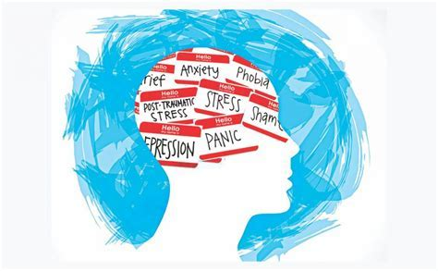
Indicators an employee needs to seek support
Duration
Intensity
Level of Disfunction
  Daily routine
  Effects on Relationships

Slide 88

When to seek support
Some main reasons employees don’t tend to seek help when they need it:
Confidentiality
Stigma
Fear of retaliation or judgement
Denial

Slide 89
If you, an employee or a family member are struggling with feelings that are intrusive in everyday life…
You are not alone and there is help and hope

Slide 90
Treatment Works…
> 80%
of employees
who receive treatment and support for mental illness report improved levels of work efficacy and satisfaction as well as remission of many intrusive symptoms that impact them at work and home.
American Psychological Association, Center for Workplace Mental Health (2024)

Slide 91

Support Services: Employee Assistance Program (EAP)
Emotional Wellness Program:
Supports MDC employees and their eligible family members with the goal of enhancing emotional wellness, impacting employees emotional resilience and assisting in times of need.
The internal services provided by the EAP are confidential and free
Experienced staff: Licensed Masters level clinicians
Short-term support services as well as community referrals, as needed

Slide 92

Employee Assistance Program
Common Concerns We Assist With:
Stress Management
Marriage Difficulties
Death of a loved one
Depression and/or Anxiety
Substance Use
Anger Management
Referrals to Community Resources, such as Elder and/or Child Care

Slide 93
Common Questions…

Slide 94
How does the EAP process work?

Slide 95
The employee can refer themselves to the program for consultation.
Managers, and Directors can also make mandatory referrals to the program in circumstances such as substance use.
An initial consultation is typically scheduled that day or the next business day. After the initial consultation, the employee and their EAP counselor will identify the best avenue to support the employee in their goals and/or provide referrals to resources.
Job security or promotional opportunities will not be affected or jeopardized by requesting assistance or involvement in EAP.

Slide 96
Does the EAP tell anyone I am contacting them?

Slide 97
The EAP is designed to be a confidential resource and support for employees.
Employees that come to the EAP on a voluntary basis will have information released only to individuals authorized by the employee.
Only the staff within the EAP who serving the employee will have access to the confidential information needed to assist them.
All confidential information is kept in accordance with state and federal regulations.

Slide 98

Miami-Dade Emotional
Wellness Program (EAP)
You can call 305-375-3293 to set up a virtual and on-site appointment or management consultation with an EAP Counselor.
The Miami-Dade County Employee Assistance Program is located on the 15th Floor of the OTV South Building
Our address is 601 NW 1st Ct., Suite 15-050 Miami, FL
www.miamidade.gov/employee-support

Slide 99
Nationwide Mental Health and Substance Abuse Help Lines
Suicide and Mental Health Crisis Prevention Hotline:
      988 (call or text) or 800-SUICIDE
Abuse Hotline:
      800-96-ABUSE (22873)
Domestic Violence:
      800-500-1119
Banyan Mobile Crisis:
      305-774-3616/3617
Thriving Minds Mobile Crisis:
      800-HELPYOU (435-7968)
SAMHSA National Substance Abuse Hotline:
      800-662-4357

Slide 100

Questions

