Slide 1



ePerformance Management
Supervisory
Human Resources Department

Slide 2
Learning Objectives
Request Nominations
Prepare an evaluation as a Manager
Review an employee evaluation as a Manager’s Supervisor
Share the Evaluation with your Employee as a Manager

Slide 3
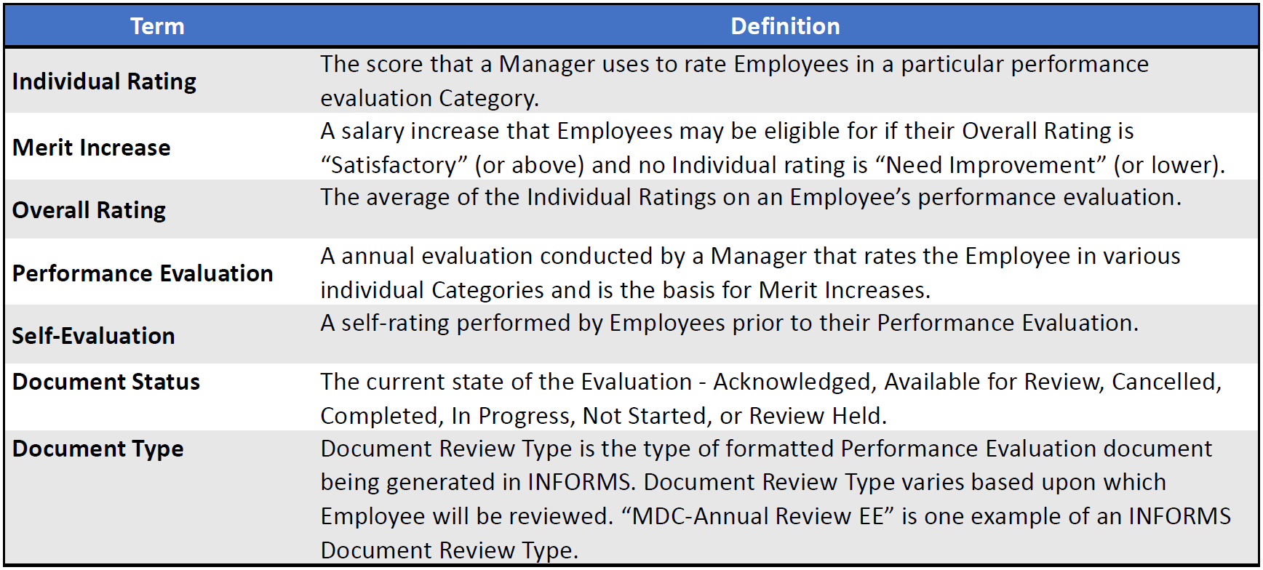
Lesson 1: Preparing an Employee’s Evaluation as a Manager
Key Terms

Slide 4
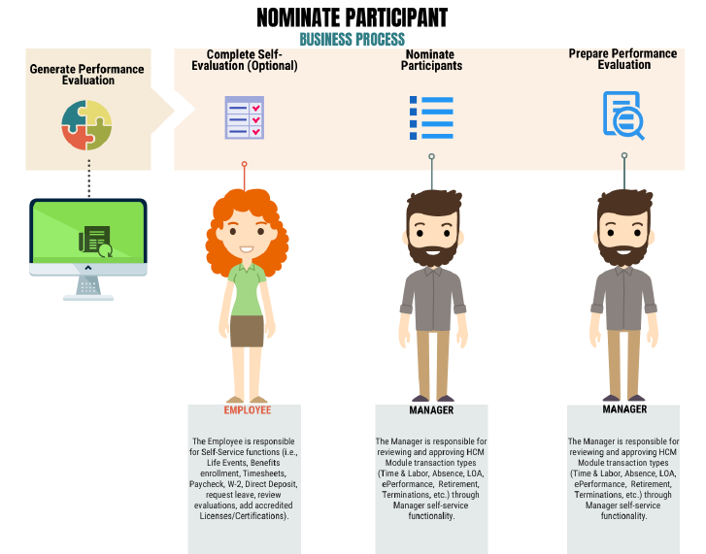
Lesson 1: Requesting Nominations
Managers can invite a nominee who will provide additional feedback on an employee’s evaluation

Slide 5
Lesson 1: Reasons to Invite a Nominee
Historical Context:
  Nominating a former supervisor, even if they have left, can offer valuable historical context regarding the employee's performance trends, achievements, and areas for improvement over time.
Succession Planning:
  If the evaluation is part of succession planning, nominating someone who can assess the employee's readiness for additional responsibilities or a higher role is crucial.
Cross-Departmental Collaboration:
  If the employee's work involves interactions with multiple divisions, nominating someone from another division can provide insights into their cross-functional collaboration and impact.
The key is to select nominees based on the specific aspects of the employee's performance that require evaluation, ensuring a comprehensive and well-informed assessment.

Slide 6
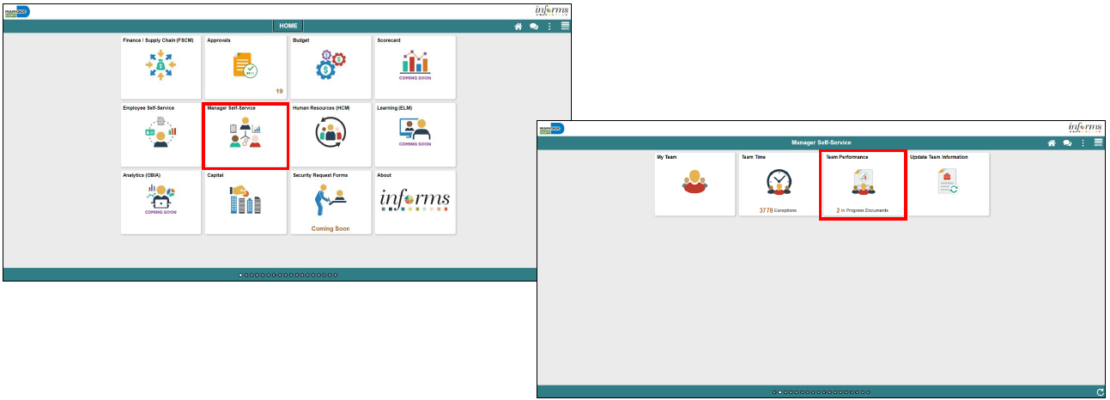
Lesson 1: Requesting Nominations Navigation
Navigate to Manager Self-Service > Team Performance

Slide 7
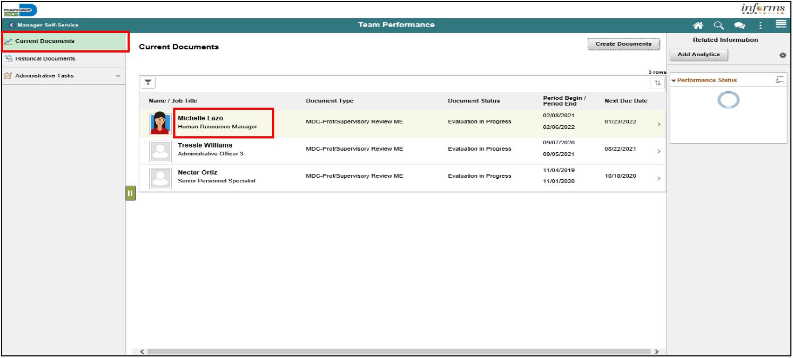
Lesson 1: Requesting Nominations
1. Select the Employee Name under Current Documents

Slide 8
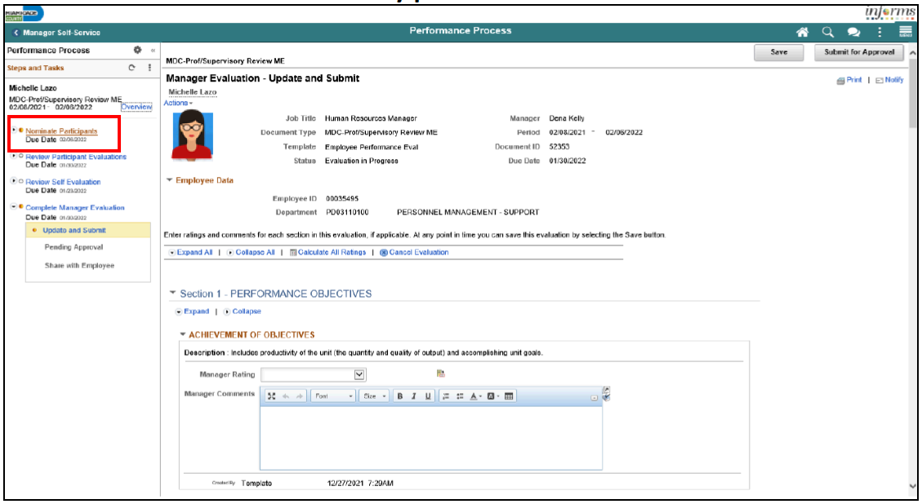
2. Select the Nominate Participants hyperlink.
3. Select the Add Nominees hyperlink.

Slide 9
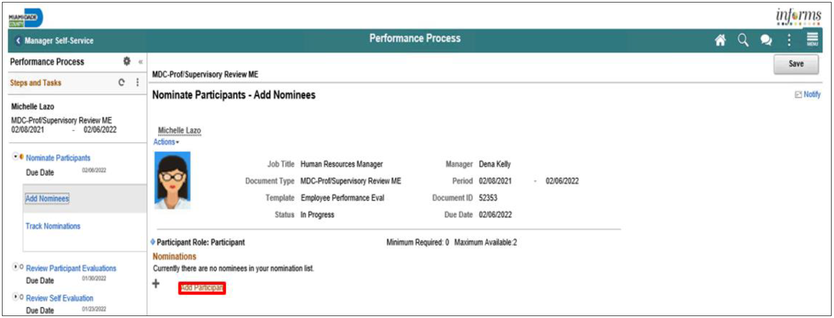
4. Select the Add Participants hyperlink

Slide 10
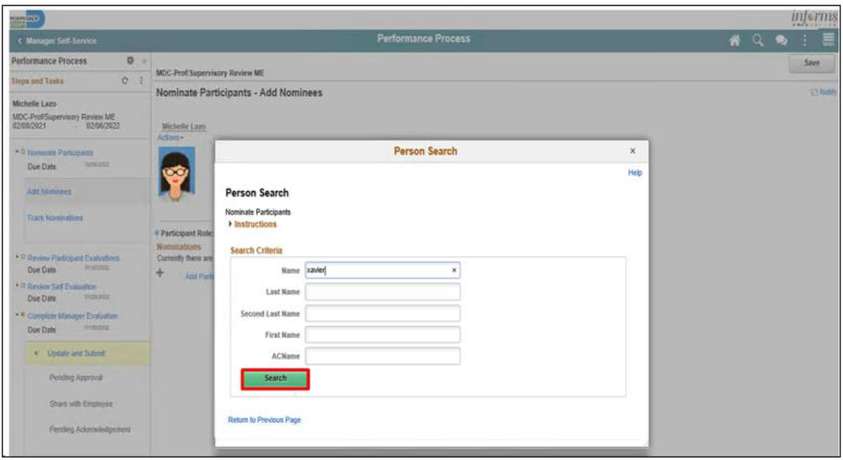
5. Input the search criteria for the person who you’re nominating

Slide 11
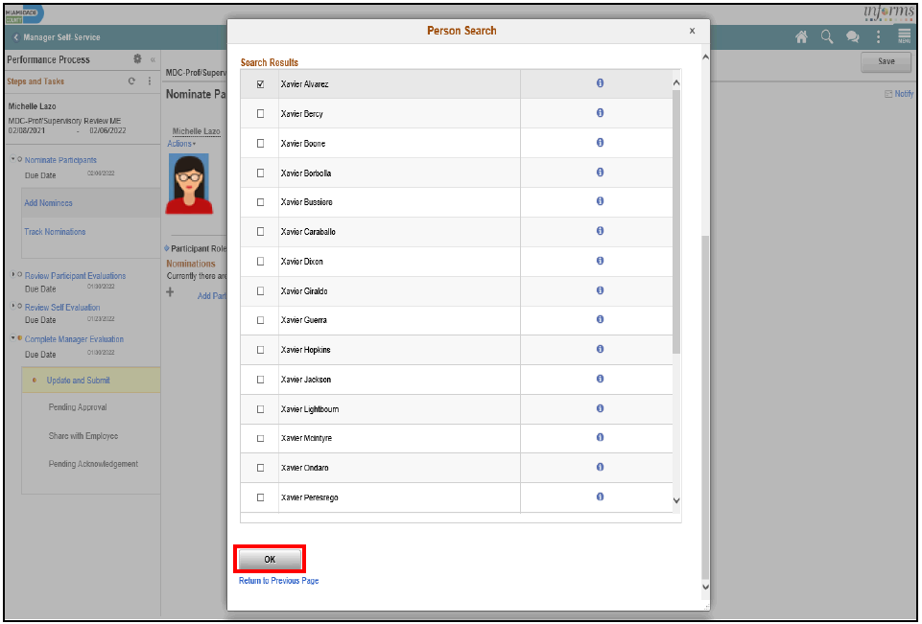
6. Select the checkbox beside the applicable search result.
7. Select the nominee and then the OK button.

Slide 12
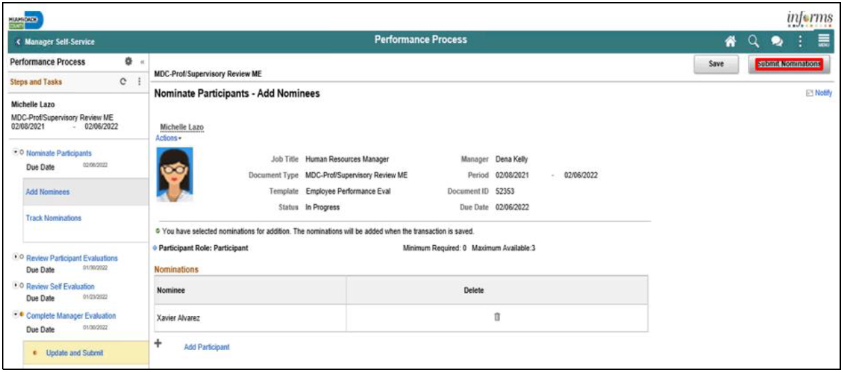
8. Select the Submit Nominations button.
9. Select the Confirm button

Slide 13
Lesson 2: Preparing an Employee’s Evaluation as a Manager
Managers must complete an annual performance evaluation for their employees in Miami-Dade County. Managers must rate their employees on four or seven objectives. An Overall Rating is generated by INFORMS and is based on an average of the individual ratings. The rating model for both the individual objectives and the overall objective is the same:
1. Unsatisfactory
2. Needs Improvement
3. Satisfactory
4. Above Satisfactory
5. Outstanding
X. Does not apply

Slide 14
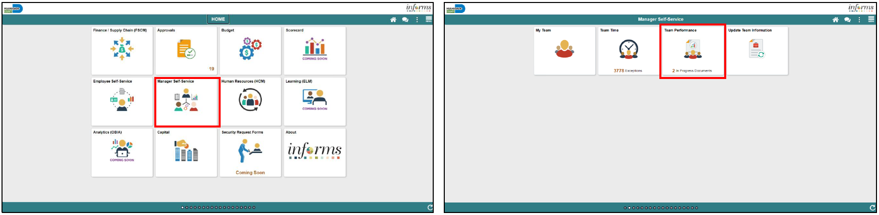
Lesson 2: Preparing an Employee’s Evaluation as a Manager
Navigate to Manager Self-Service > Team Performance

Slide 15
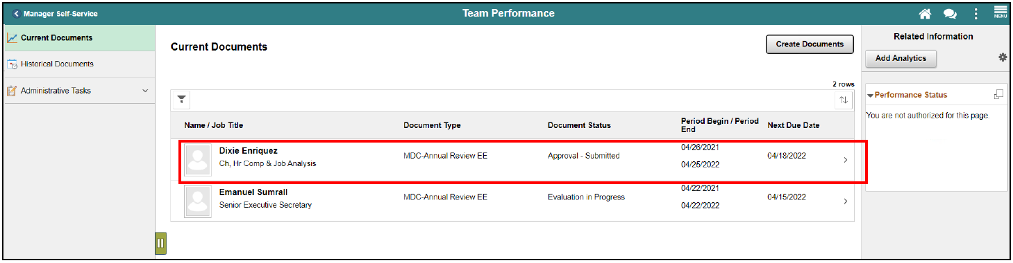
Lesson 2: Preparing an Employee’s Evaluation as a Manager
1. Select the Employee Name under Current Documents.
Note: The Current Performance Documents Page displays documents that are currently listed as “In Progress”.
Note: At this point, you can nominate a secondary preparer to review and comment on the employee’s performance.

Slide 16
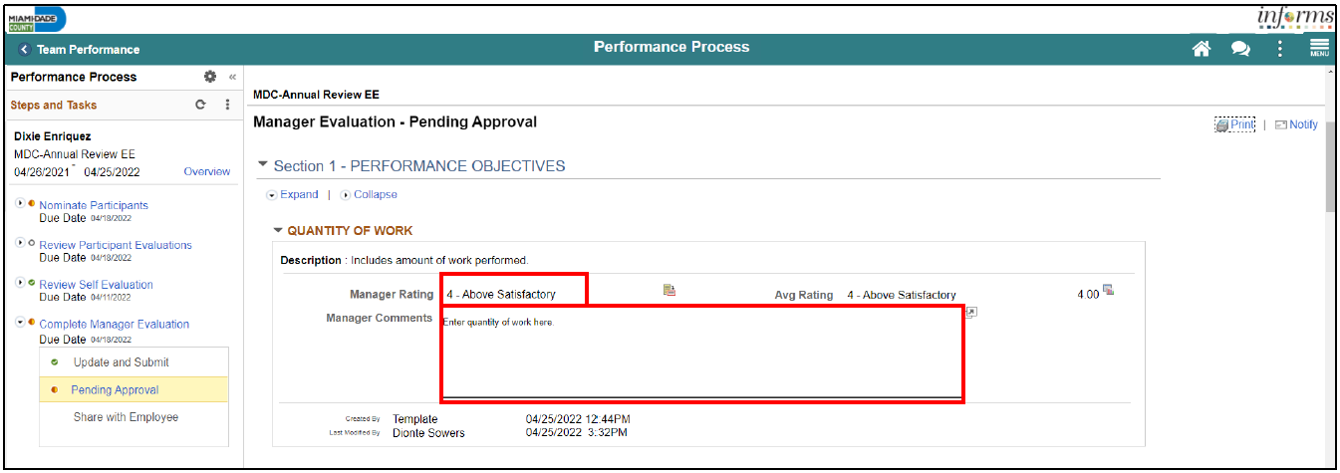
Lesson 2: Preparing an Employee’s Evaluation as a Manager
2. Select the applicable Manager Rating from the dropdown.
3. Input the applicable details within the Manager Comments field.
4. Select the Spell Check option, if desired.
Note: Please follow steps 2-4 for each sub-section within section one.

Slide 17
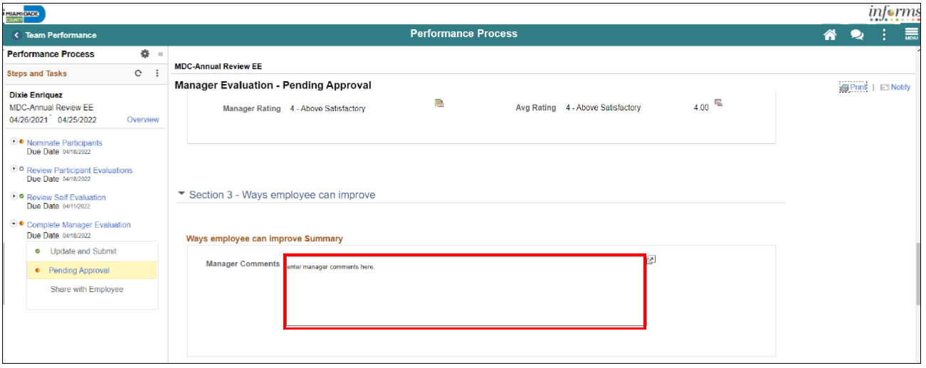
Lesson 2: Preparing an Employee’s Evaluation as a Manager
5. Input Manager Comments in the Section 3 – Ways an Employee Can Improve section.

Slide 18
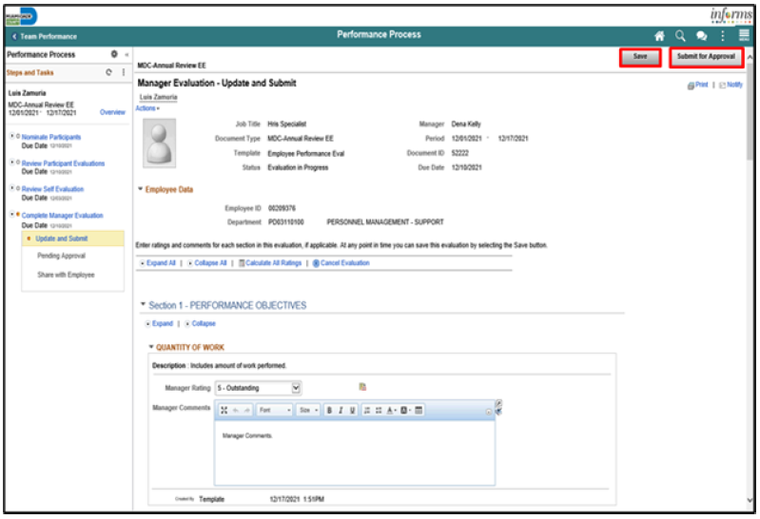
Lesson 2: Preparing an Employee’s Evaluation as a Manager
6. Select the Save button.
7. Select the Submit for Approval button. The evaluation gets routed to the Reviewer. Finally, select the Confirm button.

Slide 19
Lesson 3: Reviewing an Employee’s Evaluation (Manager’s Supervisor)
INFORMS will provide an email notification, with an embedded link to access the document, for the Reviewer to review and approve the performance evaluation. Reviewers can also view the document in their approvals tile in INFORMS.
Note: The Reviewer cannot edit the evaluation. The Reviewer can only provide comments when approving or denying the evaluation.
INFORMS will display a confirmation message once the Reviewer has approved the Performance Evaluation then route an email notification to the Manager.

Slide 20
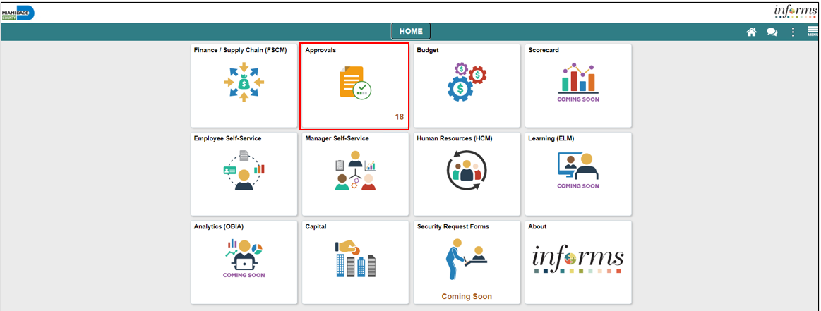
Lesson 3: Reviewing an Employee’s Evaluation (Manager’s Supervisor)
Navigate to Approvals

Slide 21
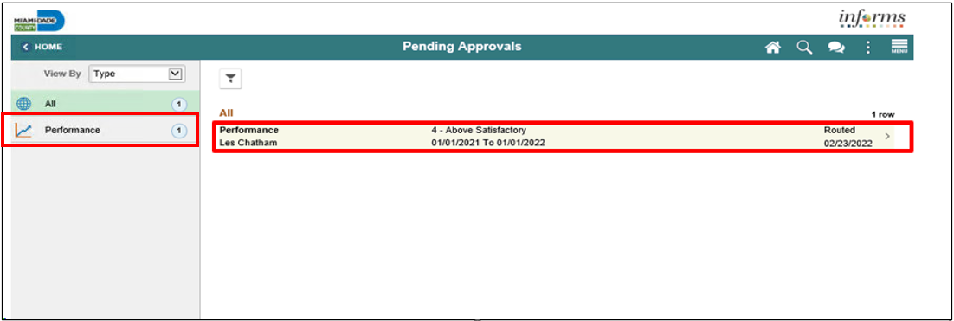
Lesson 3: Reviewing an Employee’s Evaluation (Manager’s Supervisor)
Select the Performance pane. Note, performance evaluation documents that have been prepared by the Rater and require approval by the Reviewer are displayed.
Select the Performance option for your employee and then select your employee.

Slide 22
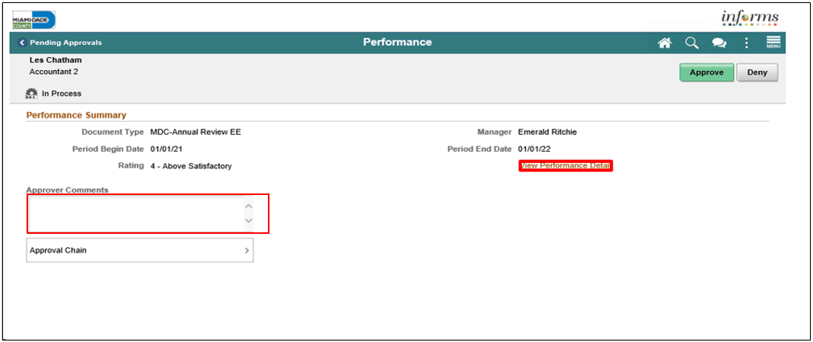
Lesson 3: Reviewing an Employee’s Evaluation (Manager’s Supervisor)
3. Select the View Document Detail link.

Slide 23
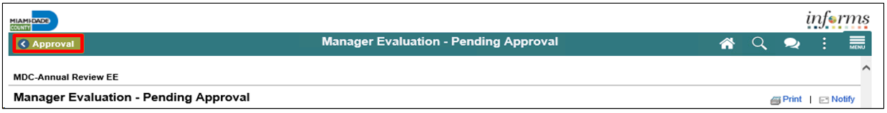
Lesson 3: Reviewing an Employee’s Evaluation (Manager’s Supervisor)
4. Review all sections of the performance evaluation document and check to see if the document contains any attachments.
5. Once the Reviewer has reviewed the entire performance evaluation, select the Approval button on the top left corner of the screen.

Slide 24
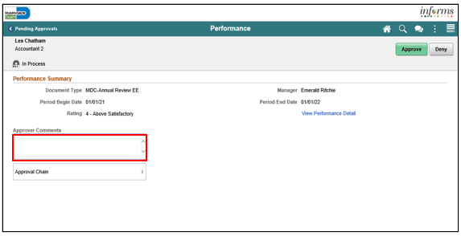
Lesson 3: Reviewing an Employee’s Evaluation (Manager’s Supervisor)
Select the Approver Comments field and enter desired information. Once desired information is entered, click on Approve button.
Note the reviewer also has the option to deny in which case the reviewer would provide the reasons for denial. At this point the document will route back to the Rater (employee’s manager) to be amended and the Rater will then have to resubmit the evaluation to the Reviewer.

Slide 25
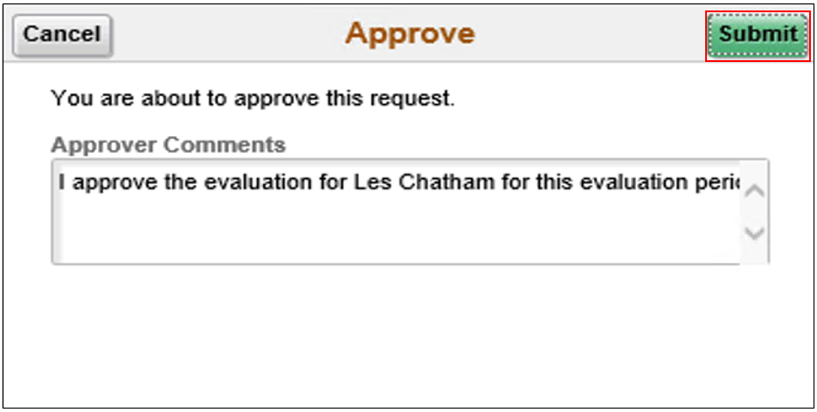
Lesson 3: Reviewing an Employee’s Evaluation (Manager’s Supervisor)
7. Select the Submit button.

Slide 26
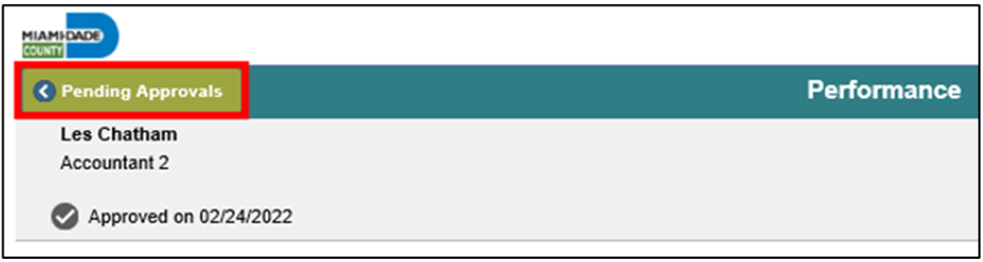
Lesson 3: Reviewing an Employee’s Evaluation (Manager’s Supervisor)
8. Select Pending Approvals to check if there are any more approvals pending.

Slide 27
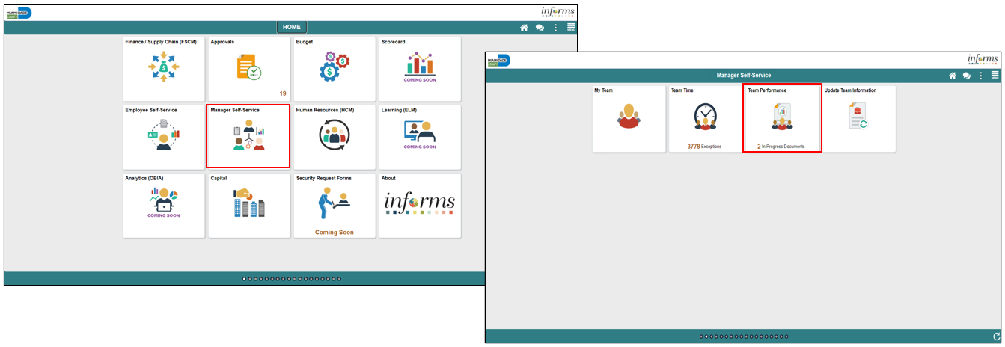
Lesson 4: Share Evaluation with Employee as Manager
Navigate to Manager Self-Service > Team Performance

Slide 28
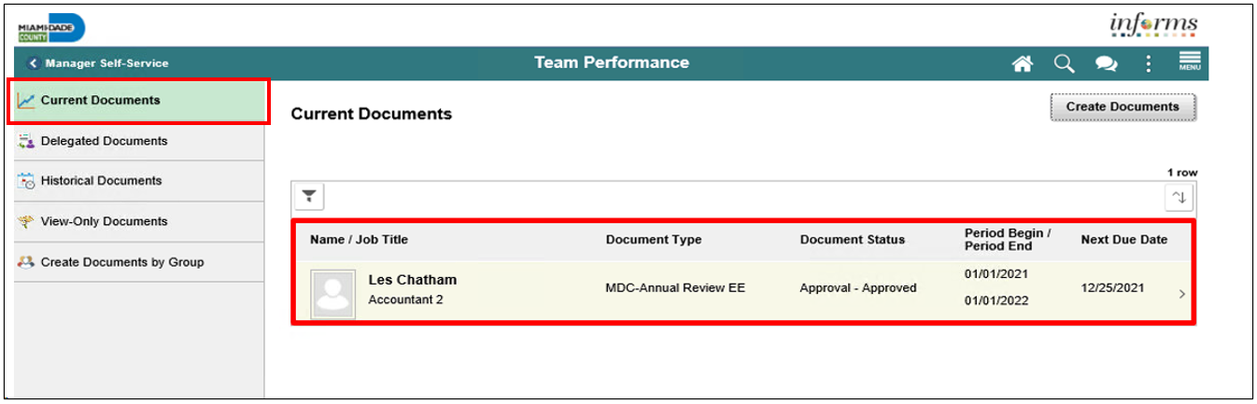
Lesson 4: Share Evaluation with Employee as Manager Continued
Select Current Document and then MDC-Annual Review EE.

Slide 29
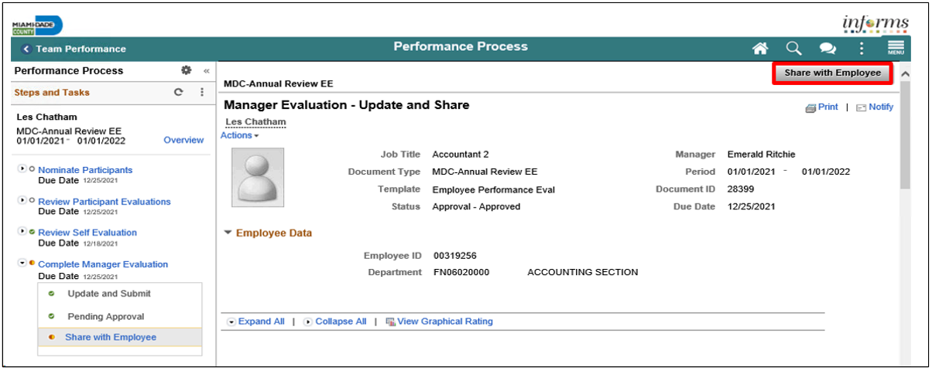
Lesson 4: Share Evaluation with Employee as Manager Continued
2. Select Share with Employee.

Slide 30
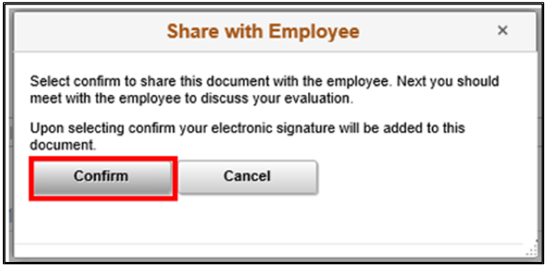
Lesson 4: Share Evaluation with Employee as Manager Continued
Select the Confirm button. This will complete the process. The evaluation will close out (edits can no longer be made) and move to the employee’s historical folder as well as the manager’s historical folder.

Slide 31

Course Summary
Congratulations on completing the overview of Manager Self-Service ePerformance Management. You now understand how to:
Request Nominations
Prepare an Evaluation as a Manager
Review an Employee Evaluation as a Manager’s Supervisor
Share the Evaluation with your Employee as a Manager

Slide 32
Additional Training and Job Aids
Users may be eligible to take the following training courses based on their INFORMS roles:
INFORMS Training Webpage: https://www.miamidade.gov/global/humanresources/training/informs.page
User Productivity Kits (Available on the INFORMS Training Webpage):
  Prepare an Employee’s Evaluation as a Manager
  Review an Employee’s Evaluation as a Manager’s Supervisor
  Share the Evaluation with the Employee as a Manager
  Request Nominations
For additional information, be sure to visit:
www.miamidade.gov/informs

