Slide 1



Proactive Performance Appraisal
Human Resources Department

Slide 2

Learning Objectives
Communicate job requirements, expectations and performance standards to employees.
Standardization and Accountability on the Performance Appraisal process throughout the County
Factors which influence and bias supervisors who conduct appraisals.
Write clear, concise, objective appraisals, using specific example of behavior and appropriate ratings.
Prepare schedule and conduct a meaningful, effective performance appraisal interview.

Slide 3

Research has indicated a 30% discrepancy between the supervisor and the subordinate on how to get the job done.
SOURCE (ATD)

Slide 4
There is a 40% discrepancy between what an employee thinks his or her evaluation will be and what it actually is.
To the employee’s disadvantage
SOURCE (ATD)

Slide 5
PERFORMANCE MANAGEMENT

Slide 6

DOCUMENTATION
Helps to ensure accurate performance appraisals.
Provides a necessary reminder of the incident.
Assists in providing and substantiating actions.
Verifies that the supervisor did something.
Used to record the employee’s training and development.

Slide 7

Question?
How often should you document?

Slide 8

DOCUMENTATION TIPS
Balance your documentation.
Document – name/position/date/time/location.
How did you hear about it?
Specify details.
What performance area is affected? (Negative/positive)
Action taken.
Follow-up planned? Yes/No

Slide 9
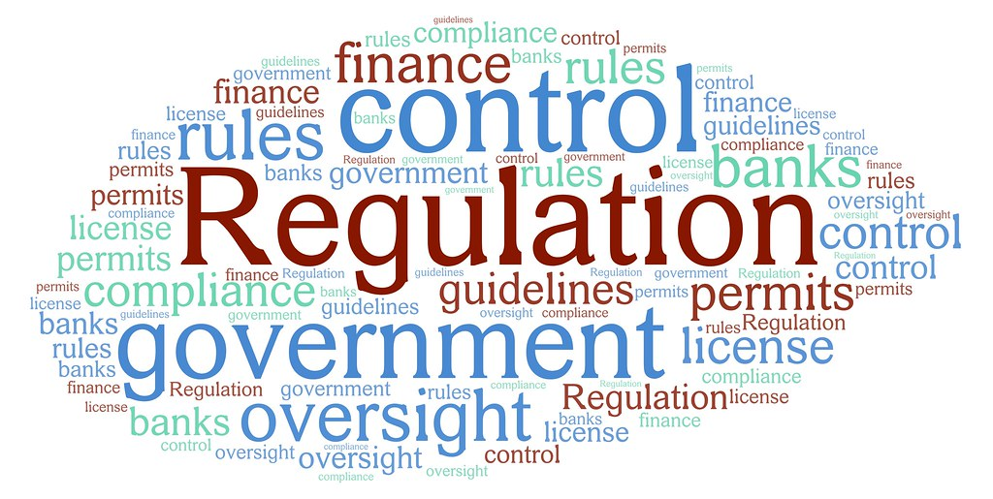
PURPOSE OF A.O. No. 7-19
Appraise employees work performance
Productivity
Effectiveness
Compliance with rules and regulations

Slide 10

THE ROAD TO 7-19
WILL TAKE YOU THERE
All of the following classifications are subject to performance evaluations EXCEPT
  Probationary
  Permanent
  Temporary
  Exempt
  Regular Part-time
The evaluation process facilitates
  Communication between supervisors and employees
  Providing accurate information in making personnel decisions
  Improving employee job performance
  Appraisal of an employee’s work performance
  All of the above
In a Performance Appeal, the final written report will be final and binding on the department.
  True
  False

Slide 11

THE ROAD TO 7-19
WILL TAKE YOU THERE
An employee’s whose overall evaluation is unsatisfactory receive
  5% cost of living increase
  5% merit increase
  re-evaluation in 6 months to determine eligibility for a merit increase
  None of the above
An employee whose overall evaluation is needs improvement will receive
  An opportunity to improve performance
  A re-evaluation anywhere from one to six months
  A dismissal prior to final re-evaluation
  Both a & b

Slide 12

THE ROAD TO 7-19
WILL TAKE YOU THERE
If the rater and the reviewer cannot agree on an evaluation, it is the responsibility of the rater to make changes as recommended by the reviewer.
  It depends
  True
  False

Slide 13

THE ROAD TO 7-19
WILL TAKE YOU THERE
If an evaluation reflects either a “Needs Improvement” or “Unsatisfactory” in one or more categories, the “Rater’s Overall Evaluation” may not be above the Satisfactory level.
  TRUE
  FALSE
A permanent employee who has received an overall evaluation of satisfactory, may appeal the evaluation by first requesting a review of the Performance Evaluation by the Department Director within 10 calendar days.
  TRUE
  FALSE

Slide 14

THE ROAD TO 7-19
WILL TAKE YOU THERE
A Performance Evaluation Appeal Panel, appointed by the Labor Relations Division Director will consist of a
  Three person management team
  Supervisor from the employee’s department
  Coworker from the employee’s department
  Both b & c
The length of probationary period for a new hire eligible for classified service rights is
  Zero months
  Three months
  Six months
  Nine months
  One year

Slide 15

FREQUENCY OF EVALUATIONS
Prior to merit increase
Prior to granting permanent status
Annually

Slide 16
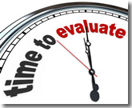
SPECIAL EVALUATIONS WHEN
Supervisor resigns or transfers
Employee transfers (after 4 months)
Substantial change in performance
Previously deferred merit increase

Slide 17

Employee Performance Evaluation
Criteria
Quantity of Work
  Amount of work performed
Quality of Work
  Includes accuracy, achievement of objectives, effectiveness, initiatives and resourcefulness, and neatness of work product
Work Habits
  Includes attendance, observation of work hours, completion of work on schedule, compliance with rules, policies, and directives, safety practice and use of tools and equipment
Interpersonal Skills
  Includes participation and teamwork, contribution of unit morale, working cooperatively with public, peers, and subordinates, and accepting advice and counseling from superiors.

Slide 18

Employee Performance Evaluation
Criteria, cont’d.
Rater’s Overall Evaluation
In what ways can the employee improve performance
Rater, Reviewer, and Employee Sign-offs
Employee Comments
Employee Accomplishments

Slide 19
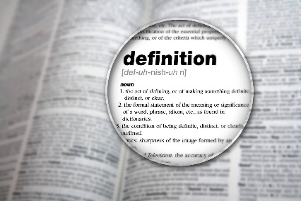
Definitions of Overall Ratings
UNSATISFACTORY
  Performance is inadequate and must be corrected.
NEEDS IMPROVEMENT
  Performance does not fully meet requirements as indicated below.
SATISFACTORY
  Employee is performing as required and expected in an entirely satisfactory manner.
ABOVE SATISFACTORY
  Performance surpasses job requirements.
OUTSTANDING
  Consistently conspicuous, distinguished performance. Employee displays initiative and creativity. Employee has substantially enhanced departmental efficiency and/or effectiveness.

Slide 20
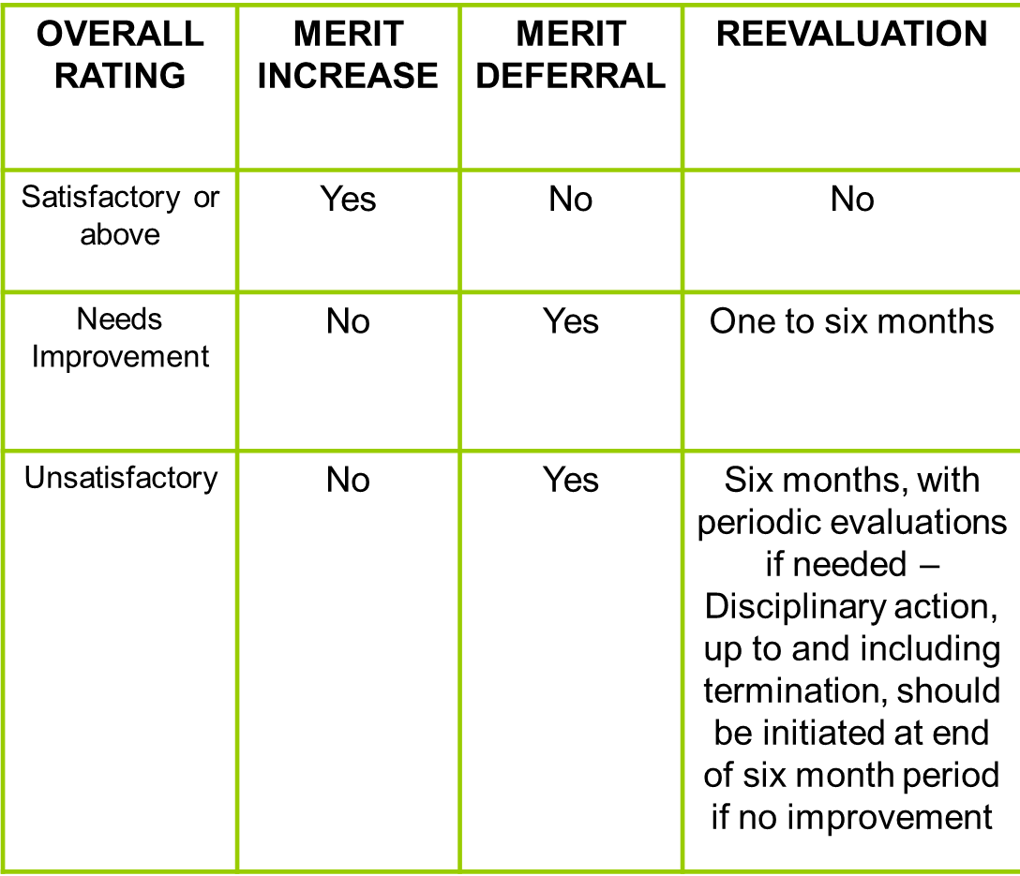
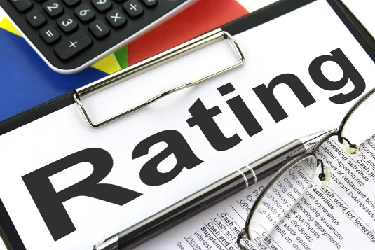
OVERALL RATING RESULTS

Slide 21

Professional/Supervisory Performance Evaluation
Criteria
Achievement of Objectives
  Includes productivity of the unit (the quantity and quality of output) and accomplishing unit goals
Decision Making and Judgment
  Includes assigning tasks, responding to work problems in a timely and effective manner, assessing and establishing priorities, and identifying and evaluating problem areas, and problem solving skills
Personnel Development
  Includes orienting new employees, assisting subordinates in accomplishing assigned tasks, recommending training and/or developmental programs (includes self-development), counseling and motivating employees

Slide 22

Professional/Supervisory Performance Evaluation
Criteria, cont’d.
Planning and Organizing
  Includes designing realistic short and long range plans, optimizing time, personnel, equipment, and material resources, clearly defining responsibility and authority, and developing work standards for the work unit
Interpersonal Skills
  Includes encouraging participation and teamwork, fostering unit morale, working cooperatively with the public, peers, and subordinates, and accepting advice and counseling from superiors
Communications
  Includes preparing clear and concise reports and correspondence, and making effective oral presentations

Slide 23
Professional/Supervisory Performance Evaluation
Criteria, cont’d.
Administrative Policy and Procedure
  Includes understanding and implementing County Code and Administrative Orders, and departmental policies and procedures, complying with Personnel Rules and Leave Manual, grievance procedures and safety regulations, adhering to affirmative action guidelines, and timely effective counseling, evaluation, and disciplinary investigation and recommendation
Additional Factors
  May include special skills, knowledge and abilities, special job requirements or temporary assignments

Slide 24

Professional/Supervisory Performance Evaluation
Criteria, cont’d.
Rater’s Overall Evaluation
In what ways can the employee improve performance
Rater, Reviewer, and Employee Sign-offs
Employee Comments
Employee Accomplishments

Slide 25

ROLES/RESPONSIBILITIES
RATER
  Review, evaluate, rate and provide examples, award/defer increase, outline action plan, consult with reviewer, schedule employee conference
REVIEWER
  Reviews for objectivity and accuracy
  Does not change review
LEAD WORKER
  Input Only
DEPARTMENTAL PERSONNEL REPRESENTATIVE
  Sends forms to rater, reviews for compliance, prepares INFORMS info, notes next evaluation date
HUMAN RESOURCES DEPARTMENT
  Processes INFORMS info, schedules appeals, appoints panel

Slide 26

Break

Slide 27
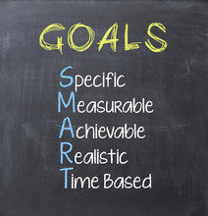
Results Oriented Government
Vision Statement
  A thriving Miami-Dade built on a foundation of innovation, care for people and the environment, and full and fair economic development and opportunity, while facilitating broad input to shape a resilient future
Mission Statement
  To provide effective and efficient resident and business services that: respond to community priorities and needs; help all our residents and businesses to prosper and thrive; make our community safe and more resilient; and build trust and collaboration inside and outside county government

Slide 28
Results Oriented Government, cont’d.
Guiding Principles
  Efficient
  Solution-focused
  Welcoming
  Agile
  Inclusive
  Open and transparent
  Respectful
  Kind
Strategic Alignment
Department Business Plan

Slide 29
Miami-Dade County’s Guiding Principles– Performance Appraisal Connection
Efficient
  Using an online Performance Appraisal process allows all parties advanced notice of the upcoming evaluation. Both supervisor and employee have enough time to prepare for the formal Performance Appraisal meeting.
Solution-focused
  Performance Appraisals not only cover the past performance of the employee; it also focuses on achieving the employee’s future goals and objectives. If there are any issues that need to be addressed, a solution-focused mindset between supervisor and employee focusing on positive outcomes will be discussed.
Welcoming
  The Performance Appraisal process should be a collaborative process not an adversarial one. Supervisor and Employee work in a spirit of partnership in assessing current performance and defining the employee’s future goals and objectives.
Agile
  The Performance Appraisal process allows for changing goals throughout the appraisal period as may be needed due to changes in the environment and county priorities. This flexibility leverages the employee’s adaptability with any changes given to them.

Slide 30
Miami-Dade County’s Guiding Principles– Performance Appraisal Connection
Inclusive
  The Performance Appraisal process involves both the supervisor and employee in discussing past performance and the future expectations of goals and objectives. In addition, besides the supervisor (rater) there is the supervisor’s supervisor (reviewer) to verify for objectivity and accuracy.
Open & Transparent
  There should be no surprises in the performance appraisal process. The reason is that the supervisor should have been giving ongoing performance feedback to the employee throughout the appraisal period.
Respectful
  The goal of the performance appraisal process is not only to assess an employee’s performance; it is to assist the employee in reaching their full potential. Part of this process includes listening to the employee’s perspective on how they performed during the appraisal period.
Kind
  The performance appraisal should be well-balanced in its documentation. The supervisor should highlight the employee’s achievements and accomplishments as much as possible. The employee has an opportunity to provide their achievements and accomplishments online to their supervisor prior to the formal performance appraisal meeting. This will assist the supervisor in their assessment of the employee’s performance during this past appraisal period.

Slide 31
Mayor’s 4 Es – Performance Appraisal Connection
Equity
  All County employees will be evaluated objectively based on their performance.
Environment
  The performance appraisal will be conducted in a private location without interruption and in a spirit of collaboration and two-way communication.
Economy
  The performance appraisal is done in an electronic format saving the process of printing paper.
Engagement
  The performance appraisal process focuses on mutual engagement and discussion between the supervisor and the employee regarding past performance and future expectations for the following appraisal period.

Slide 32
GOALS
are statements of results which are to be achieved. Goals describe:
conditions that will exist when the desired outcome has been accomplished;
a time frame during which the outcome is to be completed; and, often,
resources the organization is willing to commit to achieve the desired result.

Slide 33
SMART GOALS
Examples:
To increase the number of Social Worker Aides to 600 by October 7, 20xx at a cost not to exceed $1,700,000.
Without acquiring any additional resources, generate an additional 10% revenue by the end of fiscal year 20xx.

Slide 34
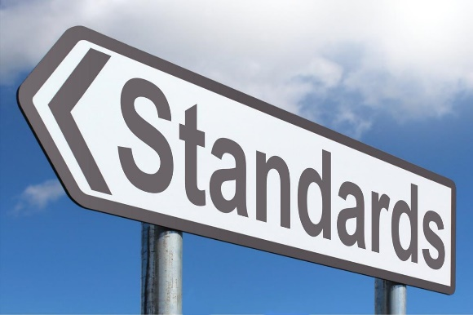
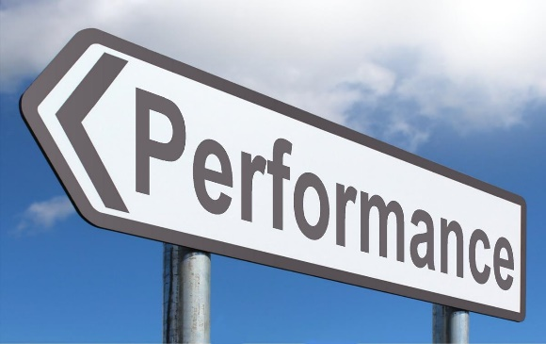
STANDARD OF PERFORMANCE
A statement which describes a satisfactory level of performance, referring to criteria that must be met time and time again
Attainable
Must be able to exceed
Meet management’s needs Not based on the “Average”
Current level of attainment
Who sets the pace
Cover all normal tasks
Must be written
Developed with the employee
Accepted by all involved (supervisor and employee)
Compatible with department standards
Kept up-to-date

Slide 35
STANDARD OF PERFORMANCE, cont’d.
QUANTITATIVE performance aspects
  Attendance
  Ability to meet deadlines
  Citations issued
  Number of applications processed
QUALITATIVE performance aspects
  Judgment
  Initiative
  Interpersonal Skills
  Development of Subordinates

Slide 36

10 Steps to Effective Appraisals
Use performance appraisal for performance feedback only
Define job standards based on core responsibilities
Evaluate & discuss performance all year
Don’t try to achieve truth in the appraisal discussion
Back up ratings with specific examples
Get feedback from others
Appraise results, not efforts & personal image
Split feedback for maximum motivation & minimum argument
Reduce subjectivity through forms & comment sheets
Provide ongoing training on writing appraisals

Slide 37
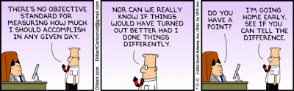
EIGHT WAYS TO RUIN A PERFORMANCE APPRAISAL
Halo Effect
Pitchfork Effect
Central Tendency
Recency Error
Length of Service Bias
Loose Rater
Tight Rater
Competitive Rater

Slide 38

WORDS TO AVOID USING WHEN WRITING PERFORMANCE EVALUATIONS
Always, usually, never, rarely, sometimes, excessive, innumerable, too little, too much, repeatedly, threaten, punish, scold, admonish, interest, attitude, personality, enthusiasm, maturity, mental condition, state of mind, demeanor, up-to-par, cut the mustard, make the grade, seems, apparently, obviously.

Slide 39
Also, Avoid Words or Phrases that
Compare employees to each other, rather than standards.
Create negative visual images.
Are not written at the appropriate educational level.
Are not consistent with County terminology.

Slide 40

Employee Appraisal Checklist
The following questions should help you prepare for your performance appraisal session. As you read and take notes on each question, think about the employee’s performance, progress, and future goals/plans.
What critical abilities does the employee’s job require? Do he/she possess them?
What does the employee like best about his/her job? Least?
What did the employee accomplish during this rating period?
What goals or standards did the employee fail to meet this rating period?
How can I help the employee do a better job?
Is the employee’s effectiveness hindered by circumstances or persons (including me) beyond his/her control?

Slide 41

Employee Appraisal Checklist, cont’d.
What changes can the employee make to improve my performance? When? How?
What does the employee want to be doing five years from now and how am is the employee planning to get there?
Does the employee need more experience or training in his/her present job?
Is the employee willing to accept more responsibility?
How are the employee’s relationships with others and how do they affect his/her performance?
What new goals or standards should be established for the employee’s next performance appraisal period? Do any current ones need to be deleted or modified?

Slide 42

Steps in Appraisal Interview Process
Preparation
  Takes the most time
  Give advanced notice to employee through PeopleSoft
Setting
  Reserve private room in advance
  Sit close to exit
  If possible, have reviewer or HR person in the room as well
Appraisal Interview
  Shouldn’t last longer than one hour
  Encourage employee to discuss how they feel about their review
  Discuss expectations for next appraisal period

Slide 43

Appraisal Interview
Focus on:
Performance not Personality
Insight, not Indictment/Blame
Development (future), not Discipline (past)
Encouragement (future), not Put-downs (past)
Discussion (with), not Presentation (to)
Action Plan (with), not Instructions (to)

Slide 44

How to Get Employee to Participate in Discussion of Performance
NO
Judgmental
  “How could you have done such a dumb thing?”
Authoritarian
  “This is what I expect you to do from now on.”
Superiority
  “We’ve all done it this way since I came to the County.”
Dogmatic
  “This is the best solution.”
Punishing
  “Everyone in your unit is upset with you for what you’ve done.”
A SPECIAL NO – Don’t fail an employee’s probation right before the 26th pay period!!! Consider monthly informal evaluations to get the person back on track!

Slide 45

How to Get Employee to Participate in Discussion of Performance, cont’d.
YES
Descriptive
  “Can you explain what happened?”
Supportive
  “What do you suggest we do to prevent this from occurring again?”
Equality
  “We’ve done it this way for years, but I’d like to hear your ideas on how we might do it better.”
Accepting
  “This appears to be the best solution to me. What other possibilities do you see?”
Encouraging
  “What do you think the effect is on your co-workers when you arrive late?”

Slide 46

QUESTIONS TO FACILITATE DISCUSSION
Open Questions
Open questions cannot be answered with “yes” or “no”.
They require an opinion or expression of ideas.
Reflective Questions
Repeat another statement in the form of a question.
Good listening skills are important.
Directive Questions
Are used to solicit information.
Usually used after the other person has finished speaking.
Used to sustain communication or obtain further ideas or information.

Slide 47

How to Develop An Action Plan
Once you have completed your planning review, you will need to develop an action plan for the appraisal. Keep the following guidelines in mind and check ✓ those you expect to use in your action plan.
________ 1. Don’t plan to cover too many areas in one discussion. Concentrate on those which deserve the most attention and are most critical to the job.
________ 2. Make sure there are specific, unbiased examples (documentation) that can be used to support your points but that also allow for dialogue.
________ 3. Develop positive approaches to correcting problems. Give the employee an opportunity to suggest solutions before any final decision are made.

Slide 48
How to Develop An Action Plan, Cont’d.
_______ 4. Be prepared to provide praise and positive reinforcement for items which deserve it.
________ 5. Identify any developmental activities that will improve the employee’s performance in the present assignment; and or provide preparation for future assignments and responsibilities.
________ 6. Note any projects, goals, and/or standards to be accomplished during the forthcoming appraisal period. Discuss them and reach agreement on them during the session. It is helpful to put these in writing.
________ 7. Plan to involve the employee in all aspects of the discussion. Remember, a one-sided discussion places you in the role of “Judge” not “Evaluator/Enabler”.

Slide 49

Wrap-up

